Slide 1
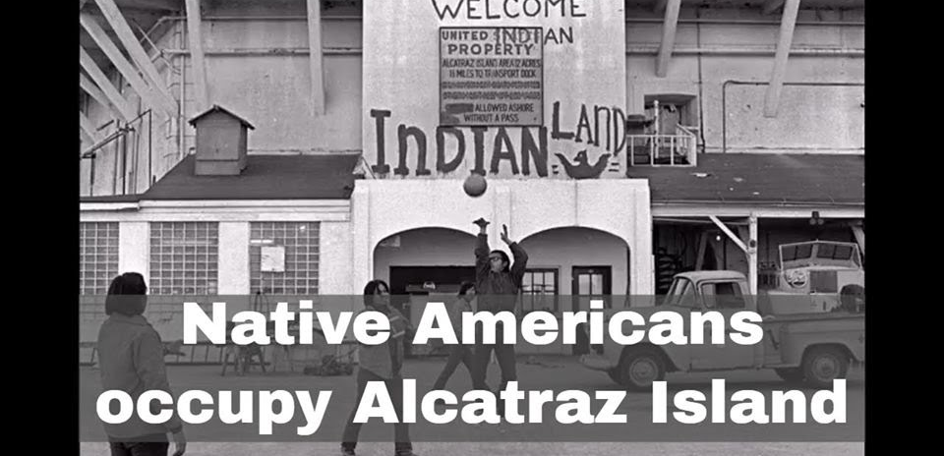
The Alcatraz Occupation:
A Stand of Self - Determination
Notes:
Photo Credit: TIME Magazine

Slide 2
Overview of the Week
Day 1 - The 1969 Occupation of Alcatraz
Day 2 - Self Determination and The “Red Power” Movement
Day 3 - Native Land Reform and the Dakota Access Pipeline
Day 4 - From Alcatraz to DAPL, Federal Policy Evolution
Day 5 - Outcomes, Big Picture, Putting It All Together

Slide 3
Grading
Grading
Grading Rubric: (120 total points)
Homework (40 pts) - 4 assignments at 10 pts each
Participation/In Class Discussion (10 pts) 2 pts per day
Group Activity (10 pts) - all 5 days
Class Presentations (60pts) 2 at 10 points
Classroom Final (10) Pts

Slide 4
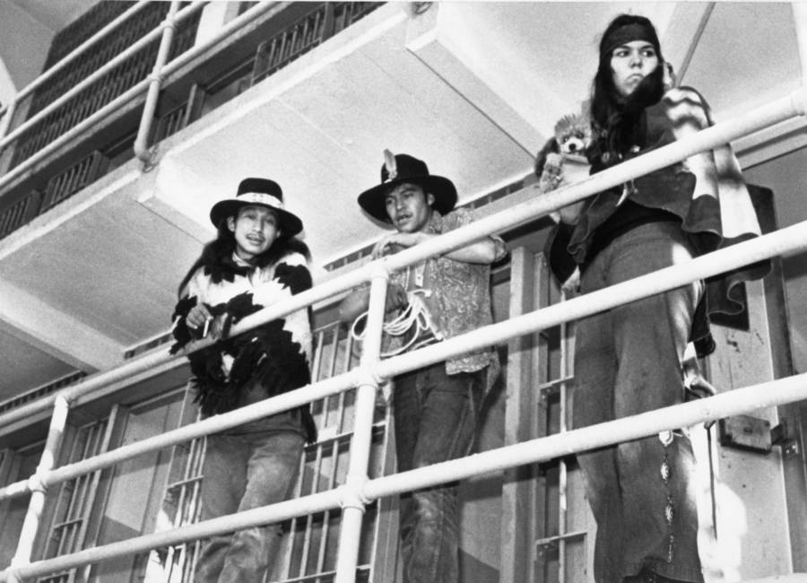
Day 1: The 1969 Occupation Of Alcatraz
What is the Occupation of Alcatraz?
Video: The Sunrise Ceremony
Video 2: Richard Oaks delivers the Alcatraz Proclamation
In Class reading/worksheet
HW: Read Historical Context of American Indian Problems
Notes:
Ask the Class: Have you ever heard of the Occupation of Alcatraz? If so, what do you know about it?
Facilitate class discussion
Students may respond by saying that they have heard about the occupation of Alcatraz. If students mention the word “Indian” or native american mention to the them that human kind consists of all races of people. Alcatraz may have been occupied by Native Americans, yet many people of all races and creed joined the movement. A movement is about a cause and this is what this lesson is about, causation, sacrilege, and human rights.
photo credit: Bettman/contributor/Getty Images

Slide 5
What was the 1969 Occupation of Alcatraz?
On Nov. 20, 1969, 70 Native Americans from various tribes made their way to a small dock in the San Francisco bay
The Goal: To reclaim the Alcatraz, a federal surplus land, for all indigenous peoples
These actions caught the local, state, and federal government by surprise. They took over Alcatraz without force and remained on the island for two years
After a fire to the lighthouse and various buildings erupted in 1971, the uprising was soon ended by the coast guard and law enforcement. Peacefully, the activists left as swiftly as they arrived
Why was this an important event in modern Native American History? We will discuss the facts behind the Occupation and explore the issues
Notes:
Provide summary of the 1969 Occupation by reading the slide
Also, in Nov. 1969, Richard Oakes, a Mohawk activist, declared to the San Francisco Chronicle, “If a one day occupation by white men on Indian land years ago established squatter’s rights, then the one day occupation of Alcatraz should establish Indian rights to the island.”
Eventually, just a few weeks later, 89 Native Americans from various tribes made it to the island, many of them members of the Red Power movement that sought civil rights for Native Americans starting in the 1960s. Very quickly, a message appeared on the island’s water tower, which read: “Peace and Freedom. Welcome. Home of the Free Indian Land,”
source: https://allthatsinteresting.com/occupation-of-alcatraz

Slide 6
What is Federal Surplus Property?
Eligible state and local government agencies and nonprofit organizations can obtain personal property that the federal government no longer needs through the Federal Surplus Personal Property Donation Program.
Surplus personal property includes all types of property except:
Land or other real property;
Certain naval vessels; and
Records of the federal government.
Alcatraz had been categorized as surplus land by the United States government, sitting unused since the prison there was closed in 1963
Source: https://www.gsa.gov/buying-selling/government-property-for-sale-or-disposal/personal-property-for-reuse-sale/for-state-agencies-and-public-orgs/how-to-acquire-surplus-federal-personal-property
Notes:
Provide more information about the background of the occupation and underlying controversy leading up to the occupation.
Tribal nations peoples from all over the US and abroad had come to settle San Francisco. Early in the 1950’s the United States under President Eisenhower had invoked native policies of assimilation and federal termination. Thinking they were helping america and the Indian, the termination policy took away tribal lands. The hope was that the indian would take to Urban society and education. Grants were created to help them to do as such. However, these programs waived the rights of urban natives to receive further assistance from the federal government. Now, not only were tribal peoples moved from their homelands, they were left to fend for themselves. For these reasons tribal members returned home or simply would not leave their prior reservation or homelands. The policy today is looked at as failing legislation. The result were uprisings like this Occupation of Alcatraz and many others.

Slide 7
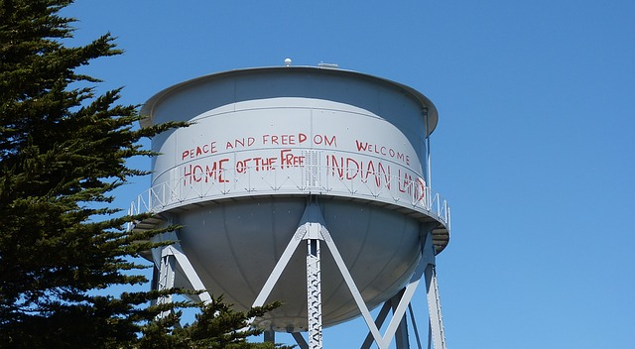
Video: the Sunrise Ceremony
Notes:
This is a picture of some of the graffiti that decorated the island during the occupation.
Credit – Alexandre Nicolau

Slide 8
Day 1: Sunrise Ceremony questions
What day of the year do Native peoples gather on Alcatraz for the Sunrise ceremony?
In the video, a young man states that Alcatraz represents a stand for “self – determination”
What does self – determination mean?
Notes:
Answers:
Indigenous Peoples Day
In this context, Native American self-determination refers to the social movements, legislation, and beliefs by which the Native American tribes in the United States exercise self-governance and decision making on issues that affect their own people - Wikipedia

Slide 9
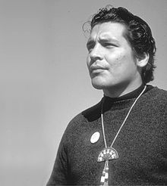
Day 1: Richard Oaks
Notes:
Photo: Ilka Hartmann
Richard Oakes (May 22, 1942 – September 20, 1972)^{[1]} was a Mohawk Native American activist. He spurred Native American studies in university curricula and is credited for helping to change US federal government Termination policies of Native American peoples and culture. Oakes led a 19-month occupation of Alcatraz Island with LaNada Means, approximately 50 California State University students, and 37 others.^{[2]} The Occupation of Alcatraz is credited for opening a rediscovered unity among all Native American tribes.^{[3] - wikipedia}

Slide 10
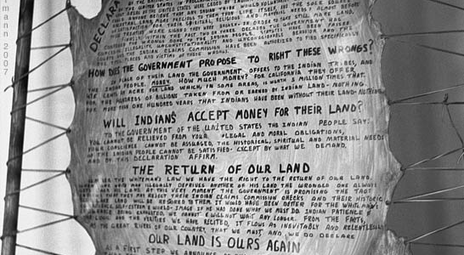
Notes:
Photo by Ilka Hartmann.

Slide 11
Day 1: Proclamation
The Proclamation
Proclamation to the Great White Father and All His People
We, the Native Americans, reclaim the land known as Alcatraz Island in the name of all American Indians by right of discovery
We wish to be fair and honorable in our dealings with the Caucasian inhabitants of this land, and hereby offer the following treaty:
Notes:
Ask the class: Read along with Richard Oakes while he delivers the proclamation.
Facilitate class discussion: What does the proclamation mean?

Slide 12
We will purchase said Alcatraz Island for twenty-four dollars ($24) in glass beads and red cloth, a precedent set by the white man's purchase of a similar island about 300 years ago
We know that $24 in trade goods for these 16 acres is more than was paid when Manhattan Island was sold, but we know that land values have risen over the years
Our offer of $1.24 per acre is greater than the 47¢ per acre that the white men are now paying the California Indians for their land

Slide 13
We will give to the inhabitants of this island a portion of that land for their own, to be held in trust by the American Indian Affairs [sic] and by the bureau of Caucasian Affairs to hold in perpetuity—for as long as the sun shall rise and the rivers go down to the sea
We will further guide the inhabitants in the proper way of living

Slide 14
We will offer them our religion, our education, our life-ways, in order to help them achieve our level of civilization and thus raise them and all their white brothers up from their savage and unhappy state
We offer this treaty in good faith and wish to be fair and honorable in our dealings with all white men

Slide 15
We feel that this so-called Alcatraz Island is more than suitable for an Indian Reservation, as determined by the white man's own standards. By this we mean that this place resembles most Indian reservations in that:
1. It is isolated from modern facilities, and without adequate means of transportation
2. It has no fresh running water
3. It has inadequate sanitation facilities

Slide 16
4. There are no oil or mineral rights
5. There is no industry and so unemployment is very great
6. There are no health care facilities
7. The soil is rocky and non-productive; and the land does not support game

Slide 17
8. There are no educational facilities
9. The population has always exceeded the land base
10. The population has always been held as prisoners and kept dependent upon others

Slide 18
Further, it would be fitting and symbolic that ships from all over the world, entering the Golden Gate, would first see Indian land, and thus be reminded of the true history of this nation
This tiny island would be a symbol of the great lands once ruled by free and noble Indians
Notes:
At the Conclusion of the Video:
Provide Students Homework
See Handout 1: read instructions to students
Homework is due the beginning of Class 2

Slide 19
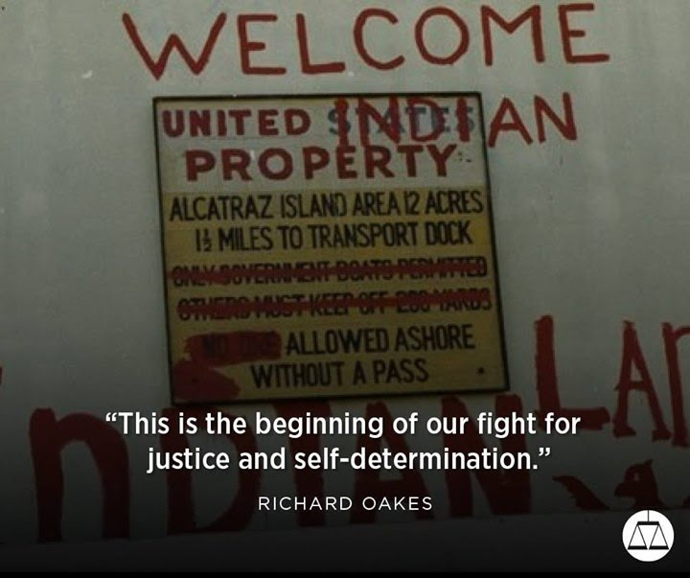
DAY 2: Why did the Occupation at Alcatraz occur?
Notes:
Discussion: Review Class I Highlights
Note the photo above and the words, Justice and self determination.
Source: https://www.pinterest.com/tmgarcia1/alcatraz/
Ask students:
What is Justice?
What is Self Determination?
Do not answer, rather, lead them into the next activity.
Brainstorm Activity:
After watching “Sunrise Ceremony” and Richard Oaks “Proclamation” what are students reactions to what they saw? What questions do students have about the occupation?
Create a written list of questions students ask. Have students volunteer to write their questions out on the blackboard or type out in electronic in class notes.
Instruct students that you will be displaying images of the Alcatraz Occupation. The goal is for the student to watch the slides in order to create more of a sense of what the occupation stood for and how influential it was for Native American/ Indigenous peoples.

Slide 20
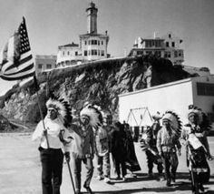
The Many Faces of The Occupation
Notes:
Photo credit: https://www.pinterest.com/pin/520165825691840815/

Slide 21
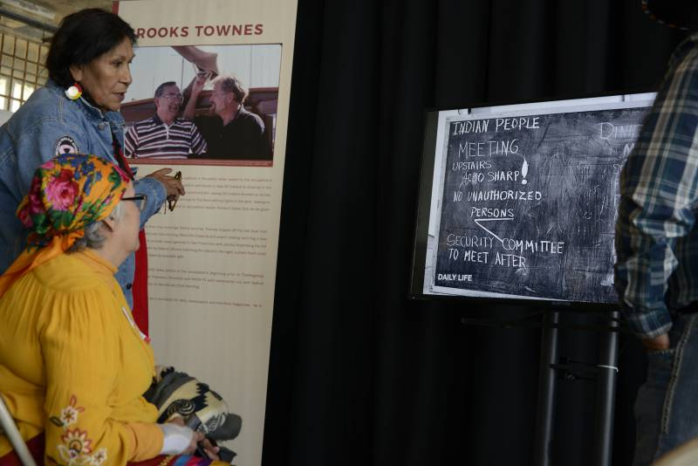
Notes:
Elaine Duncan (left) and Geneva Seaboy (seated) watch a slideshow of photos taken by Brooks Townes, a sailor who brought the first organizers to the island and also was one of the first to photograph the occupation. (Stephanie Lister/KQED

Slide 22
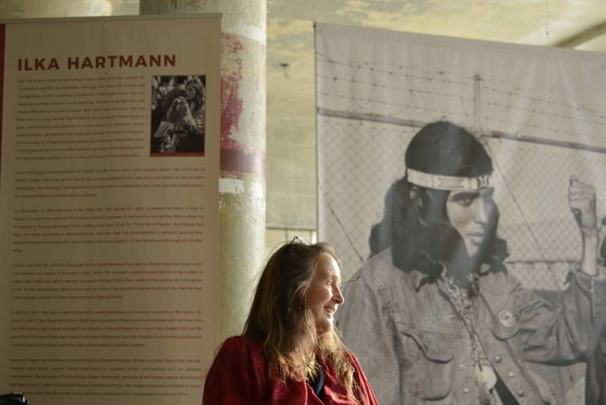
Notes:
Ilka Hartmann sitting in front of one of her photographs at Alcatraz on Nov. 23, 2019. (Stephanie Lister/KQED)
Photographer Ilka Hartmann was born in Hamburg, Germany during World War II and came to the Bay Area as a young woman in 1964.
Initially a student of Theology, a class in Photography (in which she was introduced to the work of Ansel Adams, Dorothea Lange and most notably, W. Eugene Smith) re-mapped Ilka's dedicated and life-long path as a photographer.
Soon she began to photograph most of the great social movements of the second part of the twentieth century in the United States, from the Anti-War Movement, to the Black Panther Party, the Indian Occupation of Alcatraz Island, the United Farm Workers, the Anti-Nuclear Movement and Gay, Lesbian and Transgender Marches in San Francisco and the surrounding Bay Area.
Ilka was more than a passive observer of activists and their causes, rather she was warmly embraced by and invited into these communities, thus giving her rare access to a side of their lives and activities not represented in the general media.
In 1969 she began to focus her camera lens on the people and events of her small alternative community on the Northern California Coast; documenting its history and the people whom she knows well and has seen grow up, mature and age. Some of the most notable early photos from this work illustrated the 1976 book The Town That Fought to Save Itself.
In 1970, moved by the Indian Occupation of Alcatraz Island, she began to chronicle Native Americans' lives in the cities of the Bay Area and on reservations around the country. She cares deeply for these communities and they have become the main focus of her work.
source: http://ilkahartmann.com/about/

Slide 23
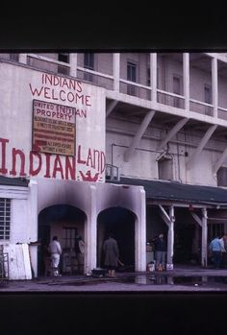
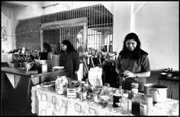
Notes:
Photo credit: https://www.pinterest.com/pin/520165825691841121/
Remind students:
Alcatraz was an unoccupied precint. The land itself was crule, rock and concrete. The occupants slept in the cells and on beds fashioned by what limited resources they had. Above is a picture of some of the signs that were fashioned on the island along with a picture of their “soup” kitchen.

Slide 24
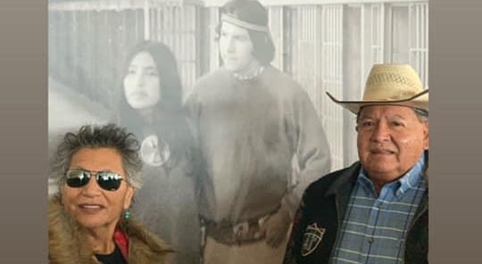
Notes:
Picture here are two of the 18 UNA Student Leaders who were Dispatched by Lehman L. Brightman to Occupy Alcatraz.
Photo credit: Tishmall Turner

Slide 25
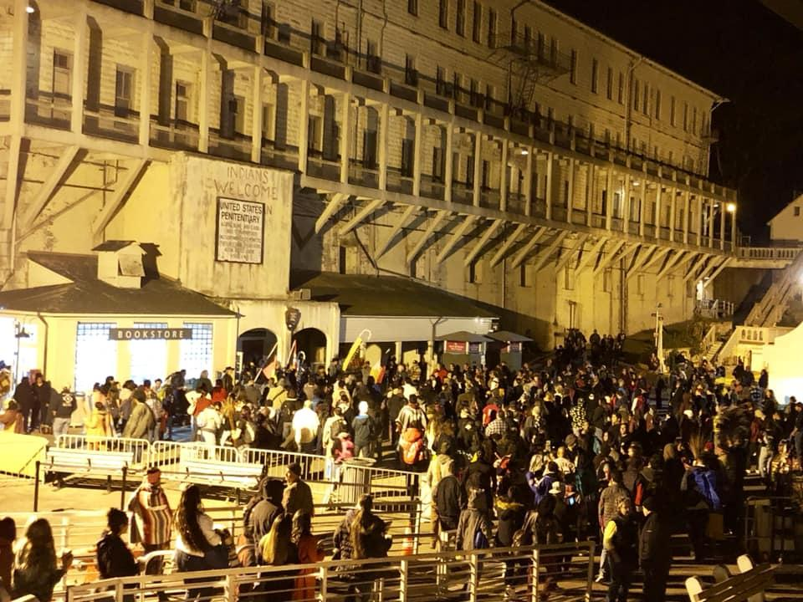
Notes:
The Alcatraz occupation from the lens of an observer (50 year commemoration –
Photo Liz hoover
This photo is from the Alcatraz Occupation 50 year commemoration. Note how many people are in this photo. The photo represents only a small amount of the hundreds of people whom went to the island to pay tribute to the Occupation of Alcatraz and what it stood for for Indigenous peoples from around the United States and abroad.

Slide 26
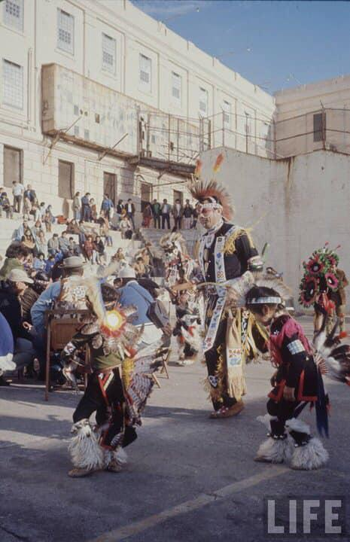
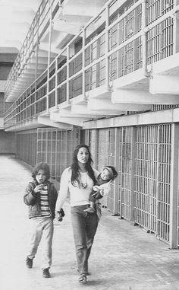
Notes:
Photo:
This picture was provided by Adam Nordwall, from the Ute tribe. His grandfather (Adam Fortunate Eagle) was an original protestor for the Occupation of Alcatraz. Cover of LIFE Magazine.
“On the right, a mother and her children during the Occupation of Alcatraz”. Eldy with Peter and Veruschka Bratt, MainCell Block during the Indian Occupation, 1969. It's amazing to me how Eldy, my mom, Beryl, Justine, Lanada, Eleanor, Lou Trudell and others were brave enough to bring their children to the occupation
Source: LIFE/Adam Nordwall
https://www.pinterest.com/pin/520165825691841027/

Slide 27
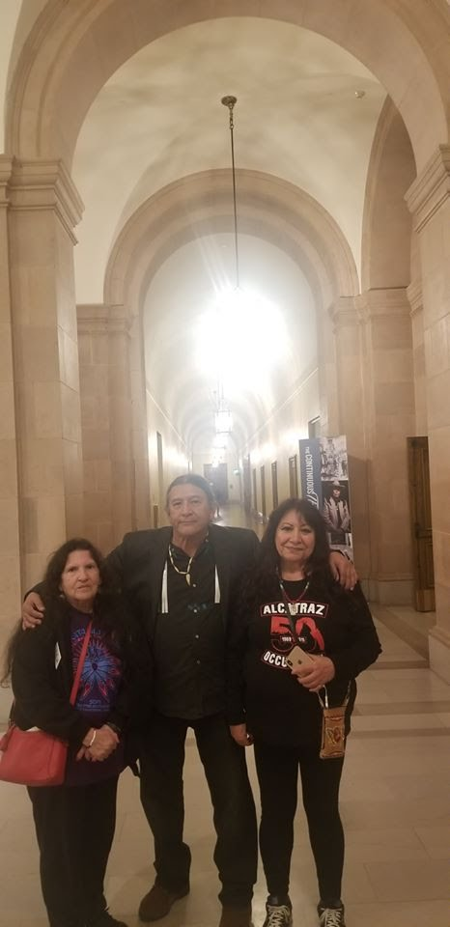
Notes:
Photo credit: Chuck Davis, Sr. Original Occupant
With Lanada War Jack...Occupation of Alcatraz 1969 "Co-Leader" and Sister/cousin "Wicapi Luta Win" (Red Star Woman) at Resistance Gem/Music Icon/ First Native American Academy Award Winner, Buffy St. Marie's Performance at The Hearbst Theater, San Francisco, Ca...

Slide 28
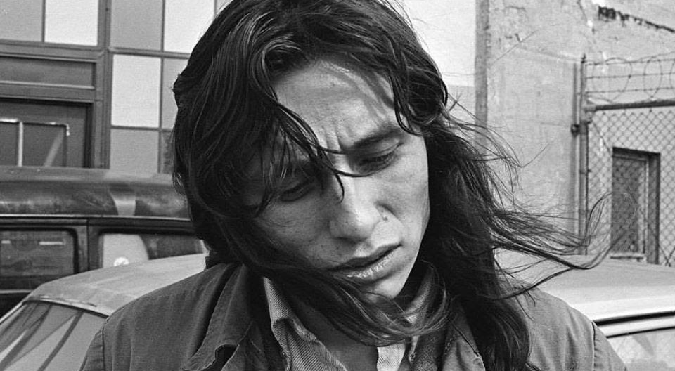
Notes:
Photo:
March 10, 1971: Activist John Trudell, seen on Alcatraz Island, was one of the leaders of the United Indians of All Tribes' takeover of the former federal prison in San Francisco Bay. Trudell served as the group's spokesman until the occupation ended a few months after this photo was taken.
Source: 📷: Clem Albers; San Francisco Chronicle

Slide 29
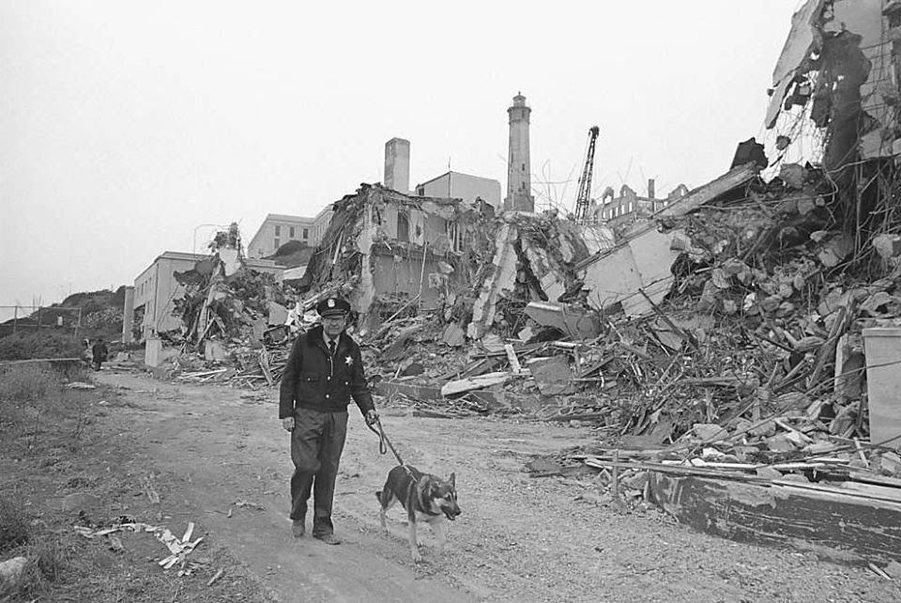
Notes:
Summary
In 1971, after the Indians of All Tribes occupiers were removed by the U.S. Marshals Service, the General Services Administration was back in control of the island as surplus federal property. New security fencing was installed all over the island and security patrols were increased. The plan was to destroy all habitable buildings to prevent another occupation. A wrecking crane (seen behind the rubble) and other heavy equipment was brought to the island. The two buildings that were destroyed seen in this photo were apartments built by the Bureau of Prisons for correctional staff and their families. The other building to the left, still standing, were apartments for single officers. In the end only the buildings on this part of the island were destroyed. In 1972 the Golden Gate National Recreation Area was created including Alcatraz Island.- credit Alcatraz Island

Slide 30
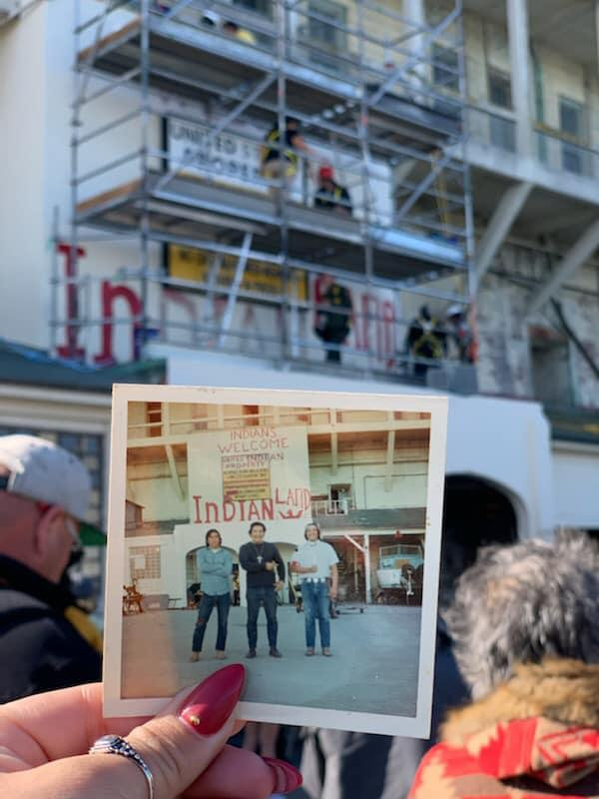
Notes:
Photo
A daughter looks at her parents picture 50 years to the day they were at the Occupation of Alcatraz
Credit: Tishmall Turner

Slide 31
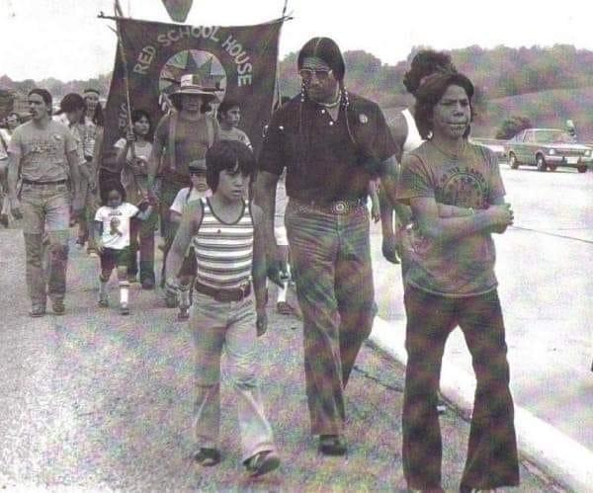
Notes:
Families at the Alcatraz Occupation
Photo credit: Ilka Hartman

Slide 32
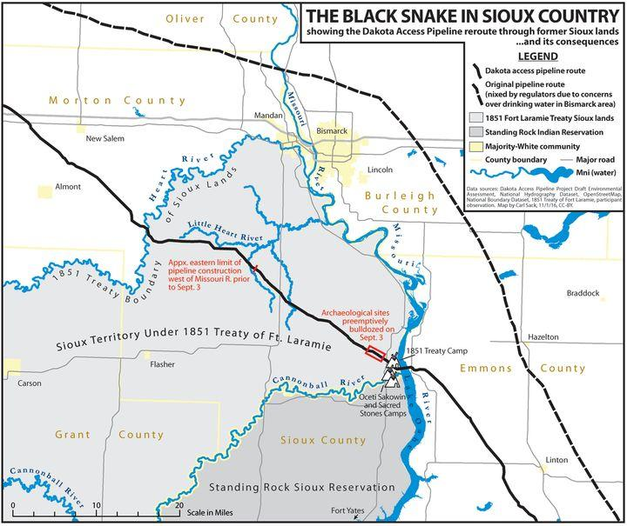
Notes:
Summary of Day 2: Review the questions developed by students prior to the completion of this lesson. Call upon those same students to provide an updated reaction for their peers. Observe and note any changes in opinions or increased development of students understanding.
Assign Homework
Read Journal Article: The Historical Context of American Indian Problems
Write Essay: (500 words) summarize the historical context article in your own words.
Teacher Instructions:
Provide a preview of Day 3 lesson and start with this slide. This is a slide of a significant portion of the Standing Rock Indian Reservation. This reservation is located in North Dakota and runs down to South Dakota. This tribe was recently in the headlines because of an issue that would effec their water and land rights. What was this issue?
Huffington post, Dec 02, 2016 carl sack “a #nodapl map

Slide 33
Homework
Read Journal Article: The Historical Context of American Indian Problems
Write Essay: (500 words) summarize the historical context article in your own words.
Hand in Homework at beginning of Class 3

Slide 34

Day 3
Native Land Reform and The Dakota Access Pipeline
Notes:
For over 400 years Native American homelands and its peoples have been under constant threat and have been nearly pushed to the edge of extinction. In the early years, 1492 through 1620, stories of famous explorers have been taught to Americans in an effort to have them believe this country was discovered. It was not. The United States and the Americas have been fully occupied by its indigenous ancestors and peoples.
Provided in the Hyperlink below are a list and explanations of significant dates and effects of the various policies and reforms prior to and up to 1968 that have changed the history of the Native Peoples of the United States
https://www.history.com/topics/native-american-history/native-american-timeline

Slide 35
Common Truth/Anti Truth of NoDAPL
It was a peaceful protest. It was a non - peaceful protest.
The police attacked protesters. The protestors attacked police
People who supported the police were pro-pipeline/against pipeline
What I saw on the live feed video was true/false.
What I read or heard on social media was true; there was no PR spin/there was a PR spin
This was pure racism, from pipeline route to local reactions/this was not pure racism from pipeline route to local reactions
This protest was solely about saving the environment and protecting water/ this protest was not abou saving the environment and protecting water
This was an environmentally friendly protest/ this was not an environementally friendly protest
By blocking that bridge, the police cut protesters off from everything/ the police did not cut off everything
Notes:
Teacher Instructions:
Watch Video 4: Part 2 (16:20) Before students react at the conclusion of Video 4, provide handout Standing Rock Primer. Have students read pages 8-11.
Discussion:
Explain what the Dakota access pipeline was.
Read the Common Truth Anti - Truth of NoDAPL slide and discuss with students.
From
source:
http://loneprairie.net/nodaplprotest-original.html

Slide 36
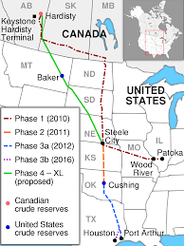
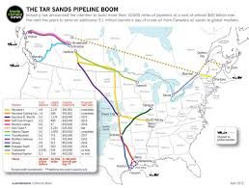
Notes:
Photo Credit: Donald Hay
Recall that many of these tribal members were of different tribes? Question for the class: how many tribal nations do you know? How many tribes are federally recognized today? Do each of these tribes have their own laws? What is the idea of sovereignty?
830,000 gallons of tar sand per day are to be transported along the DAPL route (in red) this is a threat to over 2million people who are supplied water through the aquafours that are in both North and South Dakota. There are many tribes whose reservations and lands are touched, bordered, or harbored by many pipelines. This encroachment was sometimes welcomed, in many cases took place without regards for tribes or without consultation.
https://daplpipelinefacts.com/ lists out the facts of the Dakota Access pipeline. Teachers click on this link for more information about the Pipeline.

Slide 37
What are the Truths/Anti Truths?
Celebrities And Scammers Used The NoDAPL Protest For Their Own Ends
Rich outsiders who come in and fracture a community.
Mark Ruffalo wants an armed felon set free.
The Young Turks Network sent Jordan Chariton to make fun of North Dakota.
Wesley Clark Jr. and Michael Woods Jr. seem to have taken advantage of veterans for personal gain.
Black Lives Matter leaders used an oil protest to raise money for two new pick-up trucks.
Millions of dollars in donations were raised: some can't be tracked.
Celebrities who support trespassing, anti-police action and rhetoric, and terrorizing action against private farmers.
Notes:
It is important to note that not everything you read or see is the truth. The Dakota Pipeline possessed something that the Alcatraz movement did not. Large scale media attention. This attention caught the eye of people from around the world in lighting fast speed compared to that of Alcatraz. The list above is from an anti NOdapl position but shows many questionable points about the explotation of the peaceful protest.
source: http://loneprairie.net/nodaplprotest-original.html

Slide 38
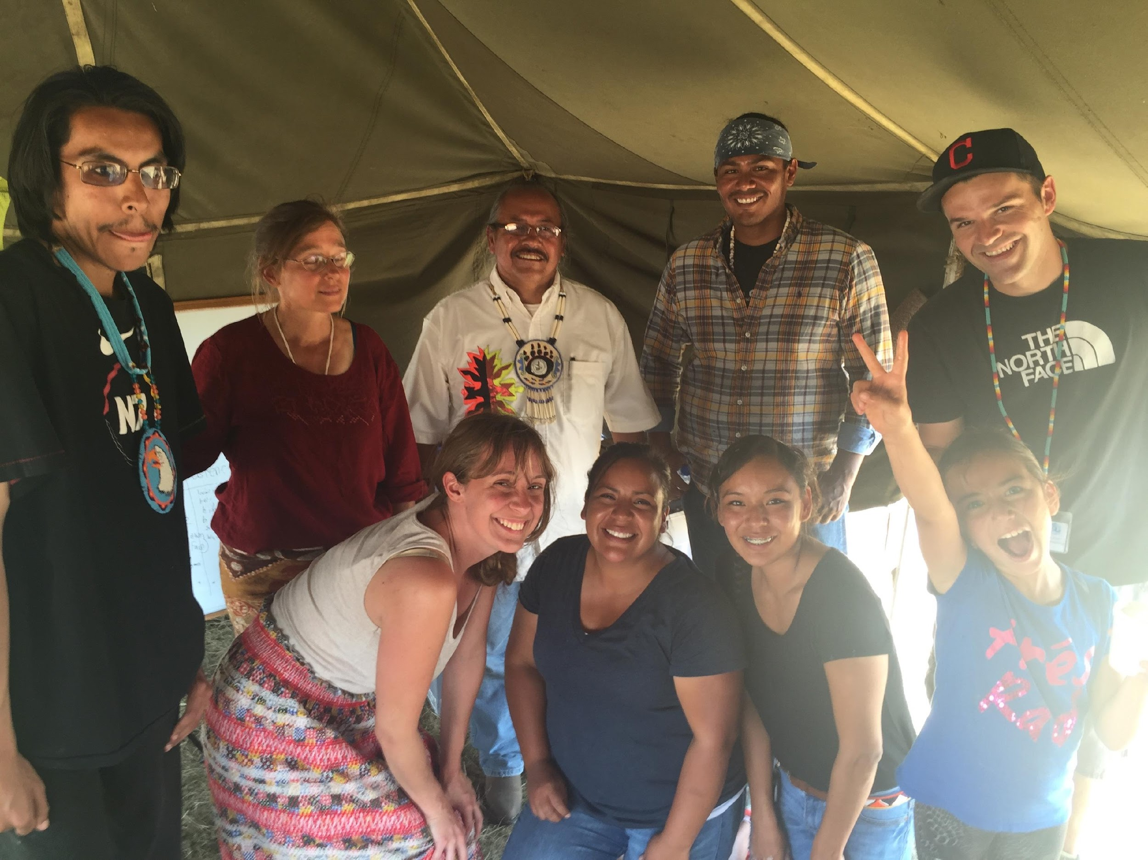
Camp School
Notes:
Photo
Teachers of the NODAPL camp school. All transit was cut off to local schools to the North of the Reservation. Many protestors came with their children from outside of the area. As a result (and as a way to get the protestors out, many of the protestors at the camp were faced with charges if there children could not attend school. Volunteer teachers came together and unified to organize a k-12 camp school.
In the photo are various teachers along with members of the Ho - chunk Nation of Wisconsin.
Photo credit: David Greendeer

Slide 39
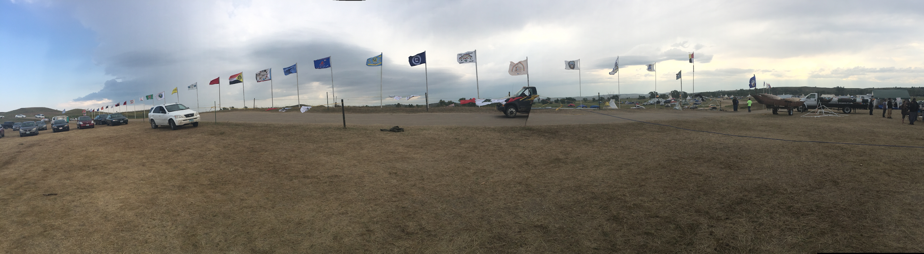
Entry into the NODAPL Camps
Notes:
Flags of tribal nations supporting the Standing Rock Sioux and NoDAPL are flown at the entrance of the No DAPL camps
Photo Credit: David Greendeer

Slide 40
Pipeline Debate
I
“We don’t want a pipeline to run through the state capital, we want it to run through Indian land.”
Notes:
Instructions:
Provide students with the following statement:
“We don’t want a pipeline to run through the state capital, we want it to run through Indian land.”
Break students into their original two groups. Have each group select a spokesperson and work together to develop an argument to present to the class.
Group 1: identify the arguments that support having a pipeline run through the Standing Rock Reservation.
Group 2: identify the arguments against having a pipeline run through or around the Standing Rock reservation.
Inform students that they can use the following resources to research their positions:
Standing Rock Primer
What we know about the Dakota access protests
What to know about the Dakota Access Pipeline Protests
Standing Rock Sioux and the Dakota Access Pipeline
Both groups will have 25 minutes total to prepare their arguments
Provide groups a 5 minute warning that time will be ending and that they will need to have their spokesperson selected who will present their groups argument
Group 1 will have 5 minutes to present their argument
Group 2 will have 5 minutes to present their argument

Slide 41
Homework
Review Resources and be prepare for class presentations by answering the following questions:
Resources:
Standing Rock Primer
What we know about the Dakota access protests
What to know about the Dakota Access Pipeline Protests
Standing Rock Sioux and the Dakota Access Pipeline
Group 1: What arguments support having a pipeline run through the Standing Rock Reservation?
Group 2: What are the arguments against having a pipeline run through or around the Standing Rock reservation?

Slide 42
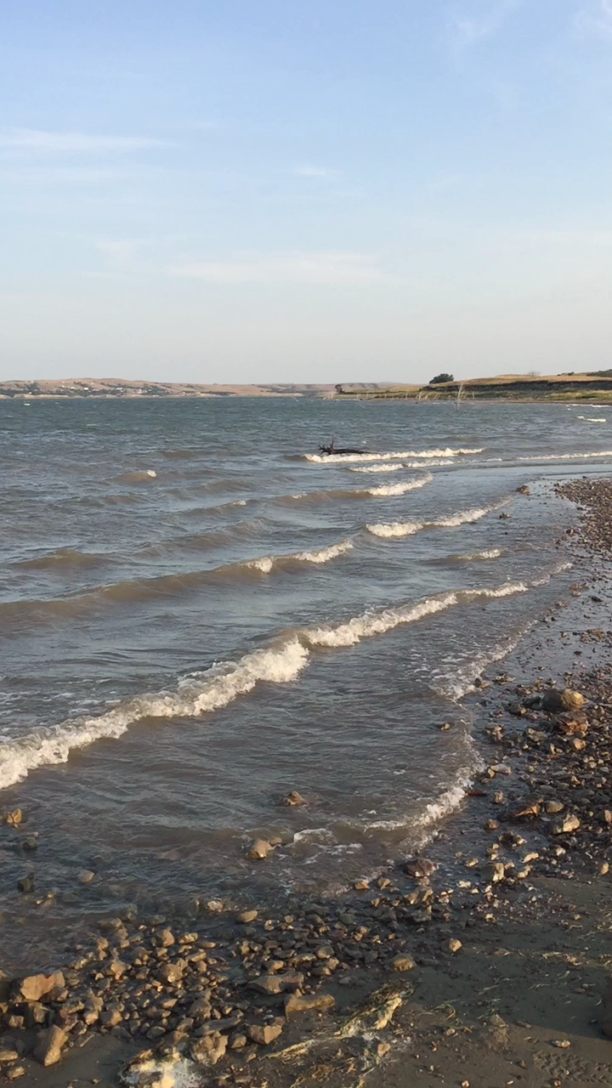
Day 4
What is Environmental Racism
Environmental racism is:
Environmental racism refers to intentional or unintentional targeting of minority communities or the exclusion of minority groups from public and private boards, commissions, and regulatory bodies. It is the racial discrimination in the enactment or enforcement of any policy, practice, or regulation that negatively affects the environment of low-income and/or racially homogeneous communities at a disparate rate than affluent communities.
source:
https://definitions.uslegal.com/e/environmental-racism/
Presentation: Where else have you seen environmentall racism occur in the United States?
Notes:
The site where the Dakota Access Pipeline would cross the only fresh water source for the Dakota People. Pipelines are notorious for corrosion and leakage. The Dakota people believe that all of Nature is sacred, but even more so they believe that we live on this earth because the water takes care of us. If it is destroyed, then all life around it dies.
Ask the class: Is one life, whether human or nature more important than the other?
Photo credit: David Greendeer

Slide 43
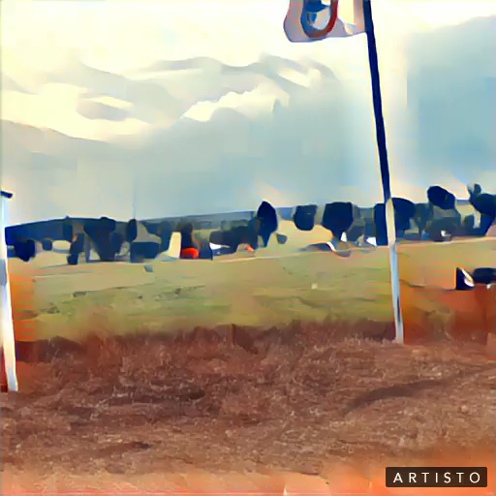
How are Alcatraz and DAPL related?
Notes:
Outcomes of Alcatraz:
July 8th, 1972 Richard Nixon ends federal termination 1970
helped produced the revivial of languages
helped indian people to find their heritage
helped indian people both individually and collectivley obtain a reconnection with their spirit.
Once again she found herself out at the dakota access pipeline area. Thousands of people went to visit the dLaNada Warjack
See speaker notes:
Read aloud Raz’s final comments from the video.
RAZ:
But one of the good—One of the beautiful things that happened out of Alcatraz was the reclaiming of lands all over the country. And we had—It was one of the first movements that got national coverage, right. So we had media coverage. We had coverage—mainstream media coverage. And Native communities, there had been other struggles and other things happening, but they never got in the mainstream news. But it was a transition period where people started to look at Natives in a different way, and they started this like, “oh yeah.” You know, kind of the hippie movement, and the beatniks, and all that kind of—They started to think about Native Peoples as like, “Oh, those are human beings, those human beings like us.” And they started giving them the media coverage they deserve, and Alcatraz was one of those first—those transition moments. So a lot of people, they heard about Alcatraz, and they—They came from all over the country, came to Alcatraz and became part of it.
But I want to just close by saying Alcatraz was a turning point for the tribes—for our tribes throughout the nation. And all these land spaces, let’s go utilize them. We have all these land spaces now that we’ve reclaimed, and that we work to preserve. Let’s go utilize them. Let’s come together as a community and put these things together.
The comments echo what history and historians have recorded about the outcome of Alcatraz. Standing Rock was no different. Although a relatively newer civil rights initiative, the future is yet unclear as to the lasting effects. Regardless, in February of 2020, on the historic day of landing of the Mayflower, President Trump relinquished the Mashpee Wampanoag lands that had been taken into federal trust in 2008. A new dark era of trust responsibility has arisen.
Photo credit: David Greendeer

Slide 44
Day 5: Classroom Final
Split the room in two groups
Group 1: Dakota Access
The year is summer 2016 and a time-machine has transported DAPL protestors from the Standing Rock protest to the Alcatraz Occupation.
Group1: Knowing the outcome of the Occupation, develop a plan to prepare for the occupation.
Include the following in your plans:
How you will change the outcomes (knowing what outcomes have occured through readings, video and discussion) of the Alcatraz occupation?
Group 2: Alcatraz
The year is December 1969 and a time-machine has transported Alcatraz Occupation protestors to Standing Rock.
Describe how you will assist the Standing Rock Occupation.
You will have 25 minutes to develop your plan.
Notes:
Teacher Instructions:
Follow the slide. Move around the room listening and watching for indications that groups may be stumped as to how to coordinate.

Slide 45
Summary - Recent Actions of the Department of the Interior
Mashpee Wampanoag Tribe of Massachusetts
ttps://time.com/5812813/mashpee-wampanoag-revoking-reservation-status/
400 years ago this tribe greeted the Pilgrims, the mistreatment that has happened to these people since then is continued today. These people continue to suffer as their homelands that were recently given to them under the Obama administration is now being taken away by the Trump Administration a few years later.
Notes:
Teaching Instructions:
Summarize the week and leave students with this slide and click the link
Last question to leave students pondering:
Do Native Americans Tribes have equal human rights as us all? They are and will always be sovereign Nations, will America every treat them fairly?

