Slide 1
Cultural Appropriation
Notes:
Review the definition of cultural appropriation:
The unauthorized taking of another culture's dance, dress, music, language, folklore, cuisine, traditional medicine, religious symbols, etc. especially by those who represent a group in a more powerful political position.
Here are two examples of cultural appropriation that Jessica Metcalfe discusses in the video, the Navajo line at Urban Outfitters and Paul Frank Industries “racist” pow wow.
They both fit the criteria presented in the definition of cultural appropriation.
Unauthorized taking: These companies took Native American representational symbols, designs and objects without the permission of the tribes involved. In the image to the left, urban outfitters did not ask permission from the Navajo Nation to create the product line they called, “Navajo.
The Paul Frank party did not ask permission of Plains Indian or any other tribes to create the mock feather headdresses and tomohawks.
Presenting things out of context: The second example takes something that is very sacred to Native Americans, the feather headdress, and trivializes it by making it into a party prop.
Party goers were given tomahawks, which furthers negative stereotypes of Native Americans as dangerous killers.
By a group in a more powerful political position: These companies represent “mainstream” fashion lines that are in a position to influence the broader American public.
By selling products and hosting parties that take Native American designs and images out of context, these trusted companies are basically saying that it is okay to disrespect Native American beliefs. In the first case, Navajo beliefs about modesty and alcohol (you shouldn’t show others your underwear or drink alcohol), and in the second case, that sacred Plains Indian headdresses can be worn by anybody at any time, when in reality those tribes have rules about who can wear them and when. It is a great honor to be able to wear a headdress, and not just something that can be put on any time for any reason, and especially not a party.
At this point, your students might be thinking? “What’s wrong with borrowing from other cultures?” We all borrow from other cultures. The next slide addresses this question.

Slide 2
Overview of the Week
What is cultural appropriation?
  Day 1: “What is cultural appropriation?” Video and discussion
  Assignment: Come up with your own examples of cultural appropriation
Why cultural appropriation is harmful
  Day 2: “How to tell the difference between cultural appropriation and cultural appreciation” Lecture and discussion
How to address cultural appropriation
  Day 3: “Cultural Appropriation and the Law” Lecture and individual activity
  Day 4: Group Project time
Applying your knowledge
  Day 5 – In class cultural appropriation mock trial
  Take home exam
Notes:
DAY 1 INSTRUCTION STARTS HERE
Review the unit structure outlined in the slide

Slide 3
What is cultural appropriation?
The unauthorized taking of another culture's dance, dress, music, language, folklore, cuisine, traditional medicine, religious symbols, etc. especially by those who represent a group in a more powerful political position.
Notes:
DAY 2 INSTRUCTION STARTS HERE

Slide 4
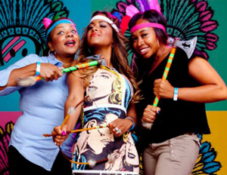
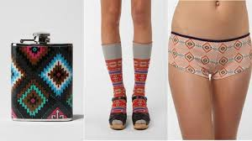
Examples of cultural appropriation:
Criteria:
The taking of these representations was not authorized
Presenting them out of context
By a group in a more powerful political position
Notes:
Review the definition of cultural appropriation:
The unauthorized taking of another culture's dance, dress, music, language, folklore, cuisine, traditional medicine, religious symbols, etc. especially by those who represent a group in a more powerful political position.
Here are two examples of cultural appropriation that Jessica Metcalfe discusses in the video, the Navajo line at Urban Outfitters and Paul Frank Industries “racist” pow wow.
They both fit the criteria presented in the definition of cultural appropriation.
Unauthorized taking: These companies took Native American representational symbols, designs and objects without the permission of the tribes involved. In the image to the left, urban outfitters did not ask permission from the Navajo Nation to create the product line they called, “Navajo.
The Paul Frank party did not ask permission of Plains Indian or any other tribes to create the mock feather headdresses and tomahawks.
Presenting things out of context: The second example takes something that is very sacred to Native Americans, the feather headdress, and trivializes it by making it into a party prop.
Party goers were given tomahawks, which furthers negative stereotypes of Native Americans as dangerous killers.
By a group in a more powerful political position: These companies represent “mainstream” fashion lines that are in a position to influence the broader American public.
By selling products and hosting parties that take Native American designs and images out of context, these trusted companies are basically saying that it is okay to disrespect Native American beliefs. In the first case, Navajo beliefs about modesty and alcohol (you shouldn’t show others your underwear or drink alcohol), and in the second case, that sacred Plains Indian headdresses can be worn by anybody at any time, when in reality those tribes have rules about who can wear them and when. It is a great honor to be able to wear a headdress, and not just something that can be put on any time for any reason, and especially not a party.
At this point, your students might be thinking? “What’s wrong with borrowing from other cultures?” We all borrow from other cultures. The next slide addresses this question.

Slide 5
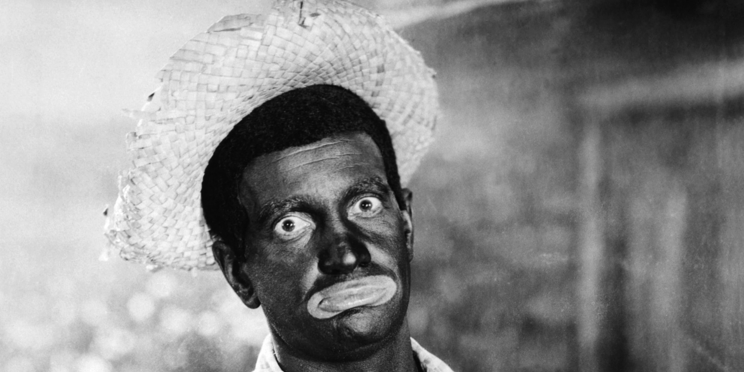
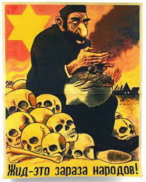
What do these images have in common with the examples of cultural appropriation you just saw?
Notes:
Less than 100 years ago, these kinds of images were commonplace.
American media often depicted African Americans in what is referred to as, “blackface.”
Here you can see an image of a white actor dressed up in Blackface.
“Blackface” exaggerated stereotyped “African” features, by portraying African Americans as slow, simple country folk which you can see by the expression on this actor’s face and the fact that he is wearing a straw hat.
Nazi Germany made and promoted similar propaganda images of Jews. As you can see here, negative stereotypical attributes of a “Jewish/Semitic” “look” are played up. What does this image say about Jewish people?
Ask the class: What kinds of negative stereotypes does the image to the right promote?
Ask the class: How do you think people would react to blackface today? What about depicting Jews this way?
Ask the class: What do these images have in common with the examples of cultural appropriation you just saw from Urban Outfitters and Paul Frank Industries?
Answer: All of them dehumanize people through false and negative stereotyping

Slide 6
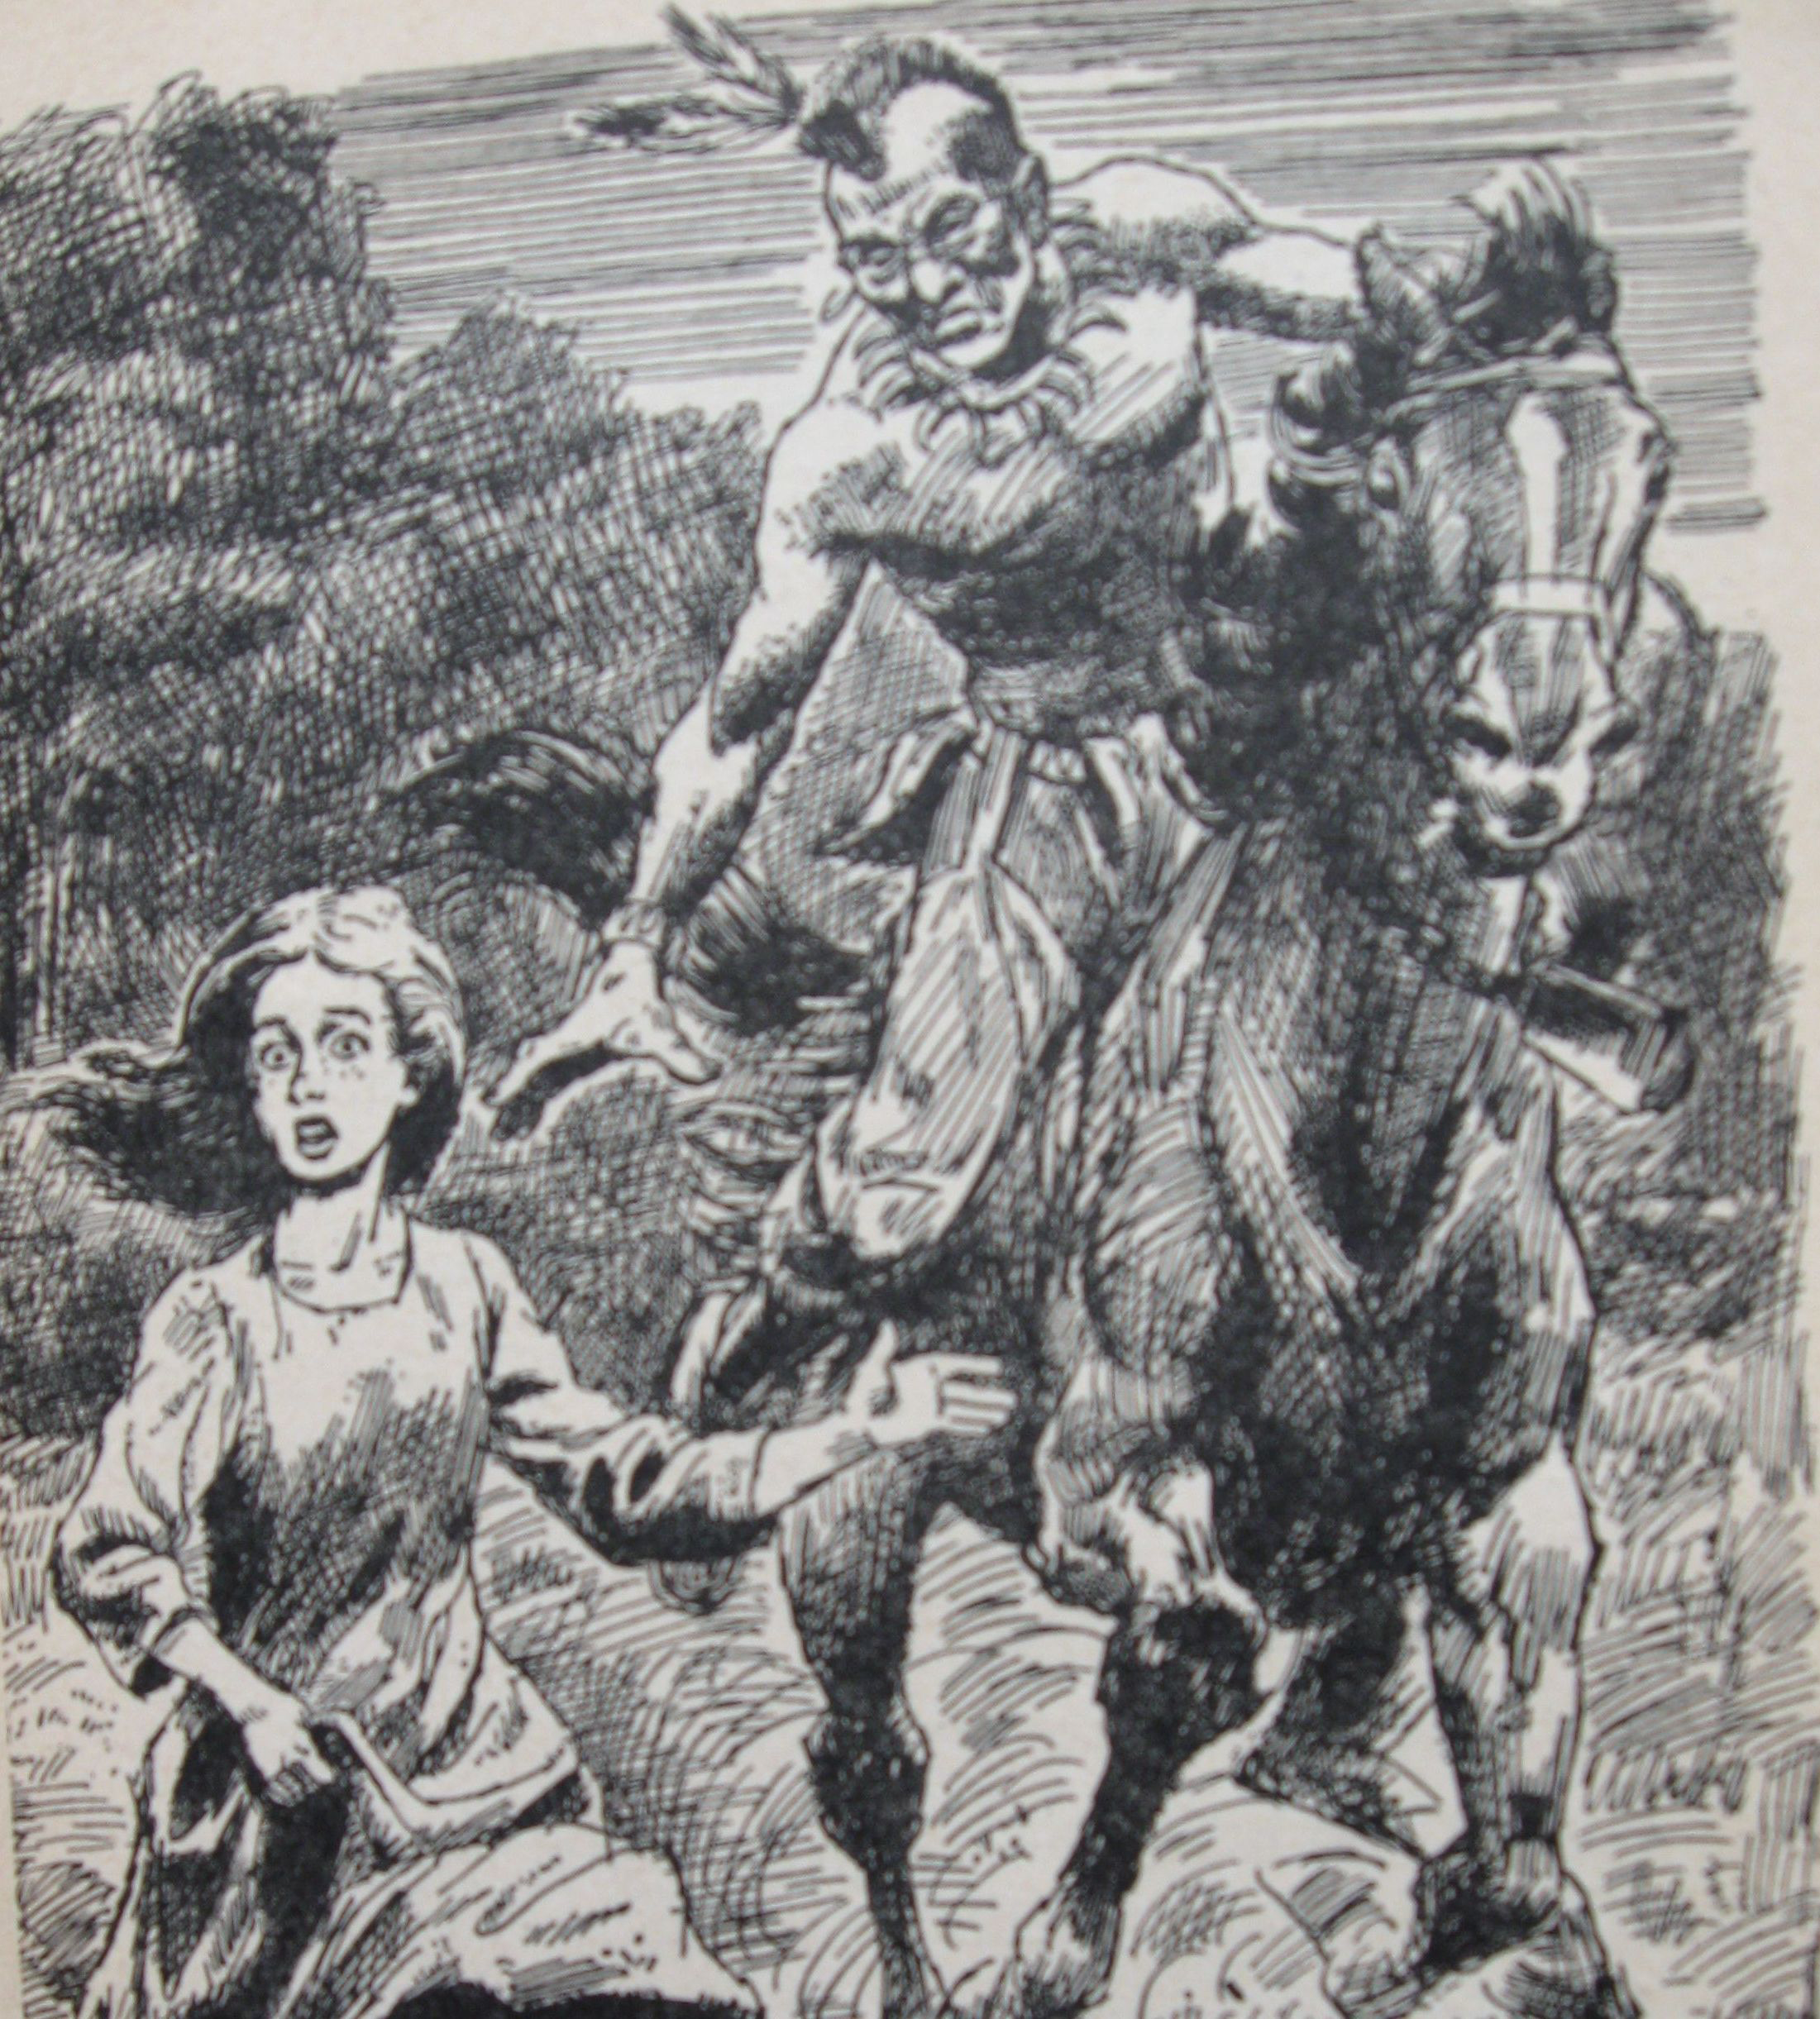
Dehumanization
Depriving a person or group of positive human qualities.
Notes:
Read definition for dehumanization.
Dehumanization is a tactic that is done intentionally by those in power to control people. It is used to convince people that those being dehumanized are not real people, and not worthy of basic human respect. It is used to get people to go along with laws that hurt minorities. For example, America used to have that treated African Americans differently, by making them go to separate schools or sit in separate sections of public buses. Laws even prevented people from marrying across racial lines. It was easier for members of [the mainstream, white] public to go along with these discriminatory laws if they saw African Americans as not really human, not really deserving of the same rights as whites.
Similarly, the propaganda you saw about Jews in Nazi Germany encouraged the non-Jewish German public to look the other way during the holocaust.
Cultural appropriation, like the Navajo Panty or the Paul Frank powow, might seem OKAY to a lot of people in America today, because there is a publically accepted belief that Native Americans aren’t “real” people, whose cultures and beliefs should be respected. This is why it is so hurtful to Native Americans. It is no different than blackface or Nazi propaganda.
When you dehumanize a group of people, it is easy to dismiss their perspectives, feelings, and basic human rights to be treated with equality and dignity.
Here is a typical dehumanizing image that American media serves up about Native Americans, from a children’s book series called “Fear in the Forest” [illustrations by Leanard vossberg, written by Cateau de Leew and originally published in 1960.] The author portrays Native Americans as one dimensional, bad guys who scoop up young girls.
Students may be wondering how this book cover dehumanizes Native Americans.
The problem with this book, and most books, television, and other media depictions of Native Americans is that Native American culture and identity is being depicted by non-Native people. They have no control over their image in the public eye. So books like these ended up defining what most people think of Native Americans, what they are like and what matters to them.
Optional//Read this from Sasha Houston Brown, American Indian academic adviser at Minneapolis Community and Technical College from Dakota's Santee Sioux Nation:
"One important factor to consider is the role of agency and self-determination in the representation of Native peoples, culture and art. As sovereign Nations, Indigenous peoples have the right to speak for ourselves and not have dominant Euro-American society project and profit off of an artificial and socially constructed image of "Indian" identity. When you have major corporations commodify and take possession of various components of Native culture and intellectual property it speaks to the ongoing dehumanization of Indigenous peoples."
You might have to define the terms “agency” and “self determination”
Agency is the ability to act freely and make decisions for onesself.
Self-determination is the idea that tribes and Native peoples have agency.

Slide 7
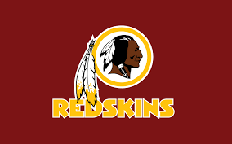
Mascots are cultural appropriation.
Notes:
https://commons.wikimedia.org/wiki/Category:Mascots_depicting_Native_Americans#/media/File:Chief_Zee_in_2016.jpg
Mascots are also dehumanizing.
Someone is a human being. Some thing is a mascot.
For extra support, read this:
http://everydayfeminism.com/2015/01/argue-against-racist-mascots/
Times change: The good news is that over time, people will come to understand that Native American cultural appropriation is no different than the blackface and Nazi propaganda of Jews less than 100 years ago. And that we can all appreciate other cultures without appropriating them.
Optional//Read this from Jennifer Weston, Endangered Languages Program Manager at Cultural Survival(Hunkpapa Lakota, Standing Rock Sioux):
"When modern Natives see half-naked chicks strutting around on runways or street corners completely devoid of knowledge of our real cultures and religions, AND misrepresenting and misappropriating these sacred symbolic articles, we must demand respect for our religious practices. Such misrepresentations sexualize, commodify, and pervert our traditions — and impart to children of all cultures and backgrounds that it's perfectly acceptable to "play dress up" as a Native person, without regard for our ceremonial practices that have persisted here for millennia despite historic violence, and recent legal acts that literally outlawed our religions until 1978! Our ancestors and our parents survive attempted genocide (for their lands) and severe discrimination (for our languages and spirituality). So to pretend that we're fictional characters vs. real people from real cultures is not only offensive, and racist, it's a vicious act suppressing our lived realities as Native peoples, and an appropriation of our very identities.”
DAY 2 INSTRUCTION ENDS HERE

Slide 8
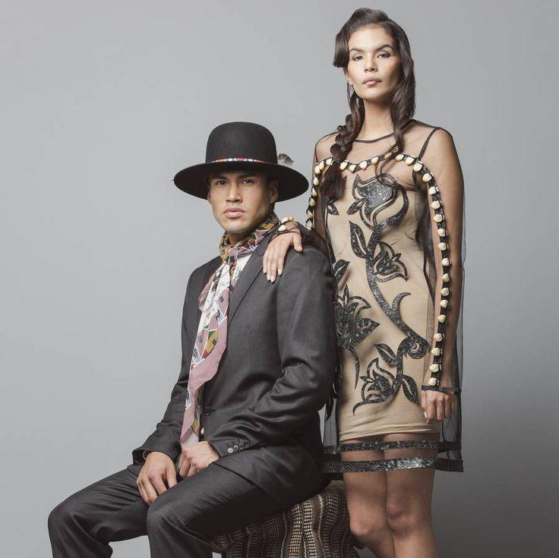
Cultural Appreciation:
learning about another culture with respect and courtesy by taking the time to learn about it, interact with people among the culture, and actually understand it.
Notes:
Read the definition for cultural appreciation.
Here is an example from the Native Appropriation in Fashion video.
Wearing Native American designer, Bethany Yellowtail’s fashions is an example of cultural appreciation.

Slide 9
The 3’s: Source, Significance, and Similarity
Source: Has the source community directly invited you to share this bit of culture, and does the community itself have a history of harmful exploitation?
Significance: What’s the cultural significance of the item? Is it just an everyday object, or is it a religious artifact that requires greater respect?
Similarity: How similar is the appropriated element to the original? A literal knock off, or just a nod to color scheme or silhouette/shape?
Notes:
Let’s review the 3 S’s that Dr. Jessica Metcalfe talked about in the video. The 3 S’s are a shortcut to help you to figure out whether something you might want to buy could be cultural appropriation or cultural appreciation.
‘Source’ is about where the thing that is potentially being appropriated or appreciated comes from.
‘Significance’ refers to the context or setting that the thing is in. You can think of it in terms of the source community. Is the symbol, image or thing in question used for religious or sacred purposes? If so, it probably isn’t meant to be transformed into something for sale.
‘Similarity’ speaks to how the symbol, image or thing is copied. How much of something is copied? Is it copied exactly, or just used as inspiration?

Slide 10
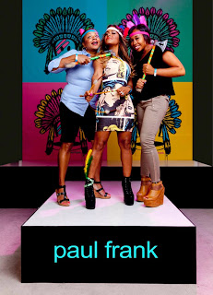
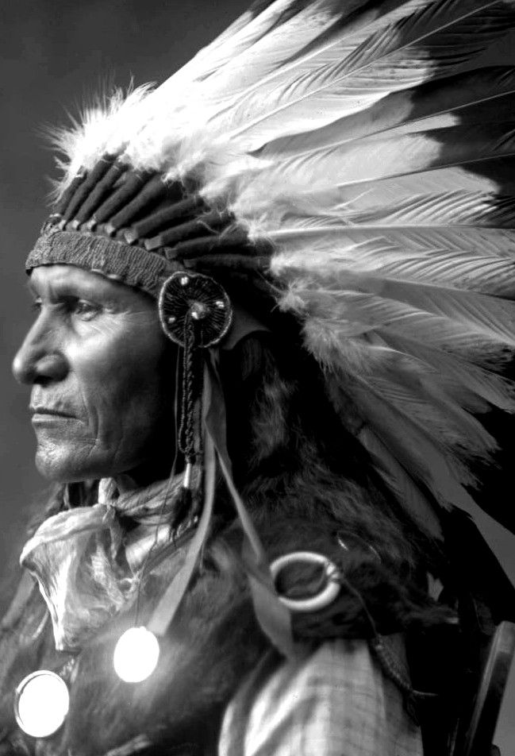
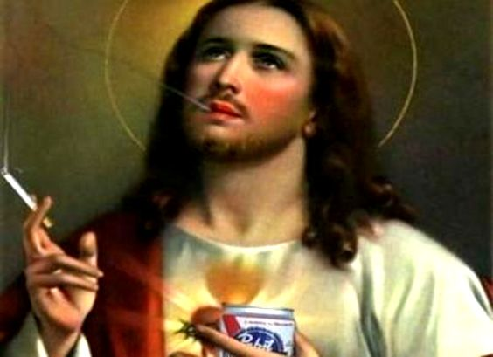
The “3S” Test:
Notes:
Let’s go through the 3 S’s test together with an example we are already familiar with: Paul Franks pow wow party.
Ask the class:
Source: Has the source community directly invited you to share this bit of culture?
Answer: No. The images used in the ’pow wow’ party are stereotypes of plains Indian cultures, who do not generally approve of this kind of misrepresentation.
Ask the class:
Significance: What’s the cultural significance of the item? Is it just an everyday object, or is it a religious artifact that requires greater respect?
Answer: Remember, Dr. Metcalfe explained that feather headdresses are very sacred to the plains peoples; that there are rules about who can wear them, when and where they should be worn because of their spiritual significance.
While ceremonies varied among the diverse plains tribes who produced the feather headdresses, most involved specific prayers and actions, often relating to EACH single feather.
Headdresses are worn used in conjunction with spiritual songs and ceremonies that represent ancient spiritual beliefs deeply tied to tribal homelands.
A similar comparison in our broader society might be the image of Jesus on the left. For those of you who are Christians, think about it this way: Would your grandmother be offended by smoking Jesus? (Don’t have to say the answer out loud, just think to yourself.)
Ask the class:
Similarity: How similar is the appropriated element to the original? A literal knock off, or just a nod to color scheme or silhouette/shape?
Answer: The tomahawks look pretty much directly like a tomahawk. The feather headdress appears fairly different from the authentic feather war bonnet you see in the photograph of Louis, Sitting Bull’s son. (Hunpapa Lakota)
Both have feathers, and a head band. And, it is clear that the Paul Frank headdress is referencing Plains Indian style, but they are really not very similar.
In this case, what really makes the racist pow wow an example of cultural appropriation relate to source and significance. The source community does not want to be exploited, belittled or dehumanized by being portrayed as stereotypes about violent Indians who attack people with tomahawks. In terms of significance, the sacredness of the feather war bonnet is very compromised and disrespected by being taken out of its original context and meaning.

Slide 11
Popcorn Discussion:
Appropriation or Appreciation?
Rules: When you see an image, shout out the answer to the question:
Q: “Is this an example of cultural appropriation or appreciation?”
Hint: Most of these examples are ”in the middle,” so be prepared to defend your answer.
Notes:
Explain the rules of the popcorn discussion outlined in the lesson plan

Slide 12
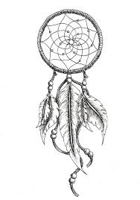

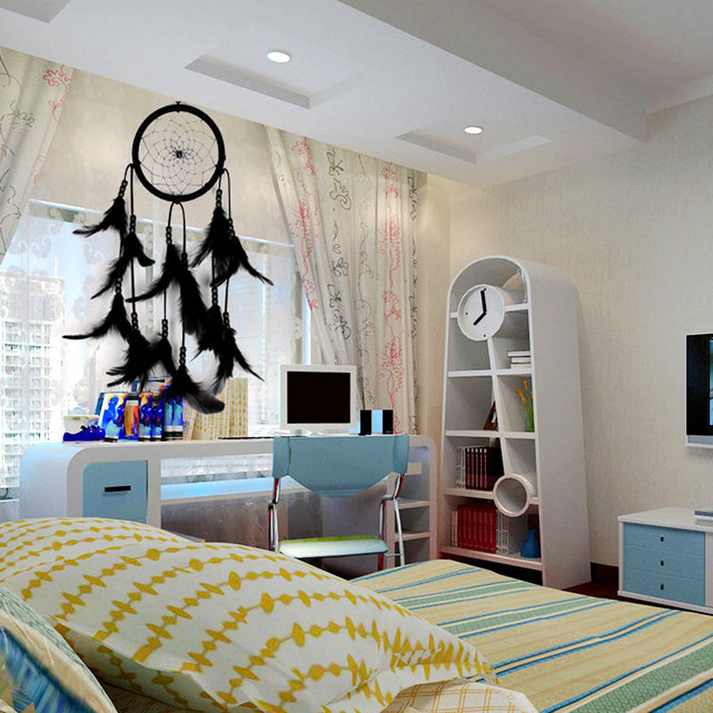
Dreamcatchers
Notes:
REPLACEMENT IMAGES:
https://commons.wikimedia.org/wiki/File:Dream_Catcher_%26_Elephant.jpg
https://commons.wikimedia.org/wiki/Category:Dreamcatchers
Notes to aid the discussion:
The idea behind the dream catcher is that if you hang them up over your bed, they will catch your dreams.
Source:
Dream catchers are cross cultural in nature, and often used for children’s toys or other items.
Dream catchers are used by many Native tribes, so they are somewhat of a generic thing. You can’t just ask one tribe for permission to use them. Its more or less accepted that dream catchers can be used by many.
Significance: The hoop design, the web and the feathers that often make up the dream catcher have symbolic significance. For many Native American tribes, the hoop is a sacred symbol for healing and the cycles of life, signifying mother earth, father sky, endless time, and the four directions. But the way the sacred hoop is embodied and made a part of spiritual practices varies from tribe to tribe.
Similarly, feathers can be sacred in many different tribal belief systems. But, like the hoop, these beliefs vary from tribe to tribe and feather to feather. Some tribes don’t let feathers touch the ground because of their sacred nature.
While people can ascribe their own meanings to them, dream catchers are typically considered “too general” to be considered sacred, or improper for those who aren’t Native American to use them.
Similarity: Dream catchers tend to follow the same basic design no matter where you see them. They tend to be a hoop, with a web inside and feathers and beads hanging down from them.
VERDICT:
MOST LIKELY APPRECIATION but a slippery slope to appropriation

Slide 13
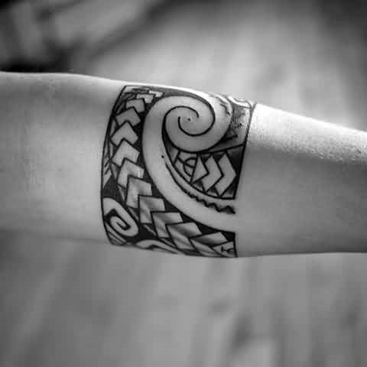
Tribal armband tattoo
Notes:
REPLACEMENT IMAGES:
https://commons.wikimedia.org/wiki/File:Tribal.jpg
Notes to aid the discussion:
Many cultures around the world have a rich history of tattooing, and this includes Indigenous cultures and communities. This armband looks a bit Polynesian in origin, but the origin of it is unclear.
Explain to the class that “Polynesian” refers to the people and cultures that inhabit the islands of the South Pacific. For example, Disney’s Moana is Polynesian.
Ask the class: What would we have to find out to learn if this armband is cultural appropriation or not?
Are these designs specific to a particular culture? (Source) Can the source peoples give permission to use the design?
If so, what is the significance of these designs? Are particular designs just for certain people at certain stages in their life? For example, in some Polynesian cultures, only people of a certain social status, like a chief, are traditionally allowed to tattoo certain designs.
If we know the source of the design, what about the source of the arm getting the tattoo. Is it a person who is a member of that culture? Does this person have permission to use those designs, regardless of whether they are a member or not?
Finally, let’s say this armband design was tattooed on someone who is not Polynesian in a tattoo shop by a non-Polynesian tattoo artist. Does the design copy a known tribal design? If so, then go back to question 2 about the significance.
VERDICT:
MAYBE. We probably need more context to make a verdict.
In some cases this might be appreciation, and in some cases it might be appropriation.

Slide 14
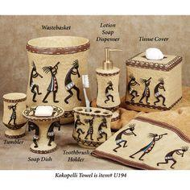
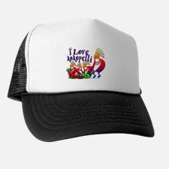

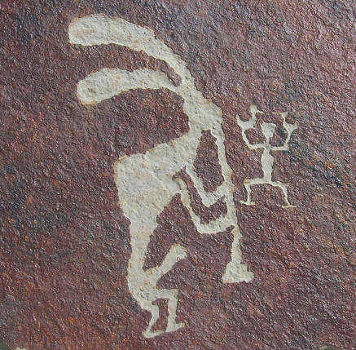
Kokopelli products
Notes:
REPLACEMENT IMAGES:
none
Notes to aid the discussion:
Source
The Kokopelli flute player is an image seen across the Southwest. Kokopelli images were found on ancient cultural artifacts such as painted pottery and rock art from the Southwest, United States. The figure associated with the name Kookopölö in contemporary Hopi and Zuni Tribes of the Southwest is not associated with the flute, rather, to help generate heat for the summer crops to mature. Kokopelli’s image does not belong to a specific Native American tribe or culture existing today, although the descendants of the people who carved the image onto rocks long ago are probably still among us and represented among tribal members in the Southwest.
Significance In traditional pueblo cultures, Kookopölö (the katsina mentioned earlier) is a symbol of fertility, but the image is used commercially from hats to bathroom sets.
Similarity - Substantial differences exist between contemporary Kokopellis and the traditional fluteplayers images on ancient artifacts. Traditional flute players often have an erect penis, a hump back and rabbit-like ears, or bug like antennae. The commercial image of Kokopelli is so altered from the original, that all the original meaning is gone, and it becomes a new, different thing.
VERDICT:
SPLIT IN THE MIDDLE
APPRECIATION –Contemporary Kokopelli are too different from the original to warrant appropriation, and there are no contemporary tribes that can give permission to use the image.
APPROPRIATION – The way contemporary Kokopelli are depicted takes away the rights of possible descendants living today to have a say in how their ancestors’ spiritual symbols should be used. It takes away their “agency” a word we talked about as important in processes of dehumanization.

Slide 15
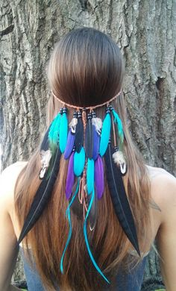
This headband
Notes:
Notes to aid the discussion:
Source
Indigenous communities from around the world make head decorations that may include a headband, feathers or beading of some sort. This headband is so generic, we can’t really connect the design to a particular tribe.
Significance
Headbands play different roles in different cultures. We have talked extensively about the significance of the feather war bonnet for Plains Indian tribes, for example. But without knowing a specific context for this headdress, it is likely that it is just meant to be what it is, an everyday accessory, and not sacred regalia.
Similarity
This headband is so generic. It has feathers and beads, but the similarity to any specific cultural types of headdresses end there. It doesn’t appear to be a direct copy of anything.
VERDICT
Neither appreciation or appropriation
It is too vague to be cultural appropriation, but cultural appreciation means that you take the time to learn about and understand the source cultures. Here, it is hard to tell if there is a source culture. Without knowing a source culture, you can’t appreciate it except beyond a very vague way, e.g. “feathers are important to some cultures.” Therefore, this cannot be cultural appreciation either.

Slide 16
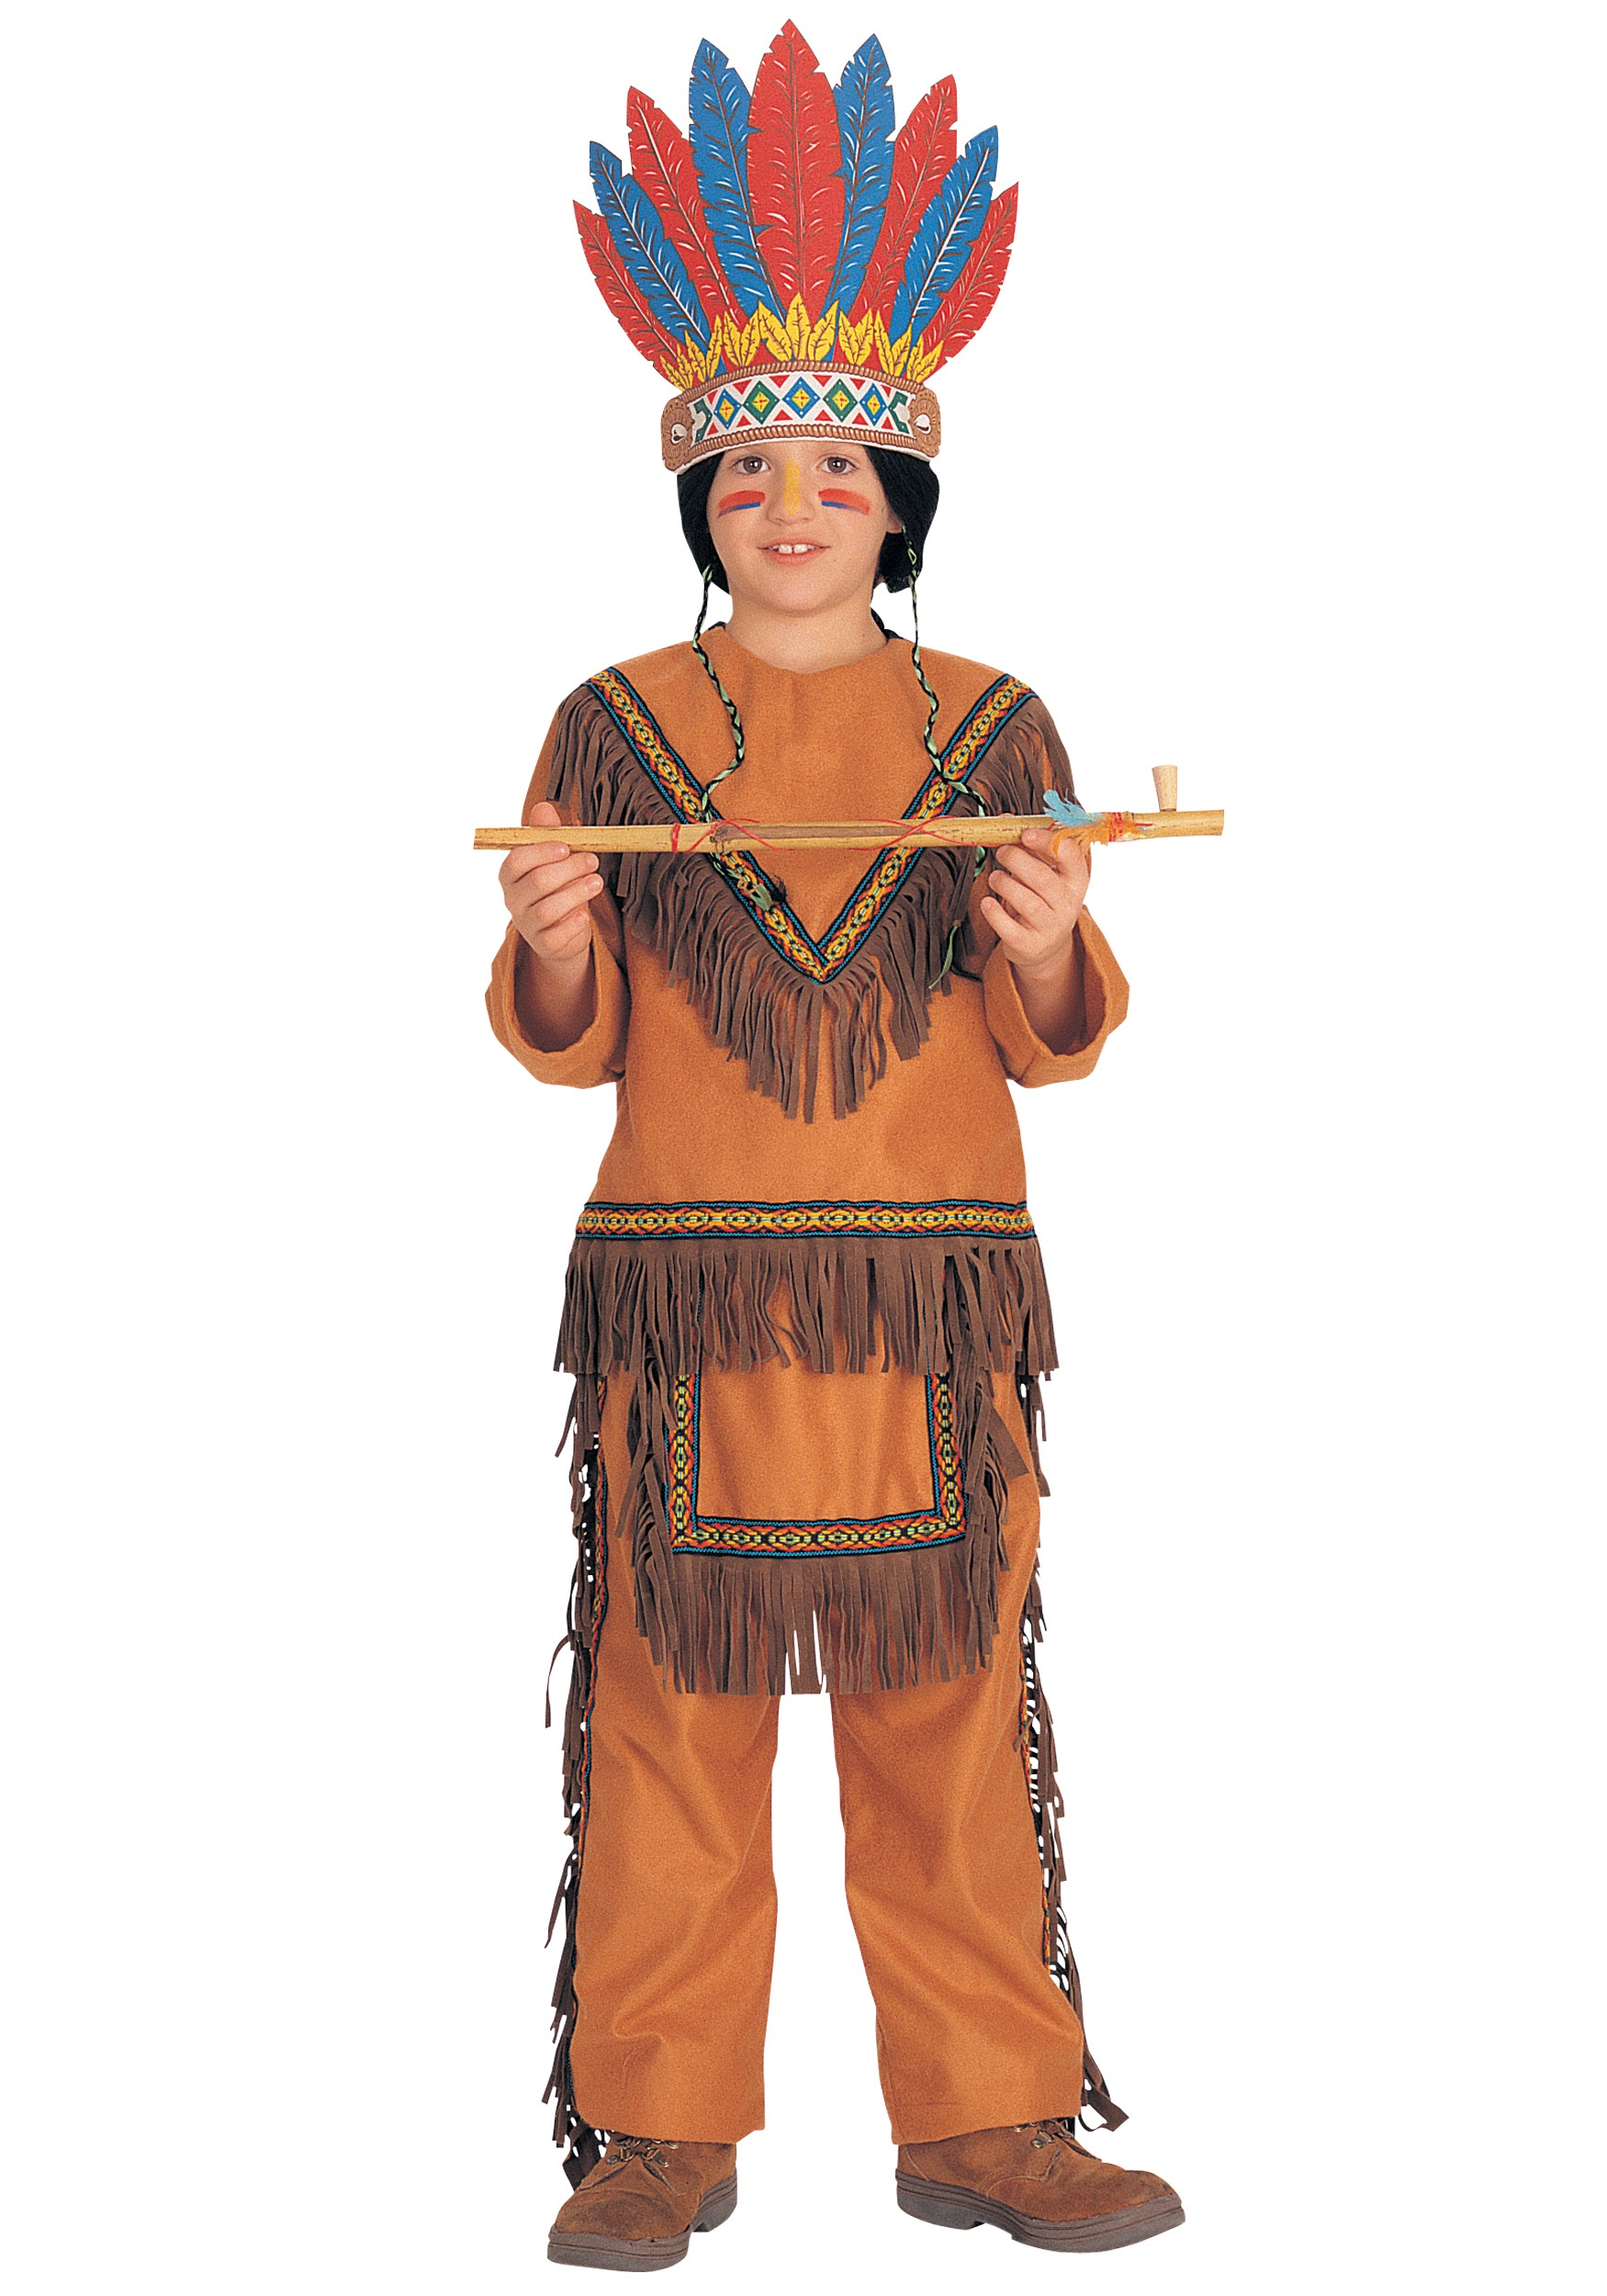
Native American costume
Notes:
POSSIBLE REPLACEMENT IMAGES:
https://commons.wikimedia.org/wiki/File:Wet_Dream_Catcher.jpg
https://commons.wikimedia.org/wiki/Category:Native_American_costumes
Notes to aid the discussion
Review the definition of cultural appropriation:
The unauthorized taking of another culture's dance, dress, music, language, folklore, cuisine, traditional medicine, religious symbols, etc. especially by those who represent a group in a more powerful political position.
Source There are no tribes that I am aware of that make Native American costumes or would give permission for others to dress like them as part of Halloween. (Individuals might, but that’s an exception to the rule.)
Significance This costume includes what appears to be a “peace pipe.” Peace pipes are sacred objects used for diplomacy. Part of the ceremony using peace pipes involves smoking tobacco, which is considered by many tribes as a religious sacrament, kind of like of like eating the body of Christ during communion for Christians. You have to know how to properly take part in the ceremony. It is not child’s play.
Similarity this costume is very similar to the stereotypes about what plains Indians might have dressed like, with buckskin fringe clothing, a peace pipe and a feather headdress. We have already been over the feather head dress extensively.
VERDICT:
APPROPRIATION –Indian costumes are definitely unauthorized. They are often made and worn by people in a more powerful social position than Native Americans. These costumes also validate the dominant society’s stereotypes about Native Americans in a way that dehumanizes them.

Slide 17
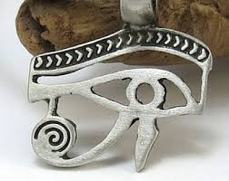
Egyptian jewelry
Notes:
Notes to aid the discussion:
This necklace pendant is an image of the eye of Horus, an ancient Egyptian God.
Source
The source of this image is ancient Egypt, a no longer existing people and culture.
Significance
According to legend, the left eye was torn from Horus by his murderous uncle Seth, and magically restored by Thoth, the God of magic.
After the restoration, Horus made a gift of the eye to [another Egyption god] Osiris, which allowed him to rule the underworld.
The story of this injury is probably an allusion to the phases of the moon as the eye which is “torn out” every month.
For ancient Egyptians, the Eye of Horus was believed to have healing and protective power, and it was used as a protective amulet, and as a medical measuring device, using the mathematical proportions of the eye to determine the proportions of ingredients in medical preparations) to prepare medications.
Similarity
This pendent exactly copies the eye as seen in ancient objects, and art.
VERDICT:
APPRECIATION
The ancient Egyptian culture no longer exists. No one has authority or say over how their imagery would have been used and the commercial use and borrowing of ancient Egyptian symbols doesn’t seem to be an issue among possible descendants of the ancient Egyptians alive in the region today.
You might compare this argument about the Egyptians no longer being around to the argument for appropriation of Kokopelli images. The difference could be that contemporary Pueblo and Southwest tribal peoples who might claim a relationship or caretaker role over the ancient peoples who made Kokopelli CARE, whereas contemporary Egyptians don’t really claim to be descendants or inheritors of ancient Egyptian art and beliefs. They don’t really voice a care about how these images are commercialized. And the ancient Egyptians can’t speak for themselves.
DAY 2 INSTRUCTIONS ENDS HERE

Slide 18
Cultural Appropriation and the Law
Indian Arts and Crafts Act
Copyright
Patent
Trademark
Trade Secret
Notes:
DAY 3 PRESENTATION STARTS HERE
Explain that you are going to briefly go over each law, giving real life examples only in the Indian Arts and Crafts Act and Trademark law. Copyright, Patent, and Trade Secrets can potentially/theoretically protect Native American artists and businesses, but they don’t tend to be invoked in lawsuits.
Explain that after going over each type of legal protection that you will go over why some of these laws are not very useful in protecting Native artists and businesses from appropriation.

Slide 19
Indian Arts and Crafts Act
Makes it illegal to advertise arts and crafts as made by a member of an American Indian tribe or certified as an Indian artist by an Indian tribe.
Up to a $250,000 fine or a 5 year prison term for a first time violation
If found guilty of more than one charge, can be fined up to $1,000,000 or 15 years in jail.
If a label says “Made by Native Americans” but it is not, this is a violation of the act.
Notes:
The Indian Arts and Crafts Act of 1990 (P.L. 101-644) prevents people who are not Native American from making art or products and mislabeling it as “Native-made.”
People who violate the act are subject to a $250,000 fine or a 5 year prison term, or both.
If a business violates the Act, it can face civil penalties or can be prosecuted and fined up to $1,000,000.
Also see: https://www.doi.gov/iacb/act

Slide 20
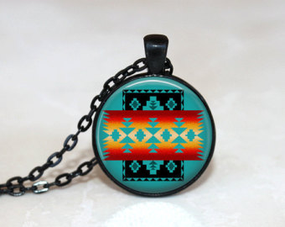
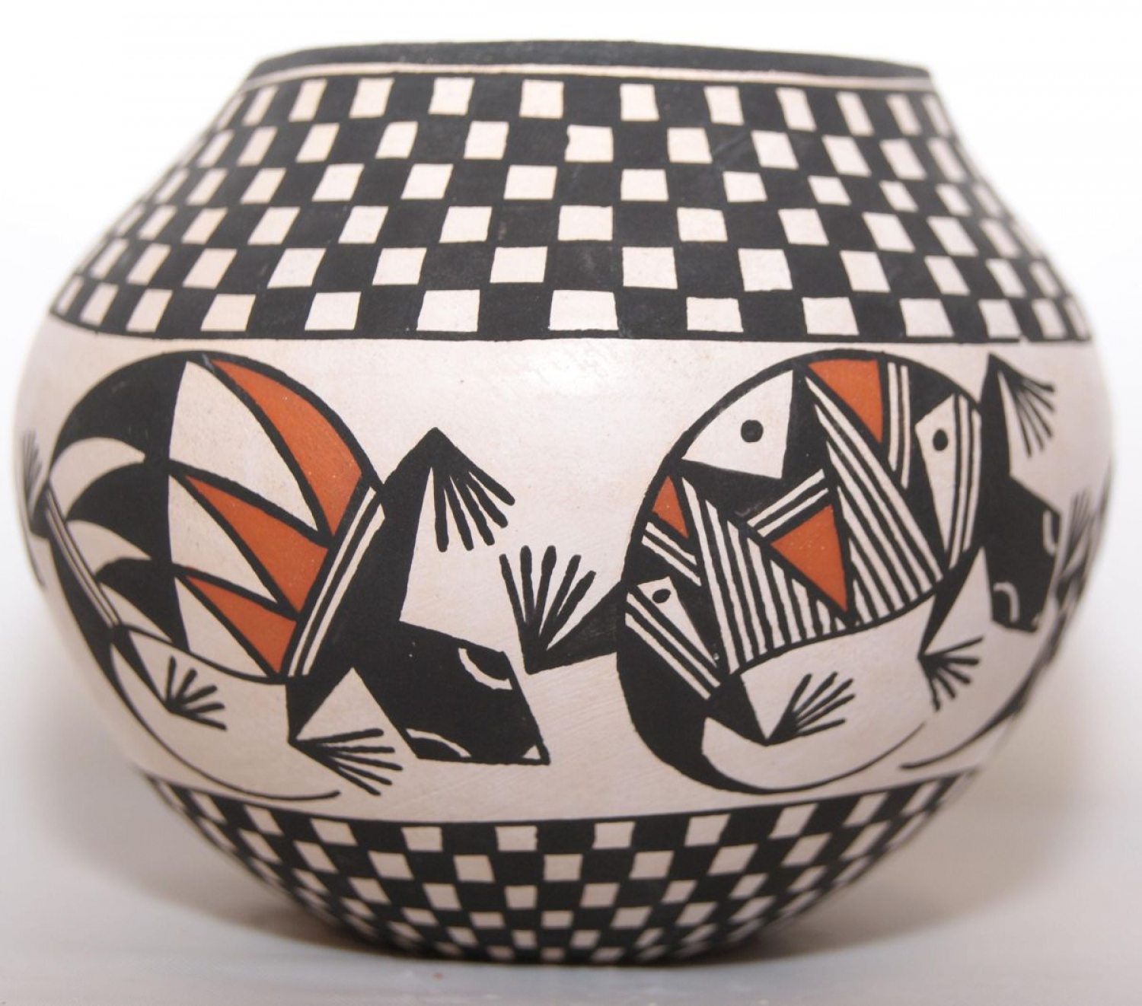
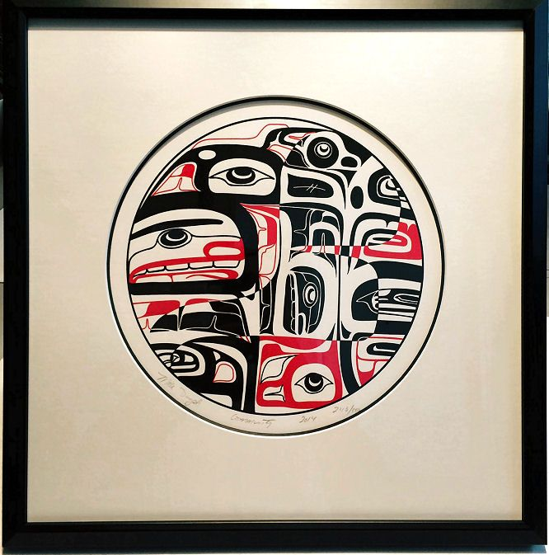
Indian Arts and Crafts Act (IACA)
Notes:
Under the Act, an Indian is defined as a member of any federally or officially State recognized Indian Tribe, or an individual certified as an Indian artisan by an Indian Tribe.
The law covers all Indian and Indian-style traditional and contemporary arts and crafts produced after 1935.
In other words, it only protects contemporary pieces.
Some examples of things that non-Natives frequently copy include: Indian-style jewelry, pottery, baskets, carved stone fetishes, woven rugs, and clothing.
The law states that all products must be labeled truthfully. If an American Indian makes a piece of Indian-style jewelry, he or she may label it as “American Indian –made”, but if someone who is not Native American makes the a very similar piece, he or she must not falsely label it as American Indian-made.
Bottom line: It is illegal to market an art or craft item using the name of a tribe if someone who is not a member of that tribe made it.
For example, products advertised as "Hopi Jewelry" would be in violation of the Act if they were produced by someone who is not a member, or certified Indian artisan, of the Hopi tribe.
Ask the class: “Why do you think this law exists?”
--It helps Native artists to make a living
--It protects the buyer who wants authentic Native-made art
--It prevents appropriation
FYI-IMAGES
jewelry on Etsy made by non-Native artist using a southwest Native American design. Example of Acoma pottery. Print by northwest coast artist, Mike Dangeli.
https://www.etsy.com/listing/225404412/glass-tile-necklace-native-american?ga_order=most_relevant&ga_search_type=all&ga_view_type=gallery&ga_search_query=native%20american%20jewelry&ref=sr_gallery_18
I don’t believe the Etsy jewelry designer is Native American.

Slide 21
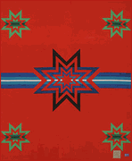
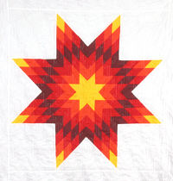
Examples of IACA Violations
Notes:
Here are some examples of IACA violations.
Do you see the blanket on the left? The non-Native manufacturer, Pendleton Mills, marketed this blanket as a “Sioux star quilt.” It was not designed or made by a Sioux person. The image on the right is of a real star quilt featured at the Atka Lakota Museum and Cultural Center. Lakota or Sioux women are well known for their star quilts. The star pattern originated in buffalo robe designs.
As the buffalo were shot to near extinction and this art form migh have been lost, Sioux children were forced to attend mission schools, where quilting was taught.
The morning star is an important symbol for Lakota people and this image and these blankets are used in ceremonies, as a link between the living and the dead.
The United States punished Pendleton for violating the Indian Arts and Crafts Act in 2013 for inappropriately suggesting that their blanket was a “Sioux Star Blanket.”
They subsequently changed the online marketing of the blanket from “Sioux Star Blanket” to the “Plains Star Blanket” and described it as not an authentic Indian product.
See: http://lastrealindians.com/unwarranted-violating-the-federal-indian-arts-crafts-act-by-gabe-galanda/
Ask the class:
Pendleton got caught, got in trouble, and had to change the way they marketed their star blanket. Their new description of the blanket put the company in compliance with the law, but do you think it is moral for a non-native company to be making and selling a Native-inspired design like this one?

Slide 22
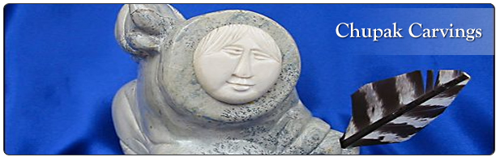
Examples of IACA Violations
Notes:
Here’s another example of a potential IACA Violation.
“Chupak” is the artist name used by a Cambodian immigrant to America, who carves art in the style of Alaska Native people like this one you see here. In this case, the Chupak art was not labeled specifically “Alaska Native-made,” but the shop owner let potential buyers of the art assume Chupak pieces were, indeed, Native made. The shop owner was prosecuted and taken to court by federal investigators, and the won because an audio recording used to prove she mislead potential buyers was unclear, and that she had admitted Chupak was not Native in an email exchange with federal investigators.
Ask the class:
The shop owner did not break the law, because when directly asked, she admitted that Chupak is not Native, and the carvings were not labeled “Alaska Native.” They are labeled “Chupak carvings.” Chupak is a made up name meant to sound Alaska Native. Even though she was not found guilty, is it morally okay to fudge the law and allow buyers to think a piece is Native made?
https://skagwaynews.com/2016/09/13/local-shopkeeper-wins-federal-native-art-scam-case/

Slide 23
Copyright
The legal right to use original literary and artistic creations, which can include sculptures, fabric designs, paintings, baskets and music. A copyright lasts for 70 years.

Slide 24
Design Patent
Provides exclusive use of a new or original ornamental design on products, including jewelry, pottery or textile designs. Patents last for 14 years.

Slide 25
Trademark
A trademark helps customers identify and distinguish your goods and services from those of others. Trademarks can be letters, words, slogans, symbols, designs, colors, product/packaging configurations, sounds, or scents. Trademarks can inspire customer loyalty and promote sales. Trademarks can exist forever as long as they are being used in business.

Slide 26
Example of trademark violation
Notes:
REPLACE WITH:
https://commons.wikimedia.org/wiki/File:Urban_Outfitters_-_Tyson%27s_(7069592725).jpg
As we learned from the Native Appropriations video, it is very hard for Native peoples to win in court on a copyright violation.
The Navajo nation sued urban outfitters for trademark infringement for labeling items for sale as “Navajo” without the tribe’s permission.
The Nation had given permission to companies to use their name with products, historically but in this case, they were not asked permission by Urban outfitters and, some of the products were deemed inappropriate, as Jessica Metcalfe explained in the video we watched.
The tribe argued that the term, “Navajo” is a “famous and recognizeable” name, and is therefore a trademark. They lost their case. The judge ruled that ”Navajo” is more of a “niche” name than a trademark, despite the Navajo Nation being the second largest Native American tribe in the country. Back in the 1970s, the Navajo Nation had tried to copyright the word “Navajo” but they were told that it is such a common name, that they didn’t have a right to it.
See:
http://www.thefrisky.com/2016-05-24/urban-outfitters-wins-in-court-against-navajo-nation-after-4-year-copyright-battle/
http://www.npr.org/2012/04/05/150062611/navajo-nation-sues-urban-outfitters-over-trademark
There are several other kinds of examples of trademark violations that can be explored.
See: Shakopee Mdewakanton Sioux Comm v FBCV LLC 2011 –injunction
Oneida Tribe Wisc W. Harms 2006 –injunction
Harjo v. Pro-Football, Inc., 2009 Time Barred
https://en.wikipedia.org/wiki/Pro-Football,_Inc._v._Harjo
Mohegan Tribe of Indians of Connecticut v. Mohegan Tribe and Nation, Inc. 2001
https://www.law360.com/articles/847696/navajo-nation-urban-outfitters-settle-trademark-dispute
http://www.eater.com/2016/6/16/11952682/budweiser-lumbee-tribe-lawsuit-nc

Slide 27
Trade Secret
A trade secret is confidential business information that gives you a competitive advantage. Trade secrets include methods or techniques for producing products, such as special techniques for firing pottery or blowing glass. Trade secrets are valuable because they allow you to maintain your competitive edge over others. Trade secret protection lasts as long as the information is secret.

Slide 28
Challenges to legal protections
Reporting
Enforcement
Cost
Material that is over 70 years old cannot be protected by copyright
Does not necessarily protect traditional knowledge
Notes:
While laws are in place to help Native American individuals, tribes and businesses, they are often not able to protect Native peoples as much as you might think.
While there are some examples of the American Indian Arts and Crafts act and trademark law working to protect Native Americans from cultural appropriation,
It is very difficult to find examples of copyright, trade secret and design patent cases that have gone to trial.
There are many reasons for this. I will share the main ones.
First of all is the issue of reporting. Unless a violation of the law is reported to authorities, they cannot investigate it. Violations happen all the time, but they simply go unreported. The main reasons for this are that many tribal citizens live in rural places, where they might not have access to, or notice cultural appropriations that break the law. Also most people –Native and non-Native-- are ignorant of the law. You can’t report a violation if you don’t know the law.
Second, is the issue of enforcement. It takes resources to investigate these cases, and oftentimes these resources aren’t available. In the case of the Chupak carvings, federal investigators actually had to go undercover in shops that sold Chupak art to find out if the owners or employees were misleading customers.
Third, it is expensive to file a lawsuit. Many Native American artists (most artists) can’t afford to file a lawsuit, especially against a big company, with lots of resources. So they don’t. And even after spending a lot of money to fight a case, Native American tribes, individuals or businesses can still lose, as we saw with the Navajo Nation suing Urban Outfitters.
Finally, there are a lot of examples of cultural appropriation that are not protected by the law. Any original work that is over 70 years old cannot is not protected. So that means that things, like tribal hierlooms or artwork with old tribal designs is up for grabs by anyone.
Many of the symbols, images, designs, songs, knowledge about how to use a particular plant for medicinal purposes, and other specific knowledge that is typically considered “traditional” by tribes are ancient, passed down through generations, and they are not protected by law. They aren’t protected because the knowledge is “too old” as in copyright law. Or, it is not considered “owned” by the law in the first place, such as the generic kokopelli designs taken from the pottery of ancient peoples who are now gone. Or, the knowledge is owned by many people belonging to a tribe or culture, as opposed to a single creative individual, a tribe, or tribal business. If traditional designs, music, knowledge etc. is not considered the property of anybody or an organization, than it can’t be protected under the law.
To summarize, the Indian Arts and Crafts Act seems to best protect Native American intellectual property, but this law is limited in scope. It only prevents non-Natives from advertizing products or artwork as “indian-Made” but it can’t actually stop them from making, or selling culturally -appropriated or derivative things.

Slide 29
Ways to address cultural appropriation outside the law
Explain the problem
Appeal to decency
Pitch for authenticity
Suggest a partnership
Notes:
For this reason, Native Americans have to turn to methods outside the law to try to protect their traditional designs and knowledge. In the video we watched, Jessica Metcalfe had some success simply communicating the problem to the people at Paul Frank Industries.
After the racist pow wow, Jessica Metcalfe demanded Paul Frank Industries apologize, to which the company responded with an apology! Metcalfe helped to connect the brand with four native American artists to help design a limited edition line of clothing, in partnership instead of appropriation.
The bullet points you see on this slide here are examples of how you might reach out to a person or business guilty of cultural appropriation. You can start by explaining the problem. Contrary to what you might think, those who appropriate don’t do it maliciously. They usually don’t understand the the issue, and why cultural appropriation is harmful. Once you can explain the problem with appropriation, you can appeal to decency. You might say something like, “it is never good business to market a product or event in a way that is harmful to some people.” Or “The right thing to do is to take down this image/stop this campaign.” Then you can pitch for authenticity and suggest a partnership. You might say, “instead of selling fake Native art, why don’t you partner with a Native American artist to design this product. You will end up with a truly authentic product, that more people will want to buy.”
Suggestion//optional assignment: In pairs, ask the students to write letters to Paul Frank industries in their own words, that incorporate all of the bullet points.
See http://www.cnn.com/2013/06/26/living/paul-frank-native-designers/

