Slide 1
Mni Wiconi: Water is Life

Slide 2
This Week’s Overview
Day 1 - Water is Life
Day 2 - Water and People
Day 3 - Water in My Community
Day 4 - Protecting Water

Slide 3
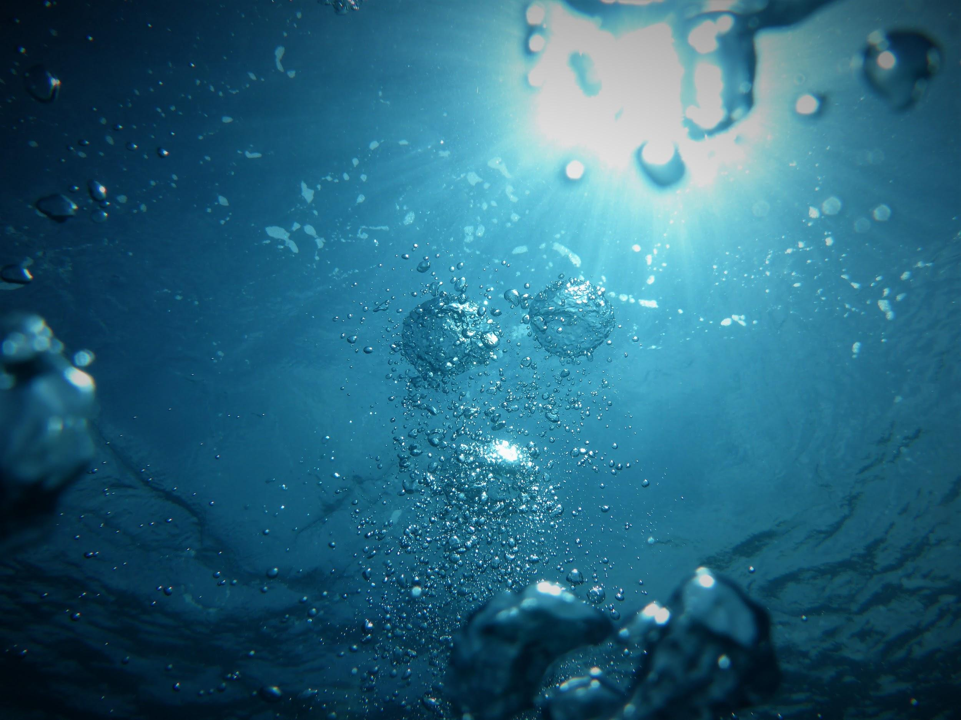
DAY 1: Water Is Life
Notes:
Ask the class: Have you ever hear the phrase, “water is life”? What does that mean to you?
Facilitate class discussion
Students may respond by saying that we drink it. It makes up to 60% of our bodies. We can’t survive without water. It makes plants grow, etc.
Information Source:
Photo Source:
Photo by Jong Marshes on Unsplash

Slide 4
Culture is a set of beliefs, and ways of living that a group of people share. When we speak the same language, celebrate the same holidays, eat similar foods -- all of those things are a part of our culture.
Notes:
Define Culture by reading the slide
The way that we think about and interact with water is cultural. Culture can be defined as a set of beliefs, and ways of living that a group of people share. When we speak the same language, celebrate the same holidays, eat similar foods -- all of those things are a part of our culture.
Culture impacts the ways that we think about water, interact with water, drink water, conserve and protect water.
In our mainstream American society, we tend to think of water as something that we need for life. All human cultures believe that. It is considered a “cultural unversal” - that is, a belief shared by all humans.
But in mainstream American culture (and for many cultures in the world), we also think of water as something that can be bought or sold. So we bottle it up, and we have to pay for the water that we get in our homes.
Native American cultures and traditional belief systems share the view that we cannot survive without water. However, in traditional belief systems, water is not something that can be bought, sold, or wasted.
It is thought of as a precious element of life, that needs to be cared for.
So when we say that water is cultural, it means that our belief systems, what we think is true about the world, affects the way we think about water.

Slide 5
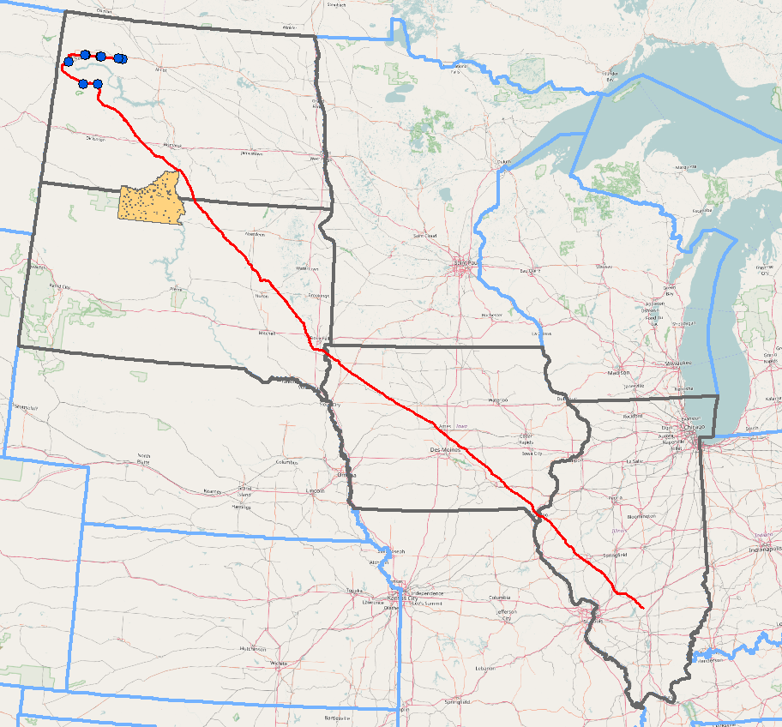
Mni Wiconi/Water is Life
Notes:
Mni Wiconi is a phrase that means “water is life” in the Lakota language. Americans became very aware of this phrase in the winter of 2016, when water protectors came to the Standing Rock Reservation in North Dakota to prevent the building of a pipeline to transport fracked oil from oil fields in North Dakota to existing pipelines in Illinois. Here is a map of the pipeline and where it crosses nearby the edge of the Standing Rock reservation.
At issue was the way that water was being used to extract oil from a hard rock called shale. The process is extremely damaging to the environment, wastes a lot of water, and releases tons of emissions contributing to global warming. It has also been known to cause earthquakes. Moreover, this pipeline was built under a lake, that serves as a resevoir for the Missouri River, which millions of people depend upon. Water protectors were concerned that any oil spill into the water would have very bad consequences.
Image source:
https://upload.wikimedia.org/wikipedia/commons/a/ac/Bakken_map_osm_basemap.png
File URL: https://upload.wikimedia.org/wikipedia/commons/a/ac/Bakken_map_osm_basemap.png

Slide 6
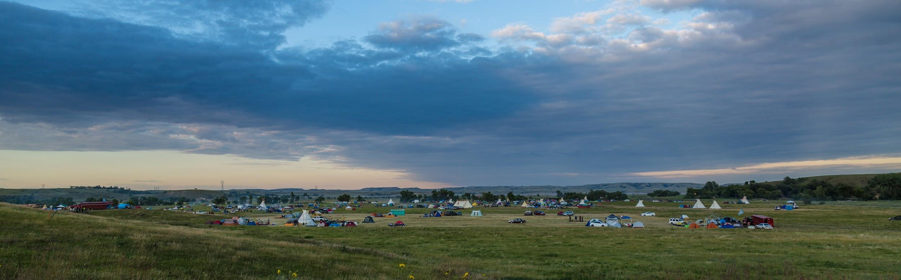
A Movement: to resist the Dakota Access Pipeline
Notes:
The company behind the pipeline, Dakota Access LLC, received the permits it needed to construct the pipeline in March 2016. By April 1, Native Americans organized to protest the pipeline due to potential environmental damages, and the fact that its construction would damage sacred sites, with burials, and places of religious importance.
That same month, tribal member, LaDonna Brave Bull Allard founded the Camp of the Sacred Stone, on her private property near the proposed pipeline route, to bring attention to the issue through occupation. Within a few months, more protest camps were established on federal land controlled by the US army corps of engineers near the Cannon Ball river, and 10,000 indigenous people from around the world (but mainly North America) came in solidarity to protest the pipeline.
It became the biggest and most diverse gathering of Native Americans working together to fight for their rights in centuries, possibly ever. Despite the protest, the pipeline was eventually built in 2017 under executive order of Donald Trump. And, it has spilled and leaked oil several times since then confirming water protectors’ concerns.
For a timeline see: http://www.usatoday.com/story/news/nation/2016/12/02/timeline-dakota-access-pipeline-and-protests/94800796/

Slide 7
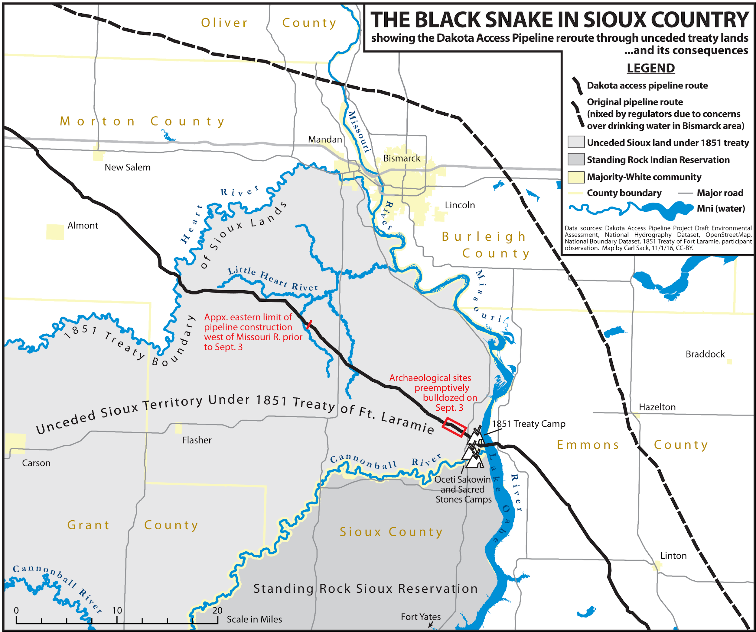
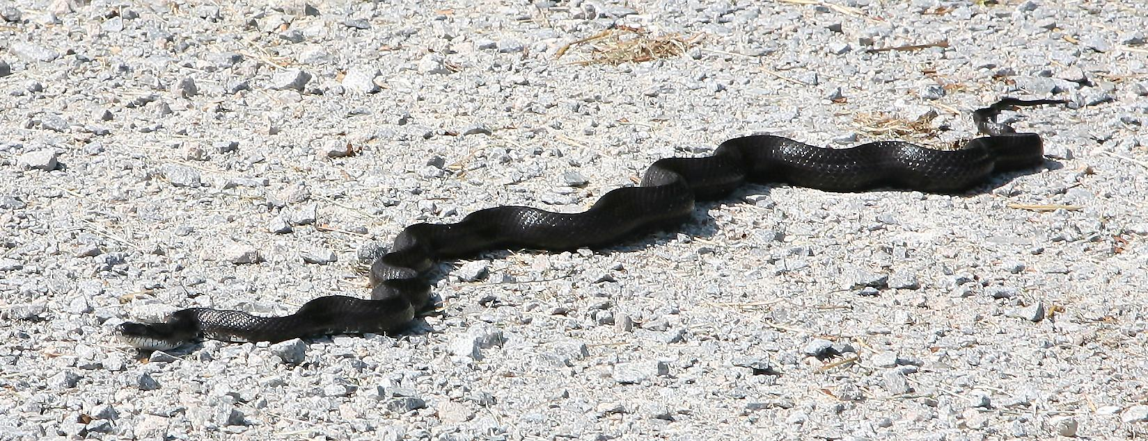
What is the black snake?
Notes:
The movement against the Dakota Access Pipeline had very deep roots in the Lakota (Sioux) belief system.
The Lakota tell a story of a black snake. Some call it a prophecy. A prophecy is a message that predicts something that will happen in the future. Most religions have prophecies. The Bible is full of prophecies. If you are familiar with the Christian bible, perhaps the biggest prophecy is the idea that Jesus Christ, who was killed by crucifixion, will return to the earth as a King to rule for 1,000 years (Revelation 20:1-6).
In the Lakota prophecy, the black snake symbolizes a force whose instruction is to bring sickness and destruction to the communities. To the Dakota peoples, the Dakota Access Pipeline is a manifestation of that black snake here to bring on destruction and disease through the peoples’ lands.
If we think about what the black snake symbolizes on a broader level, it stands in for our modern lives that run on cash money and depend on fossil fuels to run. This modern way of life must destroy land, the people who live closely with the land and have a spiritual relationship with Mother earth.
Image licenses wikemedia commons :
Map: By Carl Sack [CC BY 3.0 (http://creativecommons.org/licenses/by/3.0)], via Wikimedia Commons

Slide 8
Environmental Racism
the way in which minority groups (populated primarily by people of color and members of low socioeconomic groups) are burdened with a disproportionate number of hazards, including toxic waste facilities, garbage dumps, and other sources of environmental pollution and foul odors that lower the quality of life.
Notes:
The plan to put this pipeline at the edge of the Standing Rock reservation instead of a more rural area, or near one of North Dakota’s cities was an act of environmental racism.
Read the definition. Clarify that in this case, minorities does not just refer to racial and ethnic minorities, but also in terms of socio-economics.
[From the article: https://www.healthaffairs.org/do/10.1377/hblog20170417.059659/full/]
Many Indigenous tribes are reliant on water sources to support their livelihood. For example, tribes that rely on hunting and fishing for subsistence depend on the cleanliness not just of their local water supply but of the entirety of the ecosystem feeding the water source, which could be affected hundreds of miles or several states away. Concerns about how both subterranean and above-ground parts of the pipeline may affect the water system are not without merit, yet the concerns of the Standing Rock Sioux have been discounted by supporters of the pipeline.
Water insecurity is a global issue that encumbers marginalized and vulnerable communities around the world. When marginalized racial and ethnic minority communities are disproportionately burdened by environmental hazards (such as oil pipelines) compared to more privileged groups, this is known as environmental racism, and it’s a type of institutional racism.

Slide 9
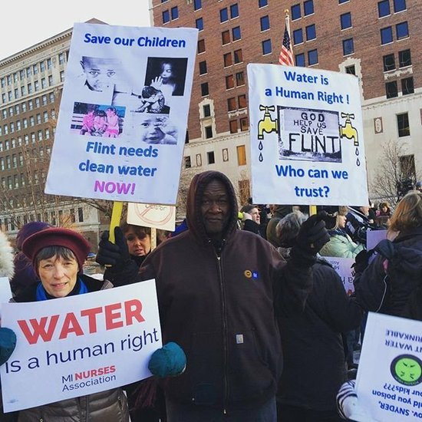
Environmental Racism Example: Flynt, Michigan
Notes:
Source of text: https://www.healthaffairs.org/do/10.1377/hblog20170417.059659/full/
In Flint, Michigan, for instance, massive lead contamination resulted from a decision by local officials to cut costs by switching the municipal water source without treating the water to ensure it didn’t corrode lead-lined pipes. Flint is a majority African American community and one of the nation’s poorest cities. Public health experts posit that about 99,000 Flint residents were exposed to high levels of lead in their drinking water, a fact that is potentially more concerning among the youngest children, in whom high lead levels can be neurotoxic and lead to permanent developmental disability.
Photo source: Shannon Noble/Instagram
[http://amsterdamnews.com/news/2016/jan/27/flint-michigan-did-race-and-poverty-factor-water-c/]
=

Slide 10
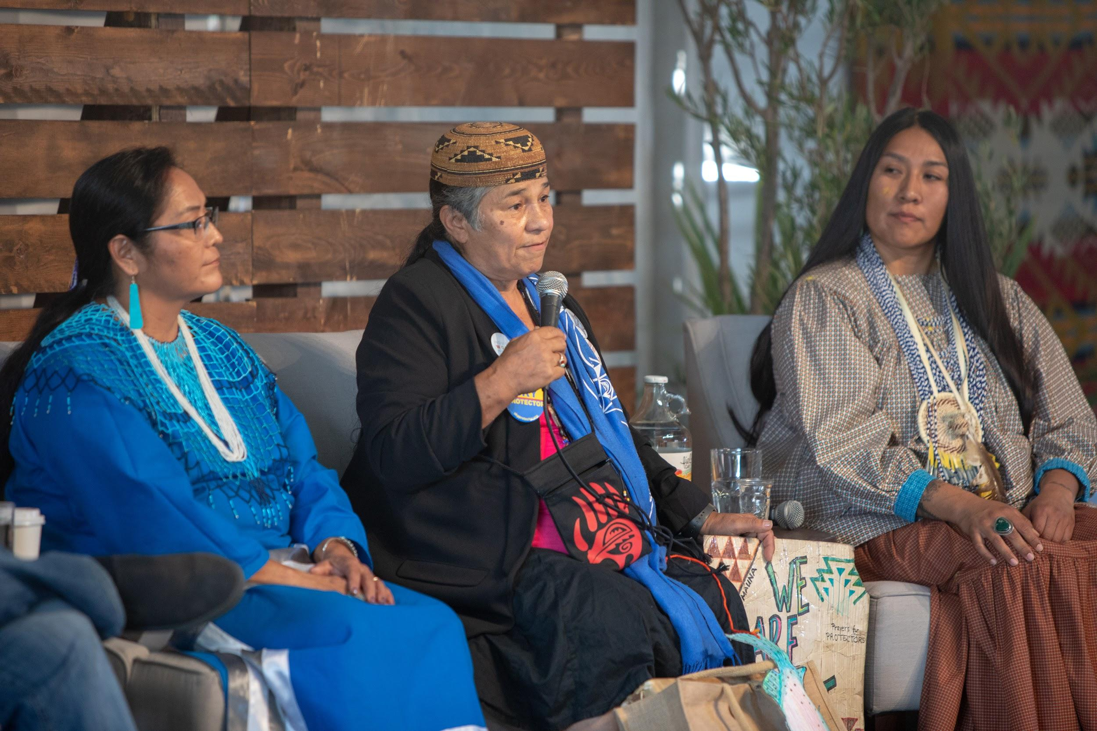
Notes:
Introduce the video resource for day 2
Native Americans are disproportionately affected by Environmental racism. In the video we are are going to watch tomorrow, we are going to learn from three Native women who are fighting for clean, safe water in their communities. Each of them will speak about different threats to fresh water sources, and what their communities are doing to protect threats to water.

Slide 11
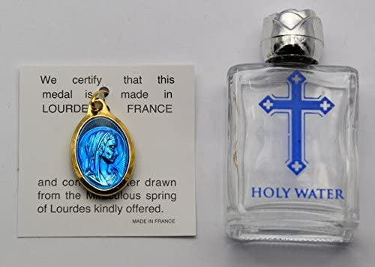
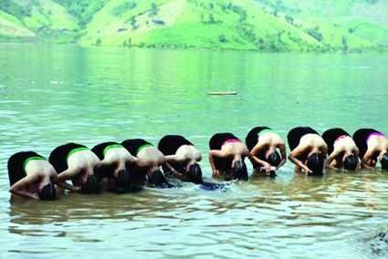
DAY 2 - WATER AND PEOPLE
Notes:
Did you notice the ‘cultural’ ways that each speakers’ tribe thinks about water and interacts with water. For most indigenous peoples, water is an important part of their ceremonies and spiritual beliefs. It goes along with the concept of “water is life.” Many peoples and religions all over the world pray over water and for water, and this is an important part of protecting, honoring and respecting all life forms.
For example: water is an important part of Christianity. It is used to baptise infants or people who are born again. In these images here, you can see the Hair washing ceremony of the Thai people who live near the Da River. [see image and information source here: http://vietnamlawmagazine.vn/hair-washing-ceremony-of-the-thai-4269.html]
And here is an image of holy water from a spring near the Lourdes cathedral in France and is believed to cure many ailments. This image was taken from a site on Amazon.com that sells the water. Note that it is widely being sold.
Information about Lourdes Holy water: https://www.directfromlourdes.com/lourdes_water
Holy water image source: https://www.amazon.com/Gold-Lourdes-Water-Pendant-Bottle/dp/B01A8ZNRO2

Slide 12
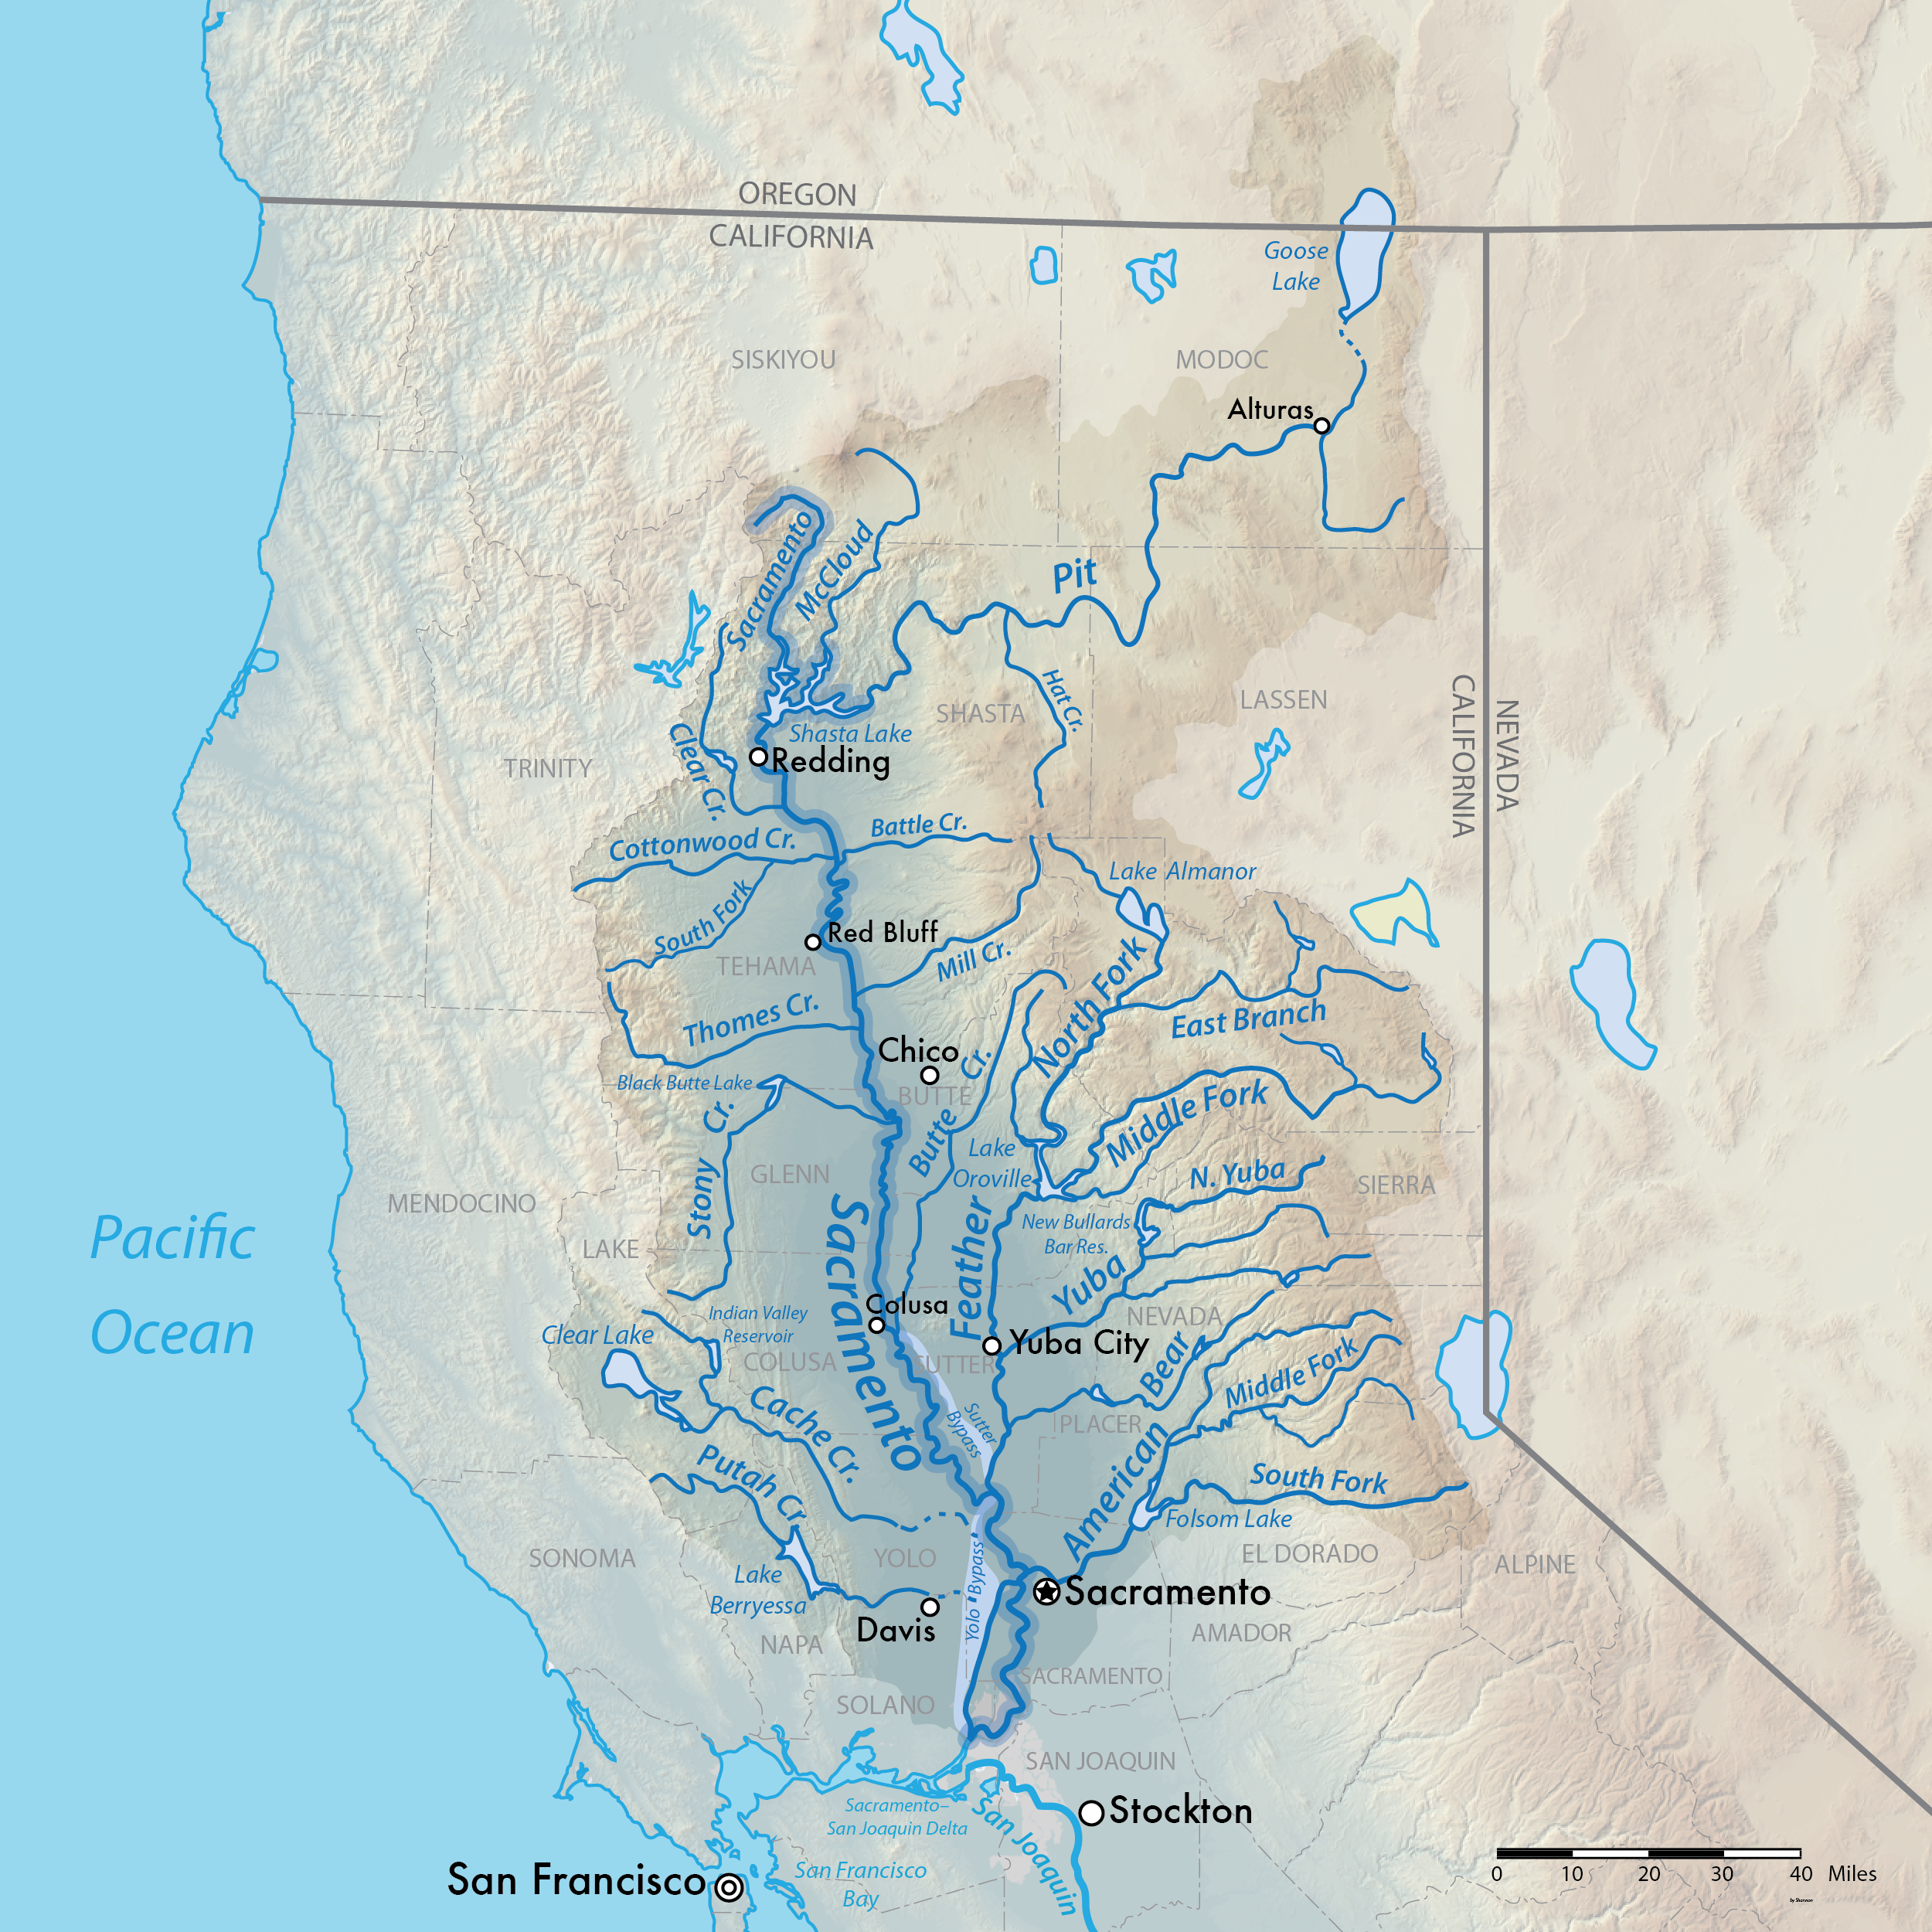
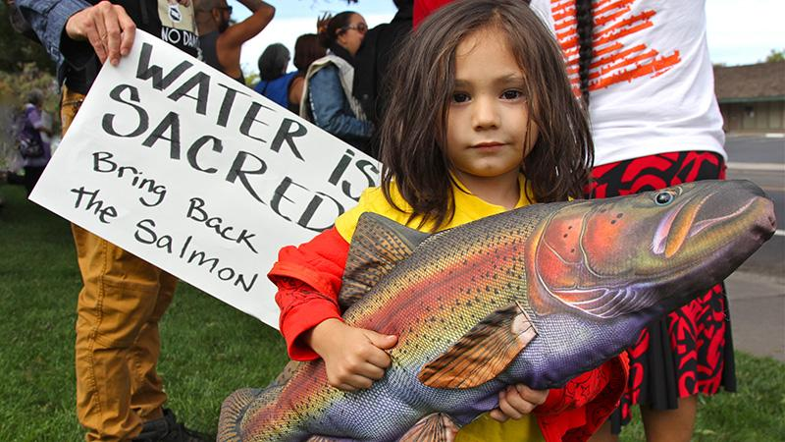
WORKSHEET REVIEW: Winnemem Wintu
Notes:
Go over the answers to the Worksheet. Review these “cases” of the three different threats to tribes’ water shown in the video, and encourage students to revise/add to the answers they put on their worksheets. Go through the answers to the questions, asking the students to share their responses in class discussion before sharing the information in the slide deck. Use the slide deck as a resource to add to what is shared in the video.
The Winnemum Wintu tribe’s traditional homeland is located in Northern California, near Shasta and the Shasta Lake area. White, American settlers first arrived to the region during the 1848-55 california gold rush. During this time, the territorial government paid militias and ordered troops to carry out numerous massacres. These settlers were encouraged through cash bonds offered by the government to murder California Indians by the thousands, clearing their ancestral territory for settlement. After the gold rush, ended, a second wave of white American settlers arrived in California’s Central Valley to farm the region’s rich lands.
From 1937 to 1945 the US Government built a dam on the Sacramento River that resulted in the manmade Shasta Lake. The dam and lake were used to create hydroelectric energy and storage to provide water to California’s Central valley, an important agricultural region. The lake that was created flooded the Winnemum Wintu tribe’s ancestral territory which included hunting and gathering lands, burial grounds and sacred sites. The dam, along with copper, iron and gold mines built along the It also cut off the migration route for salmon, who could no longer reach the cold waters of their home rivers to spawn (reproduce). The government established hatcheries below the dam to maintain fish populations, but the numbers plummeted.
In recent years, proposals have beeen put forth to raise the Shasta dam which would further degrade the ecosystem. The Winnemum Wintu have protested these developments and environmental degradation to their ancestral territory by organizing “runs for salmon” to raise the publis awareness of these issues, collaborating with environmental groups, by running for politcal office, by developing solidarity with other Indigenous groups, including the Maori people of new Zealand, where the region’s salmon were removed and have been raised successfully.
Sources
https://en.wikipedia.org/wiki/California_Gold_Rush
https://lensmagazine.org/aqualliance-winnemem-blast-bid-to-raise-shasta-dam-d8d66dde5571
https://earthfirstjournal.org/newswire/2017/08/22/winnemem-wintu-fishing-groups-sue-to-block-ecosystem-killing-delta-tunnels/
http://www.run4salmon.org/run4salmon-curriculum/lesson-five/
https://www.kcet.org/shows/tending-the-wild/when-salmon-speak-the-winnemem-wintu-and-the-winter-run-chinook
Image sources
https://upload.wikimedia.org/wikipedia/commons/1/1e/Sacmapupdate-01.png
https://www.kcet.org/shows/tending-the-wild/when-salmon-speak-the-winnemem-wintu-and-the-winter-run-chinook

Slide 13
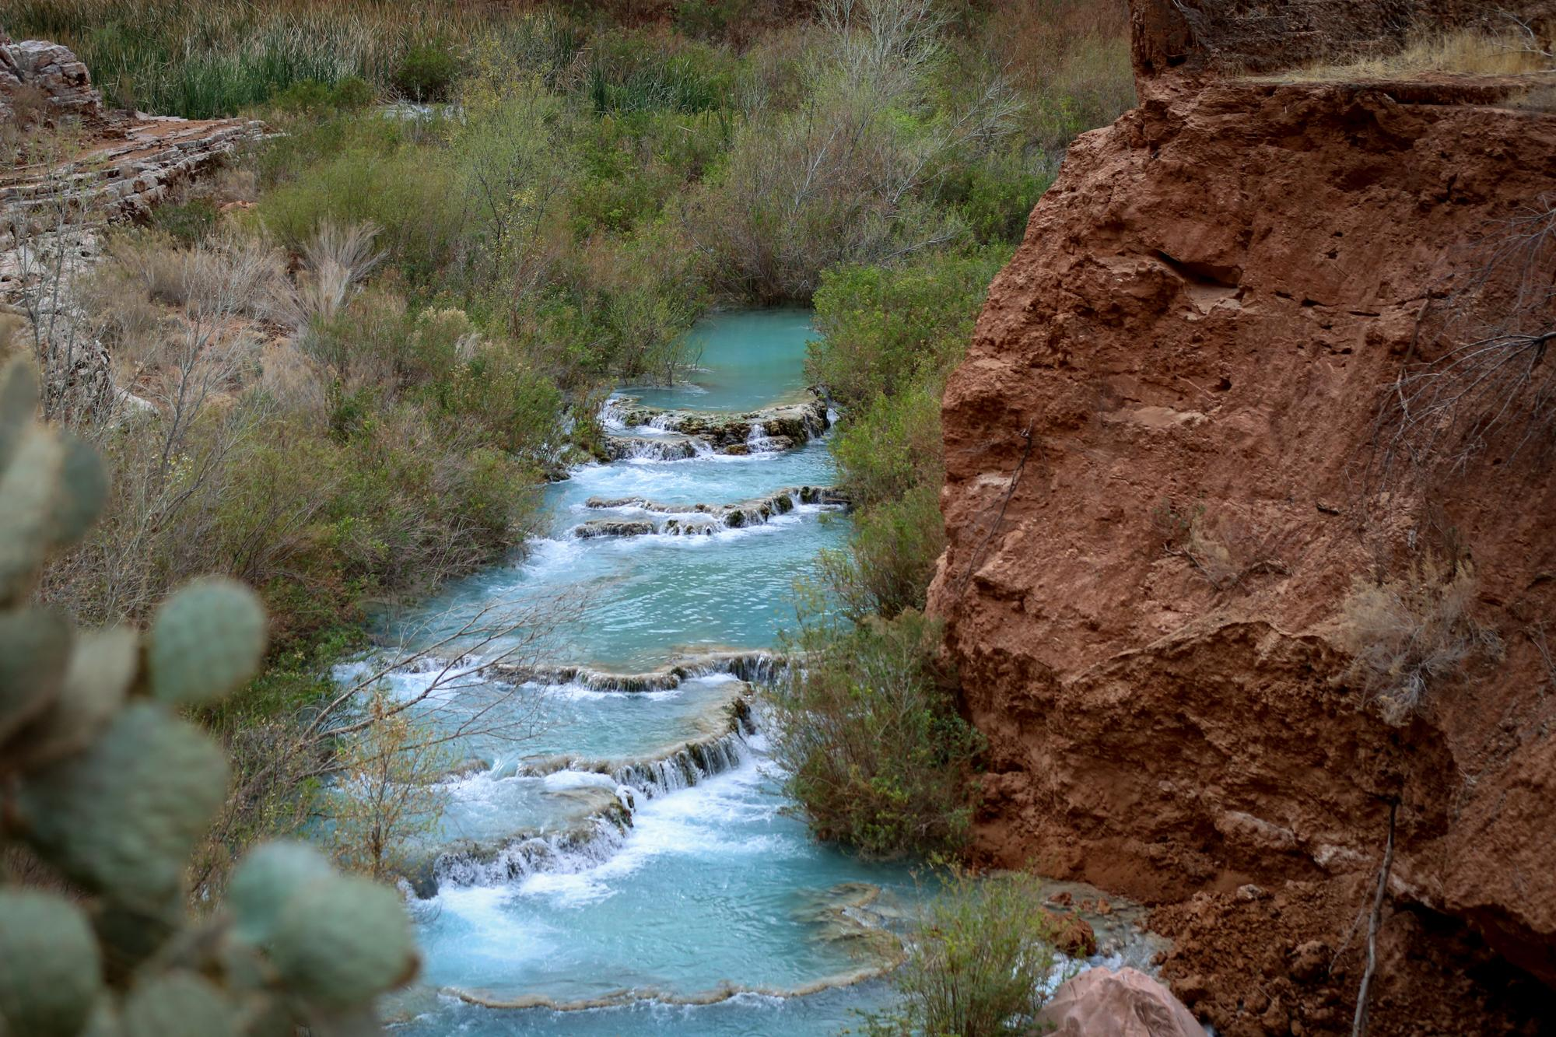
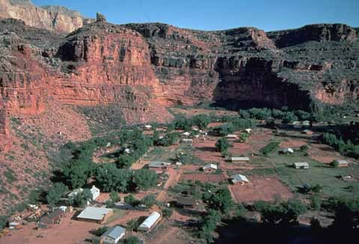
WORKSHEET REVIEW: Havasupai
Notes:
The Havasupai Tribe’s ancestral territory is along the bottom of the Grand Canyon, where they still maintain an active village today, called Supai Village. The Havasupai tribe has about 775 members, and their ancestral village, Supai, is considered one of the most remote villages in the US, and can only be reached by walking 9 miles down intot he grand canyon or helecopter. The only water supply is a creek at the bottom of the Grand Canyon that is fed by an aquifer, “redwall” or Havasu Springs, which is also considered very sacred. Near their village, the Havasupai traditionally farm for beans, corn, melon, and peach orchards, and they also traditional hunt in surrounding areas.
For decades throughout the 20th century, over 500 now abandoned uranium mines were built along the plateau at the top of the Grand Canyon just to the East in Navajo territory to supply demand for nuclear weapons. Water sources were contaminated by the radioactive material, and many Native people in the area have died prematurely of kidney failure, cancer and other illnesses linked to uranium exposure.
President Obama’s administration banned all new uranium mines in 2012, and this decision was upheld by Congress in
Sources:
https://www.google.com/search?q=uranium+mines+havasupai&oq=uranium+mines+havasupai+&aqs=chrome..69i57j33.4487j0j8&sourceid=chrome&ie=UTF-8
https://www.theguardian.com/environment/2017/jul/17/grand-canyon-uranium-mining-havasupai-tribe-water-source
https://inkstickmedia.com/havasupai-children-plead-end-uranium-mining-near-homes/
Image Sources
Havasupai falls - https://inkstickmedia.com/havasupai-children-plead-end-uranium-mining-near-homes/
Photo by Chris Cadeau
Supai Village: https://www.nps.gov/grca/planyourvisit/havasupai.htm
NPS/Tom Bean

Slide 14
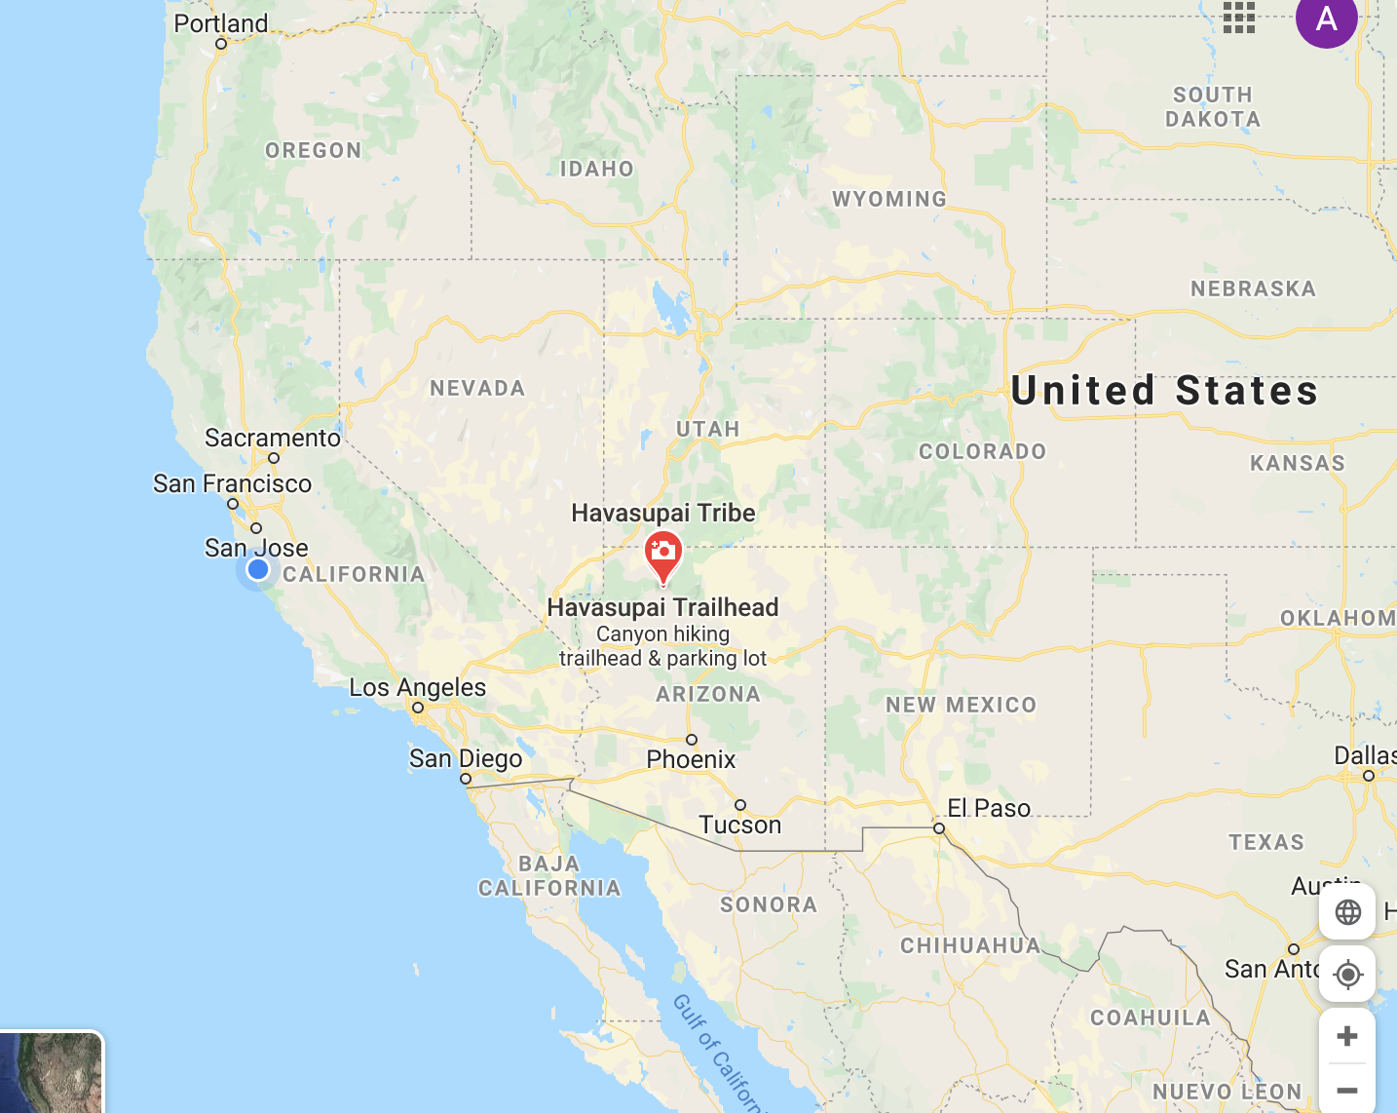
Notes:
Map source: Google Maps
Havasupai Homeland

Slide 15
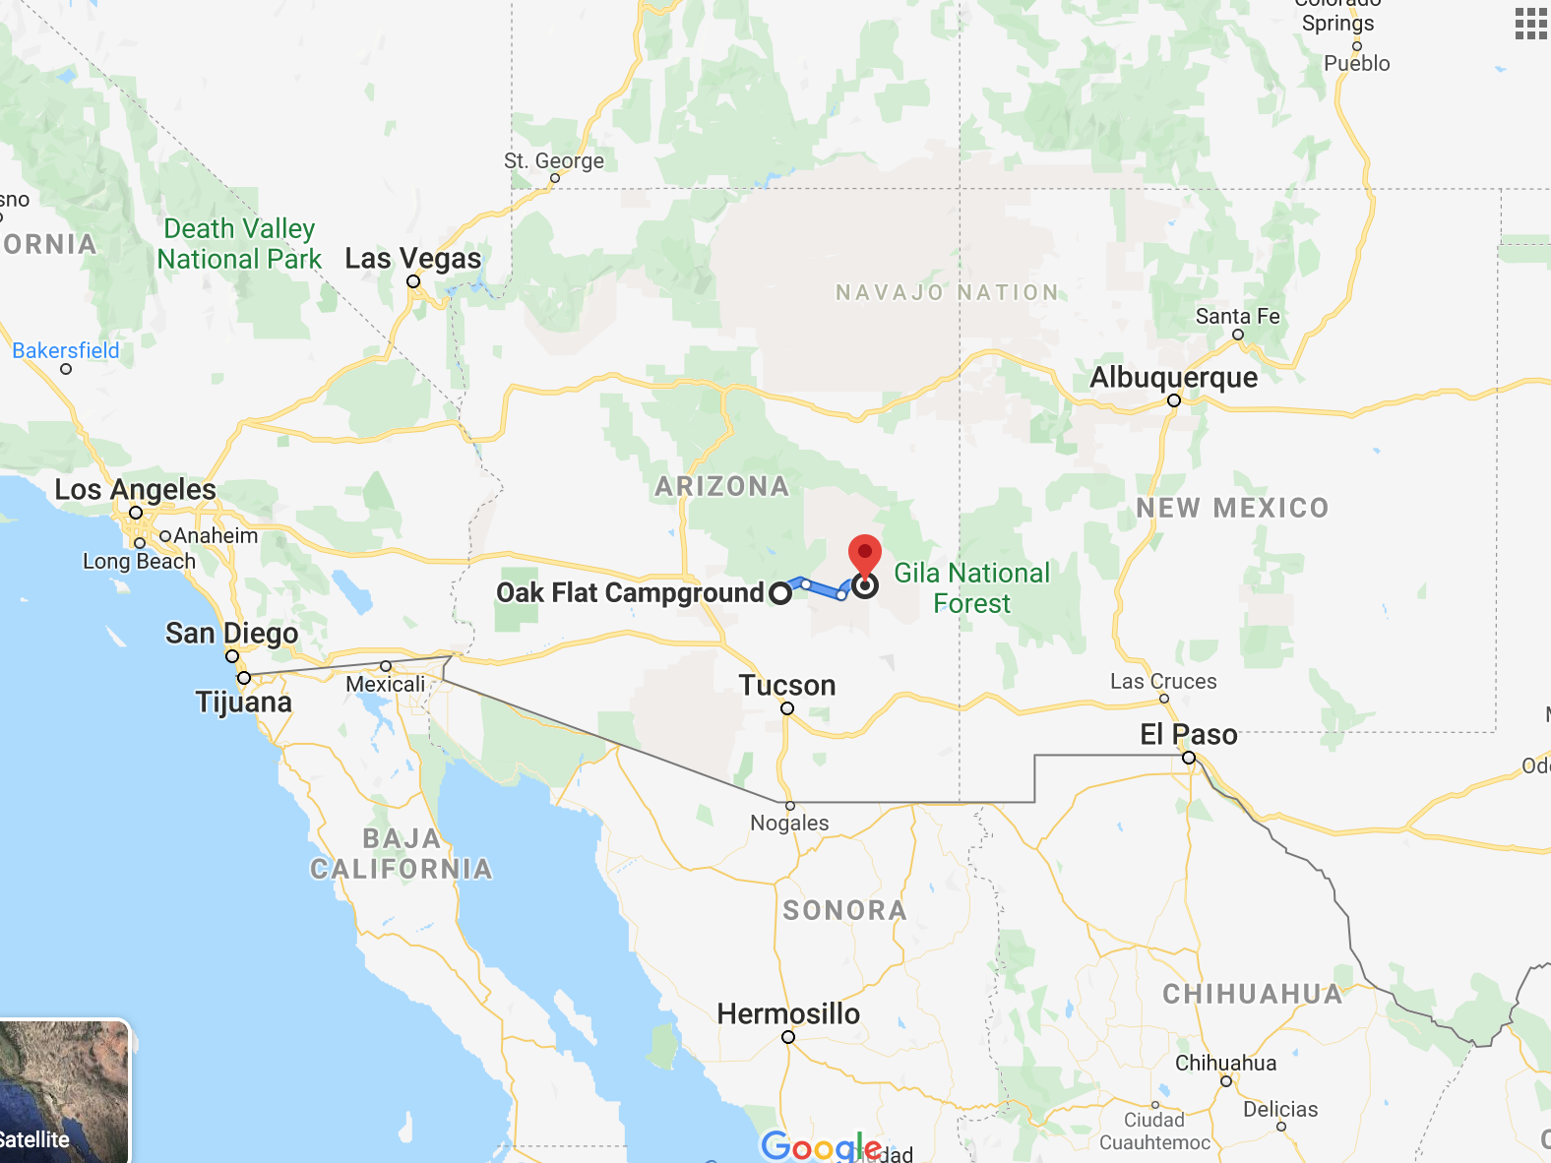
WORKSHEET REVIEW: San Carlos Apache
Notes:
The original Apache Peoples’ homelands included what is now parts of Eastern Arizona, Northern Mexico (Sonora and Chihuahua), New Mexico, Texas and Southern Colorado, but in 1871 they were removed and forced to what is now the San Carlos Reservation in Southeast Arizona. The San Carlos Reservation is represented by the red pin in the map, and the blue line leads to Oak Flat, the place discussed in the video.
Near the reservation is an ancestral site in the Mountains East of Phoenix, in the Tonto National Forest and now known as “Oak Flat.” Oak Flat is a sacred site to the Apache people and many other Native Americans. They pray, collect water, and medicinal plants to ceremonies, gather acorns and other foods, and honor those who are buried there.
In 2015, this federally managed land was granted to Resolution Copper to be developed into what might be one of the largest copper mines in North America. The Apache people have been fighting the development of this mine. Developing the mine required digging into a mountain, which would result in a crater up to two miles wide, more than 1000 feet deep. The byproduct of mining is called “tailings.” Usually in the form of a fine mud or powder, tailings are what’s left over after the metal mined is separated from the rock, and they are toxic.
In addition to completely destroying significant and sacred sites, the tailings would contaminate sacred springs, groundwater, rivers and other aquifers.
.
Sources
https://www.phoenixnewtimes.com/news/san-carlos-apache-oak-flat-mine-arizona-environmental-injustice-11348481
http://apache-stronghold.com/about-us.html

Slide 16
Forms of Resistance to Threats to Water
PRAYER
HOLDING CEREMONIES AT SITE
OCCUPYING TRADITIONAL TERRITORY UNDER THREAT
WRITING POLITICAL REPRESENTATIVES
DEMONSTRATIONS AND EVENTS THAT BRING PEOPLE TOGETHER AND RAISE AWARENESS
INVITING NON-NATIVE ALLIES TO HELP FIGHT
LEGAL PROCESS/FILING COURT CASES
TESTIFYING AT PUBLIC HEARINGS AND TO LAWMAKERS
Notes:
Have students turn in their revised worksheet and then review this slide
Although it’s not discussed at great length, in the video we watched, in some cases, like with the Winnemum Wintu, who have been protesting the environmental problems caused by the Shasta Dam that was completed in 1945, tribes have been fighting an environmental threat to water for many years.
And, all three of these tribes we see in the video have relied on similar strategies to resist these threats to their fresh water. Listed here you can see strategies that all three tribes in these cases have employed.
Describe each strategy, and why it might be effective. *optional: ask the students why each strategy might be effective in different ways.

Slide 17
HOMEWORK - WATER IN MY COMMUNITY
What Native American tribe is from this community? Use the online resource: https://native-land.ca/
What are some local water sources? Name all salt, fresh and brackish water sources. Use the online resource: https://www.google.com/maps
What are your water sources used for? Name 3 things. (Examples could include drinking, irrigation, landscaping, outdoor recreation
Where did the local tribe(s) get their drinking water from prior to the colonization of North America?
Are there any threats to any of the local bodies of water you listed? If so, what are they? If not, why?
Extra Credit: What is one additional interesting thing you learned about your water supply based on your research?
List your information sources here, include all individuals you consulted, written and online sources. If you spoke with a person or people, name them and how you know them.
Notes:
*Optional Introduce homework assignment
Hand Out Assignment Sheet
We have learned about threats to water in several different places, and now we are going to turn our attention to the water where we live. This is what your homework for tonight is about.
The purpose of this assignment is to learn about our local water supply in relation to human beings and ecosystems. Conduct research online, and ask your family members, community members and neighbors to help you respond to the question prompts:
What Native American tribe is from this community? Use the online resource: https://native-land.ca/
Demonstrate how to use this webpage with another community
What are some local water sources? Name all salt, fresh and brackish water sources. Use the online resource: https://www.google.com/maps
Demonstrate how to use this webpage with another community. Describe examples of what water sources can be.
What are your water sources used for? Name 3 things. (Examples could include drinking, irrigation, landscaping, outdoor recreation…)
Brainstorm with the class some other uses for water
Where did the local tribes get their drinking water from prior to the colonization of North America?
Where does your drinking water come from? How many sources? Explain how to find this information
Is your tap water treated? With what? What are the potential benefits or hazards related to your water treatment ( or lack of water treatment)?
Explain how to find this information
Are there any threats to any of the local bodies of water you listed? If so, what are they? If not, why?
Explain how students might research this
Extra Credit: What is one additional interesting thing you learned about your water supply based on your research?
List your information sources here, include all individuals you consulted, written and online sources. If you spoke with a person or people, name them and how you know them.

Slide 18
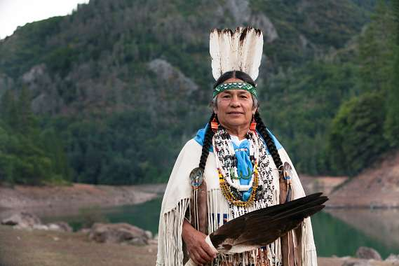
DAY 3 - WATER IN MY COMMUNITY
Chief Caleen Sisk said, “water is unifying.” What are the ways that all people connect through water?
Notes:
Lead students in a discussion.
Chief Caleen Sisk said, “water is unifying.” What are the ways that all people connect through water?
Then ask class the follow up questions:
What does “water is life” mean to you?
What is your responsibility towards water?
What can you do to protect water?
Image Source
https://www.humansandnature.org/fight-for-free-and-wild-salmon-rivers-interview-with-chief-caleen-sisk

Slide 19
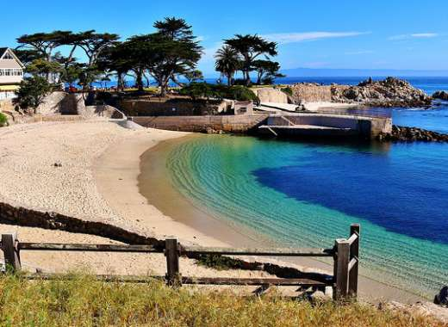
Addressing a Water Issue
An example from Monterey, California.
Notes:
Demonstrate how to research water issues, and ways to address them through a concrete example. The purpose of this mini lecture is to prepare students for the group activity taking place on Day 4.
Now we’re going to learn a new set of skills so that you are able to research any kind of water issue, and understand practical ways to address it using online research.
Tomorrow, we are going to work in groups to address a specific threat to fresh water. In your groups, you are going to research a local elected official to write to request the issue your team chooses.
Divide students into groups of 3 and pass out the group assignment sheet.
First you are going to select an issue and place. To demonstrate, I am going to pick water shortage in Monterey, California. To research the issue online, you just type in the issue and the place from one listen on the assignment, or you can pick your own.
Image Source
https://www.seemonterey.com/
Other Sources:
https://www.reuters.com/article/us-usa-water-foreverchemicals/u-s-drinking-water-widely-contaminated-with-forever-chemicals-environment-watchdog-idUSKBN1ZL0F8
https://www.businessinsider.com/cities-worst-tap-water-us-2019-3

Slide 20
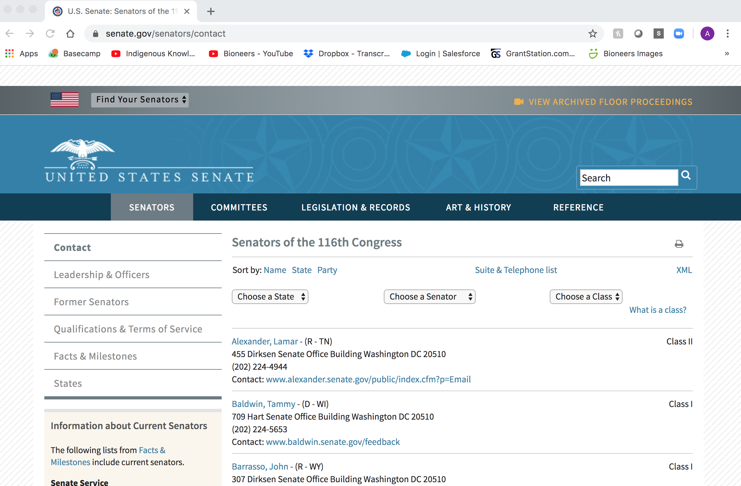
Notes:
Next, you want to find your local elected official, either a representative from the House of Representatives, or the Senator in the senate. The assignment tells you what websites to find them.
*optional. If teacher wants to live demonstrate this, they can.
As we have learned this week, there are many different things that can be done to address water issues. But, one thing we saw in common across all the examples in the video, was that they all reached out to their lawmakers in Congress. We vote for our elected officials, and it’s their job to represent our interests and concerns. That’s what the democratic process is about.
The more people that reach out to a representative, the more pressure they feel to change laws to address the issue from the ground up.

Slide 21
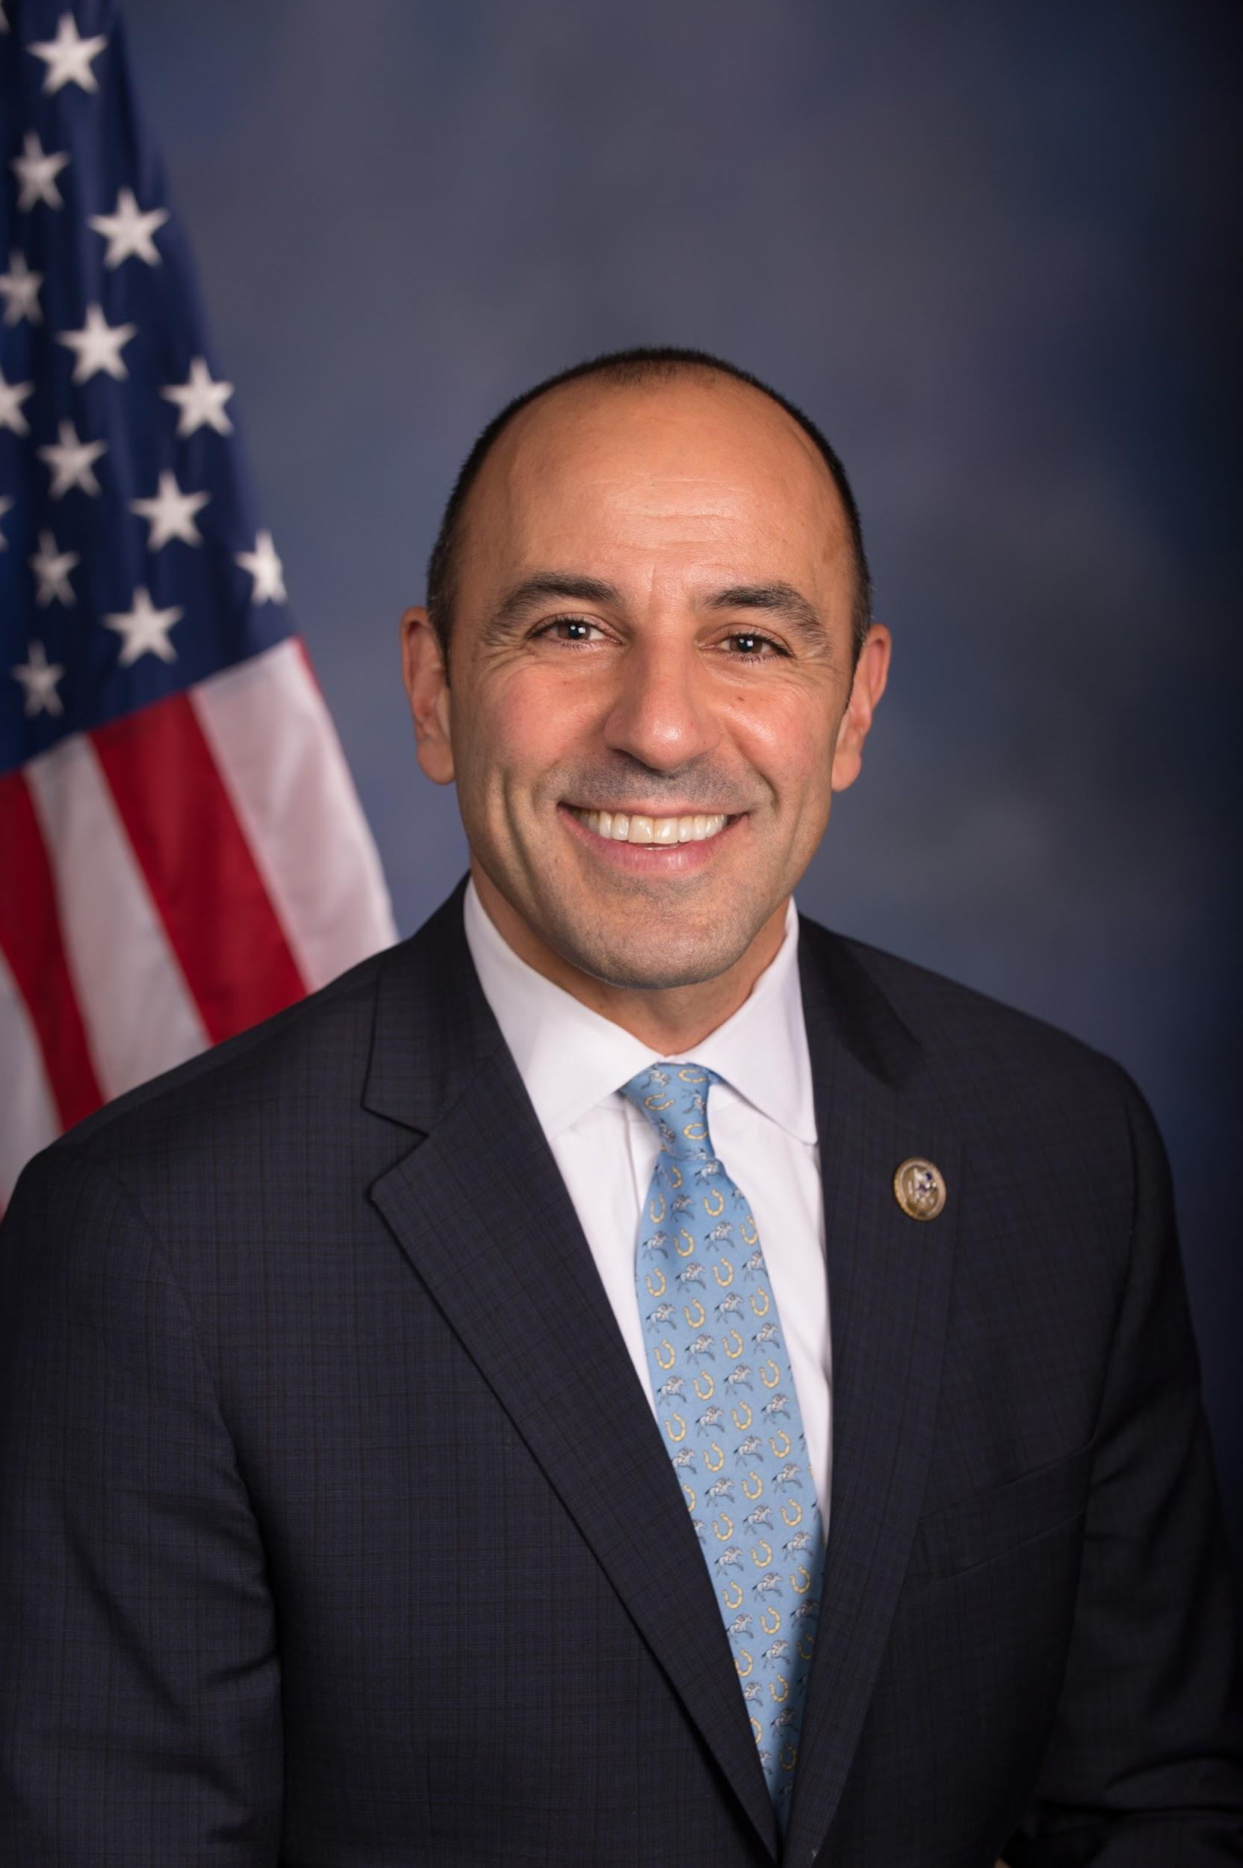
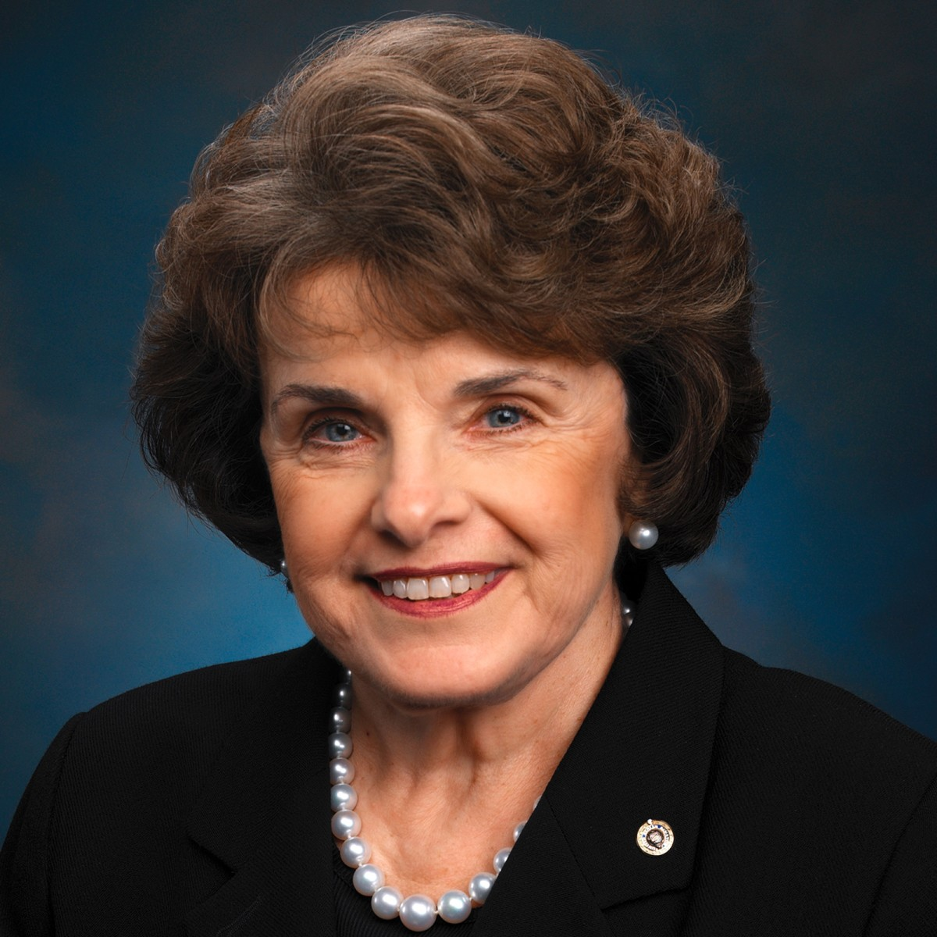
Notes:
Monterey California’s Representative in the House is Congressman Jimmy Panetta.
And our Senator is Diane Feinstein.
I would choose to write Panetta a letter. He is more connected to local issues in Monterey, since he lives there, and probably more likely to know and care about the water shortage issue.
From Source: https://www.thoughtco.com/write-effective-letters-to-congress-3322301
It's usually best to send letters to the representative from your local congressional district or the senators from your state. Your vote helps elect them—or not—and that fact alone carries a lot of weight. It also helps personalize your letter.

Slide 22
Your letter should have 3 parts:
Who are you and why are you writing?
Who or what is affected by the problem?
What action do you want your elected official to take?
Notes:
Present what is written on the slide.
Review the example letter about water shortage in Monterey, California that is provided on the the Group Assignment Handout.
If there is any remaining class time, have groups decide what water problem they want to address
Give them the option to work together on the project as homework.

Slide 23
DAY 5: PRESENTATION AND REFLECTION
Notes:
Please share one thing that stood out to you about any of the material we learned this week

