Slide 1
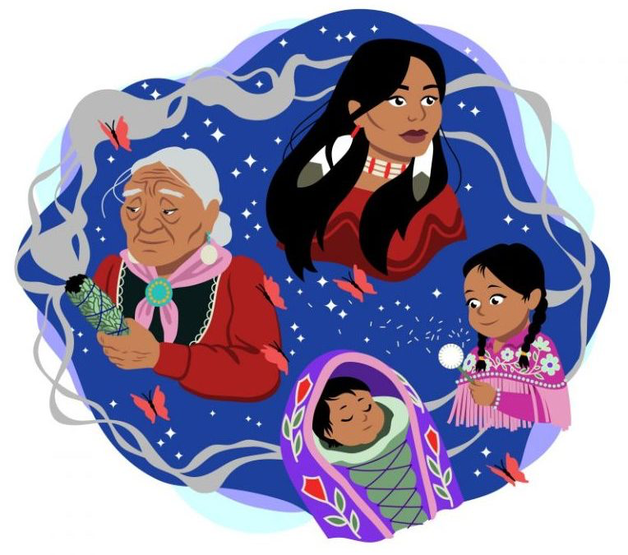
Honoring Menstruation Through Ceremony
Reclaiming Native American Coming of Age Ceremonies
Notes:
Teacher Text: The Honoring Women Lesson plan is a 4 day intensive that will focus on Women’s Ceremonies and the importance of honoring and celebrating girls and women and its impact on their self-esteem. This lesson will cover a variety of topics such as, ceremony, menstruation, storytelling and patriarchy.
Photo Credit - Remembering and Honouring Missing and Murdered Indigenous Women and Girls on October 4 Article By Melanie Ferris
Manitoba Keewatinowi Okimakanak - http://mkonation.com/remembering-and-honouring-missing-and-murdered-indigenous-women-and-girls-on-october-4/

Slide 2
Overview of the Week
Women’s Role in their Community
•Day 1: Part 1 Video and discussion; “Revitalization of Coming of Age Ceremonies”
•Assignment: Menstruation Story or Haiku Poem
Healing Through Storytelling
•Day 2: Part 2 Video and discussion; “What is your inspiration?”
•Assignment: Menstruation In The Media
Why Honoring Women is Important
•Day 3: Part 3 Video and discussion; “Patriarchy”
Part 4 Video and discussion; “Why Ceremonies are Important”
•Assignment: Create Your Own Ceremony

Slide 3
Day 1 - COMING OF AGE CEREMONIES
What is a Coming of Age Ceremony?
“Coming of age is a term used to describe the transition between childhood and adulthood.”
Notes:
In Many Native American communities, Coming of Age Ceremonies are an important part of the fabric of society, both boys and girls have different ceremonies… such as ….
Like the Hoopa Valley Tribe, other Native American tribes like the Ojibwe, Apache and Oneida hold ceremonies for their young boys and girls and each one is very different. These ceremonies usually last several days and boys and girls must overcome a test of spiritual and physical endurance, are taught their traditional origin stories and are given their new adult names.
In non-native cultures there also exists many coming of age ceremonies that you probably have heard more about in mainstream society. Let’s take a look at the following examples in the next 3 slides.
Teacher to ask the question: “Who has participated in a Coming of Age Ceremony?” Allow 2 minutes for class participation.
Definition text- https://www.verywellfamily.com/what-does-coming-of-age-mean-3288528

Slide 4
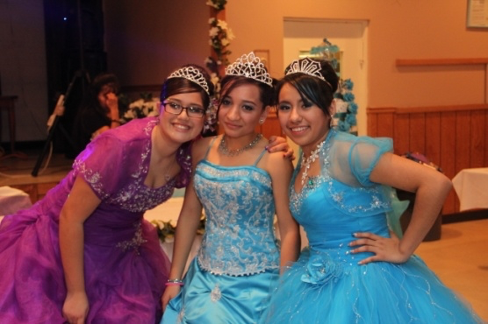
Coming of Age Ceremonies Examples
Quinceañera - “In Mexican, Puerto Rican, Cuban, Central and South American traditions there is a celebration of a girl's 15th birthday. Historically, in the years prior to their 15th birthdays, girls were taught cooking, weaving, and about childbearing by the elder women in their communities in preparation for their future roles as wives and during the celebration the girl's father would present her to potential suitors.”
Notes:
Text - https://www.verywellfamily.com/what-does-coming-of-age-mean-3288528
Photo - https://obamawhitehouse.archives.gov/blog/2012/10/04/addressing-underage-drinking-local-leve l

Slide 5
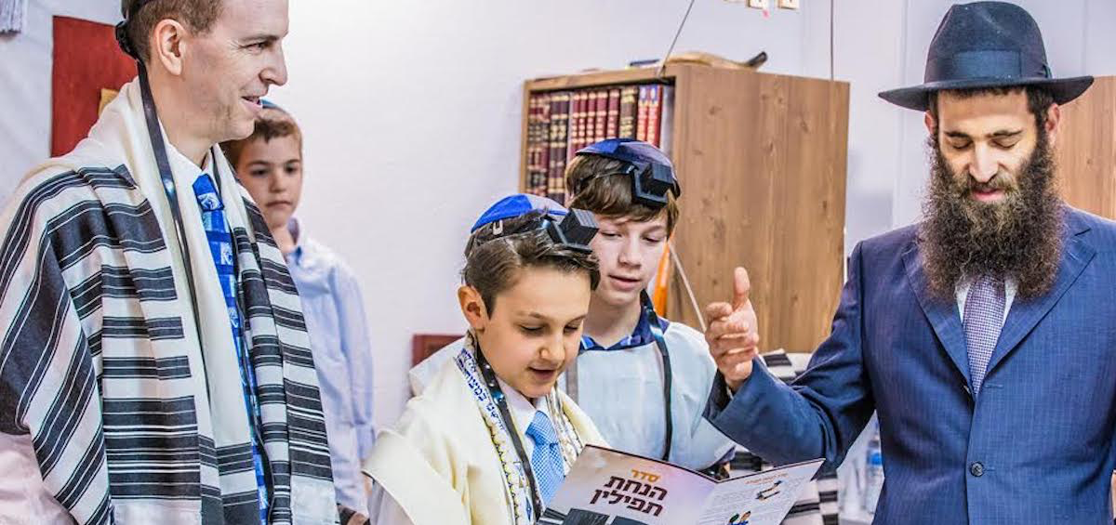
Coming of Age Ceremonies Examples
Bar or Bat Mitzvah: “For 13 year old Jewish adolescents they partake in an event called the Bar Mitzvah (or, for girls, Bat Mitzvah). This represents the culmination of years of Hebrew and Torah study and signifies the child's entrance into adulthood.”
Notes:
Text - https://www.verywellfamily.com/what-does-coming-of-age-mean-3288528
Photo - https://www.chabad.org/library/article_cdo/aid/144321/jewish/Bar-Mitzvah.htm

Slide 6
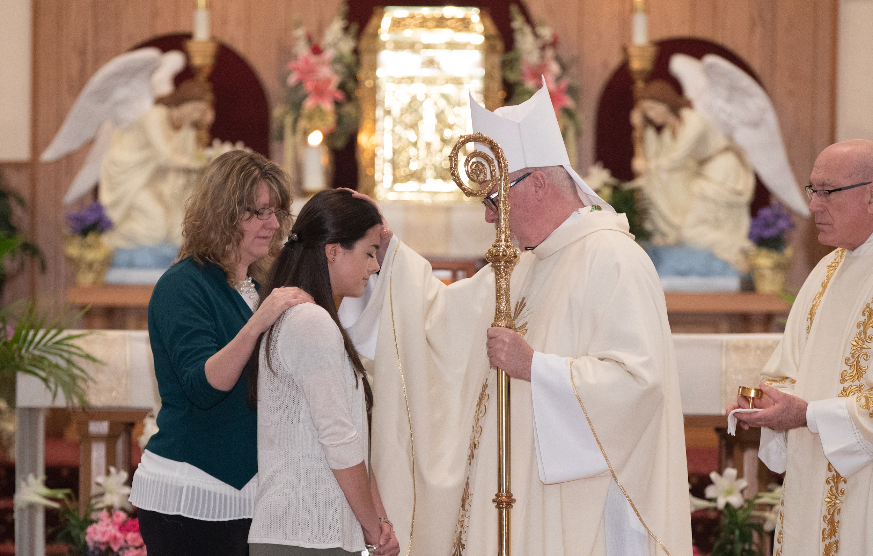
Coming of Age Ceremony
Confirmation: “Catholic teens are confirmed in their faith as one of the three most important sacraments (along with baptism and the Eucharist). Teens going through confirmation are sponsored by an adult and choose a confirmation name (usually a saint's name).”
Notes:
Text-https://www.verywellfamily.com/what-does-coming-of-age-mean-3288528
Photo- Photo Credit: Submitted photo/Don Whipple change-coming-to-timing-of-sacrament-of-confirmation

Slide 7
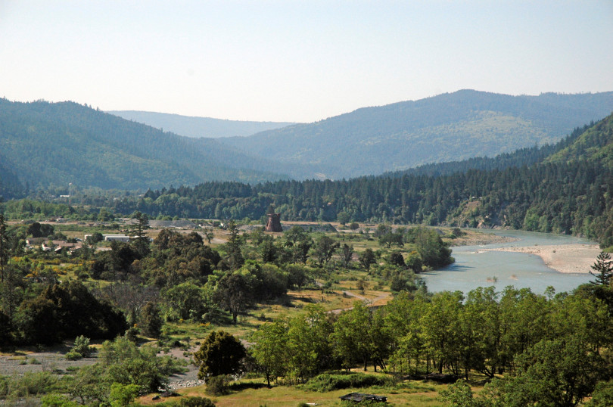
Hoopa Valley Tribe
“The Hupa people are located in Hoopa Valley, California, which was named after them. Their heritage language is Hupa, which is a member of the Athabaskan language family. Their land stretched from the South Fork of the Trinity River to Hoopa Valley, to the Klamath River in California. In 1864, the United States government signed a treaty that recognized the Hupa tribe's sovereignty to their land. The United States called the reservation the Hoopa Valley Indian Reservation where the Hupa now reside, one of very few California tribes not forced from their homeland.”
Notes:
Over the next 3 days, this Lesson will focus on the Hoopa Valley Tribe Coming of Age Ceremony called the Flower Dance, but first let’s learn about the Hoopa Valley People.
Text-https://en.wikipedia.org/wiki/Hupa
Photo - Hoopa Valley, Times-Standard News https://www.times-standard.com/2016/02/18/hoopa-tribe-set-to-make-emergency-declaration-due-to-crime/

Slide 8
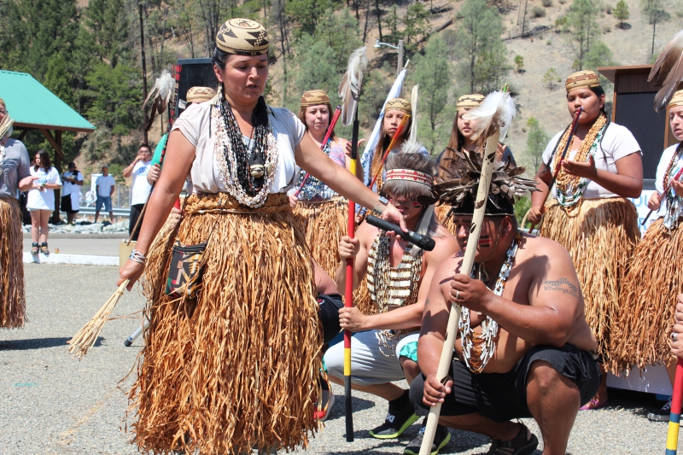
Hoopa Valley Tribe & The Woman’s Role
Women are celebrated, hold positions of power and are treated equally.
Menstruation is very powerful and represents a time when a woman is at her highest ability to connect with and to speak with her higher selves.
Notes:
Text - Honoring Women Video, Bioneers
Photo - Melody Moore, Hoopa Valley Woman demonstrating the flower dance; By Dan Bacher, https://www.indybay.org/newsitems/2014/09/02/18761038.php

Slide 9
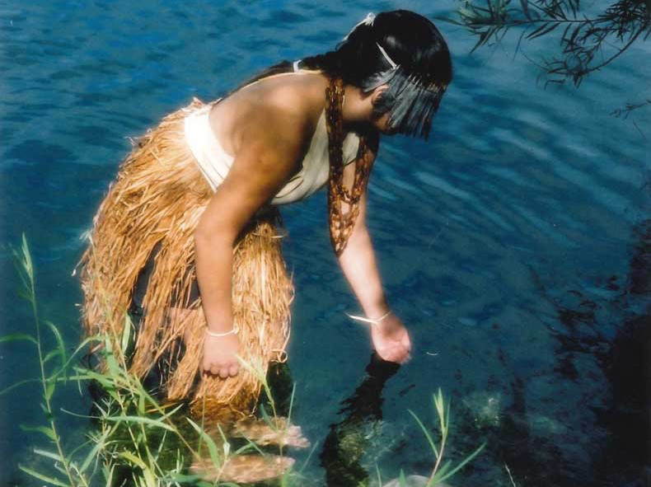
The Flower Dance
Flower Dance - a dance that is part of a coming of age ceremony for women in the Hupa tribe, that has been revitalized since the colonization and genocide of Native Americans
The Hupa women’s coming-of-age ceremony (Ch’iwa:l) lasts for three, five, or 10 days and is held after a girl starts menstruating. The ceremony is a public celebration that includes specific practices and ritual guidelines for the young girl.
Notes:
Teacher:
Discussion Question1: What is the difference between the way Hoopa tribal members celebrate a woman’s first menstruation and what your community does?
Young Hoopa Valley girl
Text - Article, The Flower Dancers, Reviving Hupa coming-of-age ceremonies By Cutcha Risling Baldy
https://www.northcoastjournal.com/humboldt/the-flower-dancers/Content?oid=10229320
image - Photo by Trish Oakes, courtesy of Melitta Jackson and Marlette Grant-Jackson https://www.northcoastjournal.com/humboldt/the-flower-dancers/Content?oid=10229320

Slide 10
What Does the Hupa Flower Dance Give to Young Girls?
Song
Dance
Celebration of her
Participation of the community
Talking Circles
Self-Care Lessons
Herbal Lessons
Steaming Lessons
Bathing Rituals
Hupa Language
Domestic Violence Prevention
Love her
Notes:
Ask students: “What does the Flower Dance give to young girls and women?”
During the video, Dr. Cutcha Risling Baldy explains the components involved in the ceremony.

Slide 11
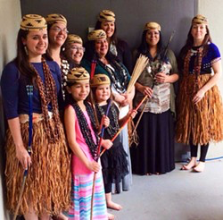
“We Should Have Danced For You”
Class Discussion - What does this phrase mean to you? What is the connection between Community, Dance and Ceremony?
Notes:
Image - PHOTO BY CUTCHA RISLING BALDY
https://www.northcoastjournal.com/humboldt/the-flower-dancers/Content?oid=10229320

Slide 12
Day 2: Healing Through Storytelling
“Native American culture is oral and everything from biology to history to morality to medicine is passed on in the form of stories. Stories have the power to heal: they contain the rituals and ceremonies that can cure individuals and communities. They do this primarily by reminding us of the interrelations between all people and all things. As a story is told communally or is shared by one person with another, it creates a sense of community between those people.”
Dr. Cutcha Risling Baldy reminds us that a way to solve the problem of low self esteem amongst Native American adolescent girls is for them to share menstruation stories.
Notes:
Text- Ceremony By Leslie Marmon Silko - Sparknotes - https://www.sparknotes.com/lit/ceremony/themes/

Slide 13
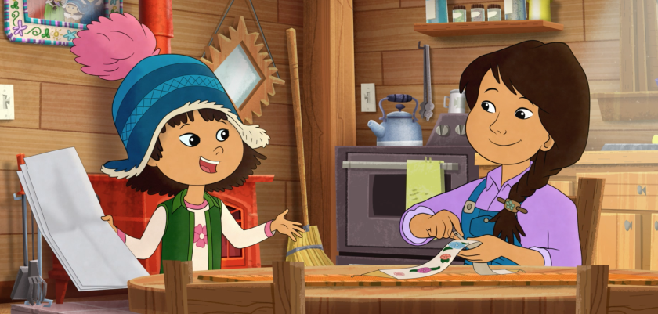
Sharing Our Stories
Notes:
Photo Credit- Los Angeles Times, “How Molly of the Denali helps Native American Children Feel Seen” https://www.latimes.com/entertainment-arts/tv/story/2019-10-14/native-representation-molly-of-denali-pbs
WGBH Educational Foundation, Molly of the Denali

Slide 14
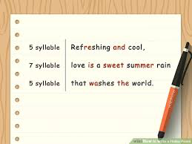
Haiku or Poem about Menstruation
Notes:
Directions for Students: Write a “Haiku” about coming of age. Listen, appreciate and reflect. Sharing with the class is optional.
Follow the line and syllable structure of a haiku. Haikus follow a strict form: three lines, with a 5-7-5 syllable structure. That means the first line will have five syllables, the second line will have seven syllables, and the last line will have five syllables.^{[6]}
The poem will have a total of seventeen syllables. To count syllables in a word, place your hand under your chin. Then, say the word. Every time your chin touches your hand, this is one syllable. A haiku does not have to rhyme or follow a certain rhythm as long as it adheres to the syllable count.
Photo Credit- Wikihow

Slide 15
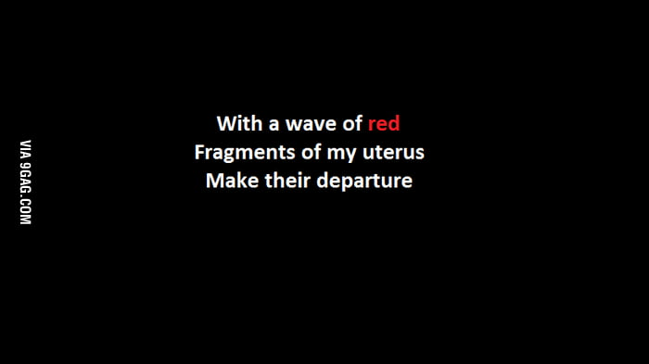
Notes:
Haiku Example
Photo Credit- https://9gag.com/gag/aXbmyKP/a-haiku-about-menstruation

Slide 16

Notes:
Poem Example
Poem By Nikki Tajiri from the Book: “She dreams when she bleeds, Poems about Periods” By Nikki Tajiri

Slide 17


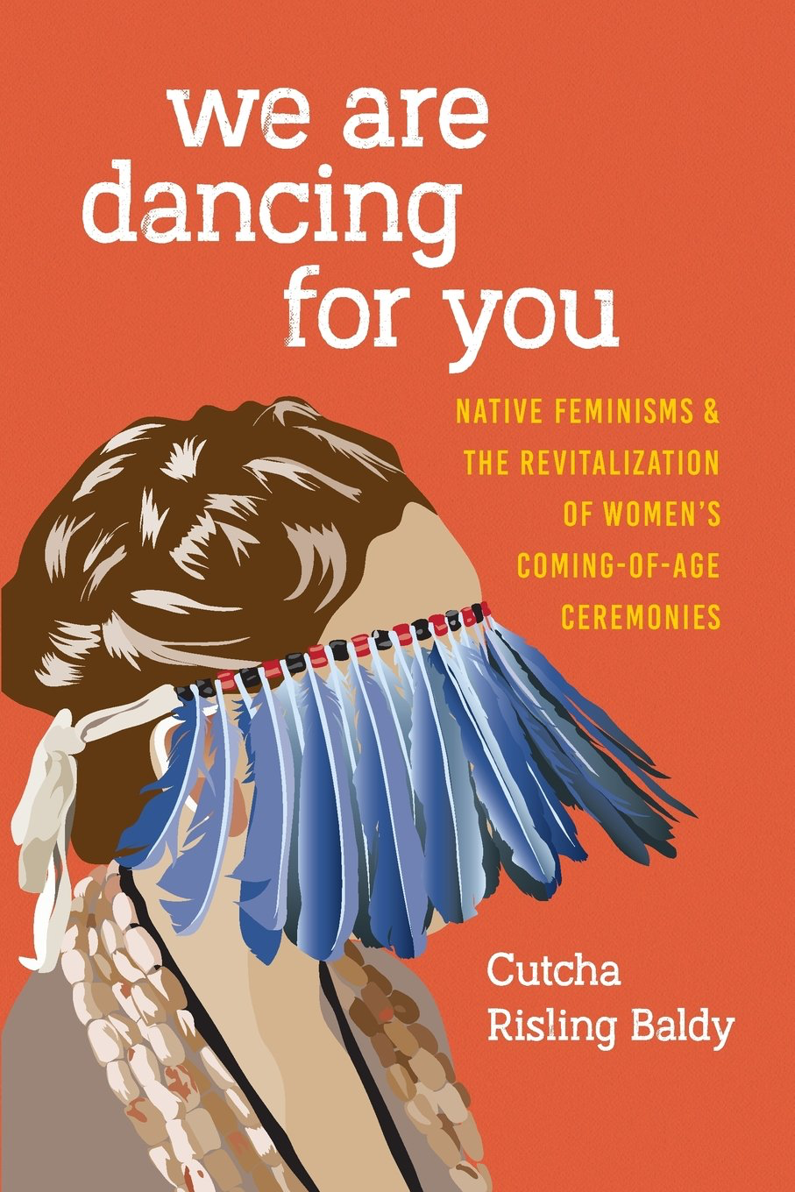
Write Your Story, Poetry or Haiku
Understanding the experiences of other adolescents helps to make the transition into a adulthood a little easier.
Notes:
Optional Reading-
She Dreams when She Bleeds By Nikki Tajiri
Coming of Age Around The World - collection of short stories and poems by Mary Frosch
we are dancing for you by Cutcha Risling Baldy

Slide 18
What is Self Esteem?
Self esteem is a reflection of what you think and how you feel about yourself. Typically based on these 6 components:
One’s inherited endowments, including intelligence, physical characteristics, and natural abilities
Feeling likable and lovable;
Being a unique human being, of value, and worthy of respect;
Feeling in control or responsible for one’s life;
Moral virtue or integrity;
What one has achieved–one’s skills, possessions, and successes.
Notes:
Class Open Discussion- Studies show that at the onset of Puberty- a girl's self esteem plummets whereas boys overall self esteem rises. Why do you think that is? Answers can be written on whiteboard.
Discuss the 6 components of self esteem
For Extra credit- fill out the “What I believe worksheet.”
For more information on Self- Esteem visit the National Association for Self Esteem website - https://healthyselfesteem.org
Text- The National Self Esteem Association - https://healthyselfesteem.org/lessons-activities/self-esteem-lesson-plan/

Slide 19
Native American Teen Suicide
“Despite the strengths of American Indian and Alaska Native (AI/AN) families and communities, suicide remains a devastating and all too frequent event. Complex, interrelated factors contribute to an increased suicide risk among AI/AN people and include mental health disorders, substance abuse, intergenerational trauma, and community-wide issues. Factors that protect AI/AN youth and young adults against suicidal behavior are a sense of belonging to one's culture, a strong tribal/spiritual bond, the opportunity to discuss problems with family or friends, feeling connected to family, and positive emotional health.”
Notes:
Text- Indian Health Service - https://www.ihs.gov/suicideprevention/
As Dr. Risling Baldy explains in the video, Suicide amongst Native American populations is higher than any other demographic.
In the Context of Coming of Age Ceremonies and Honoring Women communal storytelling is connected to one's sense of belonging in the community and can help increase self esteem and potentially prevent teen suicide cases.
American Academy of Child and Adolescent Psychiatry - https://www.aacap.org

Slide 20
What should you do? Help is Available!
Call 911
or
National Suicide Prevention Lifeline
1-800-273-8255
or Confide in a Trusted Adult
Notes:
Adolescence can be a challenging time for many teens because there is pressure to fit in socially, to perform academically, and to act responsibly.
*Pass out American Psychological Association Suicide Prevention Information sheet. In an emergency, call 911 or take the teen to a hospital or crisis center for evaluation. If your concerns are less urgent, seek help as soon as possible and tell a Parent, Teacher, school psychologist or school nurse.

Slide 21

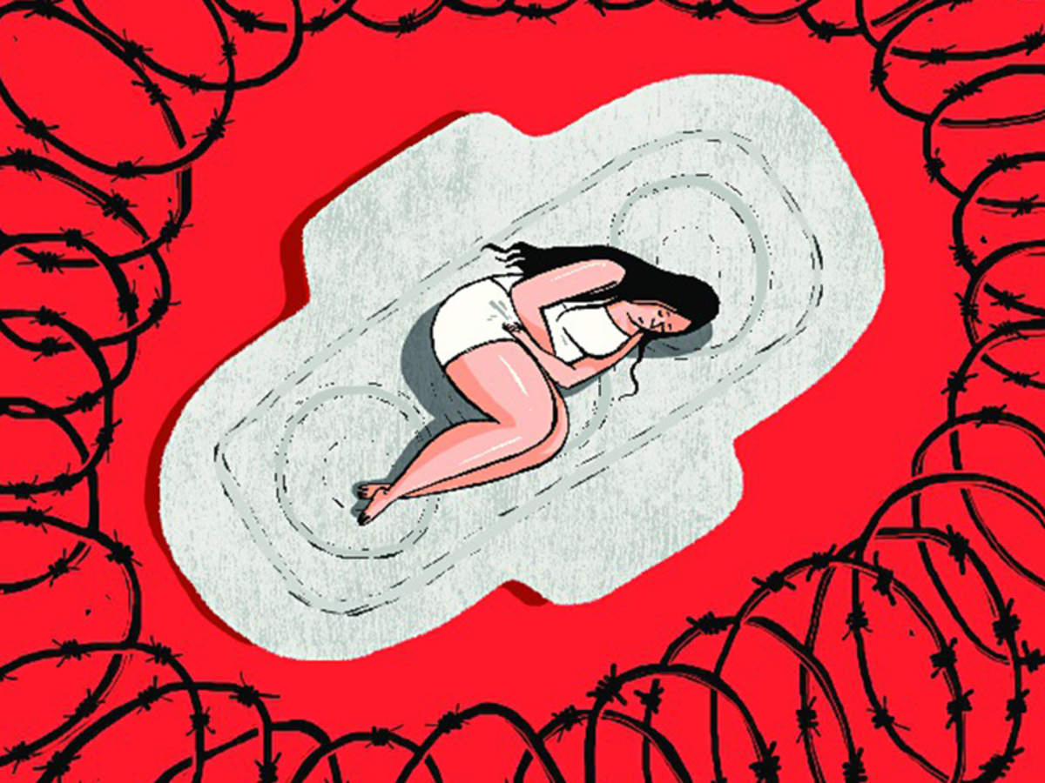
Representations of Menstruation in the Media
Notes:
Image- www.playtextplayon.com
The Times of India - Article No Shame: Let’s talk about Periods. By, Anurita Sinha https://timesofindia.indiatimes.com/city/lucknow/noshame-lets-talk-about-periods/articleshow/58878456.cms
There are still conflicting images within the media concerning menstruation, pms and female hygiene- some images are either empowering or disempowering to women. These images often depict the time of menstruation as either shameful and inconvenient or as a time when normal or even hyperactivity can be achieved.
Class Discussion- How do these images affect the self esteem of young girls entering menstruation?
Pass out Group Text Homework Assignment.

Slide 22
Day 3 - Why Honoring Indigenous Women Is Important
Indigenous Women share many of the basic concerns and needs with their non-indigenous sisters but their situation as women in Indigenous societies sets them apart from those who are in mainstream society and their needs and concerns are often different.
Notes:
Teacher Text: “Being part of Indigenous Communities, they are being discriminated against for being Indigenous and for being a woman. They are also suffering from loss of land and resources due to dispossession, and encroachment, from racial discrimination, cultural alienation and the pressure to assimilate and from violations of their human rights often exacerbated by the violent conflicts engulfing their communities.
Text and Quote Credit- Indigenous Women in Redd+: Making Their Voice Heard https://issuu.com/iwgia/docs/indigenous_women_and_redd_web

Slide 23
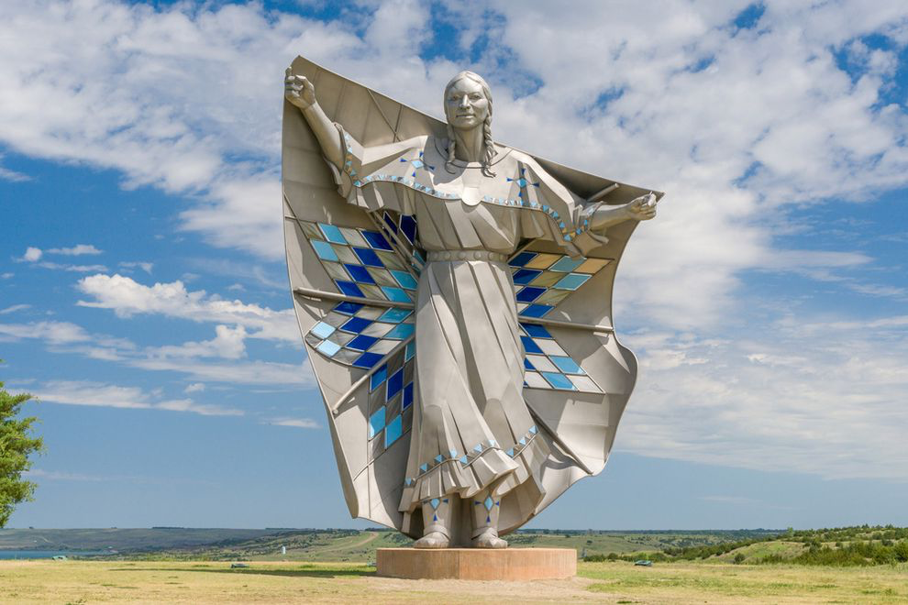
“The invaluable contributions of Indigenous women for the wellbeing of their families and communities are not properly acknowledged and recognized.”
Notes:
Teacher Text- “Indigenous women hold various roles in society, from warriors to mothers to healers and caregivers. Modern society has repeatedly devalued the important roles women perform in our families, in the workplace and within the world. “Women’s work is not valued equally when compared to “men's work.” Throughout the years, many brave Indigenous women have worked tirelessly to reclaim their traditional roles. They do so by advocating and engaging in protests to bring awareness as well as using legal action to change policy and legislation. All of these efforts are part of the road to reconciliation with the hope that the impact will have long term benefits. Indigenous women deserve our respect and honour as they fight diligently in spite of the struggles they face.” - - Honoring Indigenous Women, Girls and Gender Diverse People Toolkit; A Native Women’s Association of Canada Initiative. https://www.nwac.ca/wp-content/uploads/2018/05/Honouring-Women-Booklet-PrintReady-20PTFont.pdf
Quote Credit- Text- Indigenous Women in Redd+: Making Their Voice Heard https://issuu.com/iwgia/docs/indigenous_women_and_redd_web
Photo- Dignity Statue, South Dakota, Photo by Ken Wolter, Shutterstock

Slide 24
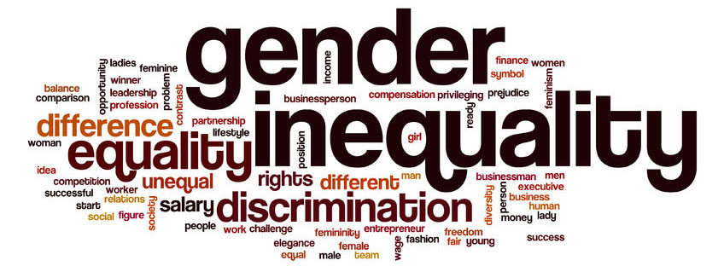
Patriarchy
Patriarchy - a system of society or government in which men hold the power and women are largely excluded from it.
Notes:
Teacher Script: “The Europeans came from a culture where men held all of the decision making power. This type of culture is called a “Patriarchy.” Europeans regarded Indigenous people as Inferior, and specifically did not like the power that Indigenous women held. This was a threat. As they established their own communities and assert control over the land, they enacted various harmful policies designed to control and assimilate Indigenous people. This systematic assimilation policy is known as “Colonization.”” - Honoring Indigenous Women, Girls and Gender Diverse People Toolkit; A Native Women’s Association of Canada Initiative. https://www.nwac.ca/wp-content/uploads/2018/05/Honouring-Women-Booklet-PrintReady-20PTFont.pdf
The United States is still a Patriarchy today, and men and women are working on various fronts to change the culture in to a more inclusive system. Let’s explore where elements of Patriarchy are seen in our everyday lives.
Photo Credit: http://www.anupartha.com/resources/blog/metoo-is-this-the-beginning-of-the-end-of-patriarchy/

Slide 25
Recognizing Patriarchy
Definition of double standard :: a set of principles that applies differently and usually more rigorously to one group of people or circumstances than to another, especially : a code of morals that applies more severe standards of sexual behavior to women than to men.
What are ways we see patriarchy happening in our everyday lives?
Notes:
Definition: Merriam Webster Dictionary- https://www.merriam-webster.com/dictionary/double%20standard
Once we understand what Patriarchy is, we can start to see examples of Patriarch in our everyday life. At home

Slide 26
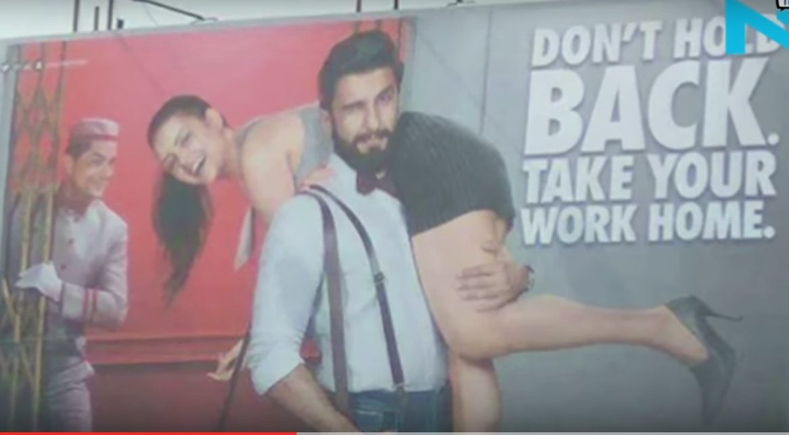
Recognizing Patriarchy in the Media
I
Notes:
Teacher Text - Patriarchy In the Media:
Example: Romantic films often portray women as being stalked as a sweet sign of affection, which creates toxic norms around harassment and intrusion as a way for men to pursue women. Men are often portrayed to be hyper masculine and violent and not show any sign of emotion in turn normalizing aggression, violence and independence.
Photo Credit- https://www.womensweb.in/2017/02/media-and-ads-promoting-patriarchy/ Womens web online, Article “It Is Time Media, Especially Advertisements Own Their Responsibility In Promoting Patriarchy” by

Slide 27

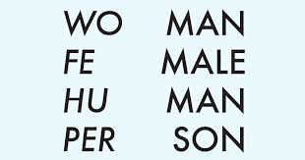
Recognizing Patriarchy

Slide 28
Group Project: Creating Your Ceremony
Create a ceremony that is inclusive of all group members and based upon commonalities identified in the Identity charts. Ceremonies should be cognizant of equality of gender roles and should not promote patriarchy or colonization.
Notes:
Teacher to pass out the the Identity Chart worksheet and the Creating your Ceremony Worksheet. Read the directions of both.
https://u.osu.edu/jennamarie/2018/08/30/identity-chart/

Slide 29
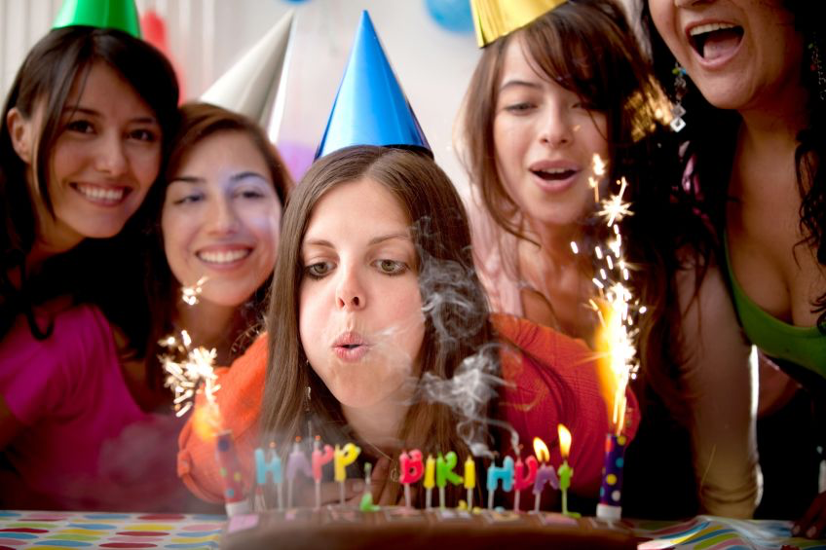
Golden Birthday Celebration Example
Notes:
Teacher to review the Answer Key for the Creating Your Ceremony Worksheet, using a Golden Birthday as an Example.

